Slide 1
ABC CHAMPION
REVIEW
ABC CHAMPION YEAR, Lesson 8
PROJECT CORNERSTONE
Notes:
This presentation is intended for use by ABC Leads who have attended the monthly ABC Lead training.
This is a presentation to help review and wrap up the Champion Year 2023-2024. For all resources, see Project Cornerstone website, materials, Champion year, Review:
https://www.ymcasv.org/ymca-project-cornerstone/champion-year-review
Special Notes for 5th-6th Graders Moving to Middle School:
Instead of doing the review, there is a special lesson dedicated to all 5th and 6th graders. It can be found on the website.

Slide 2
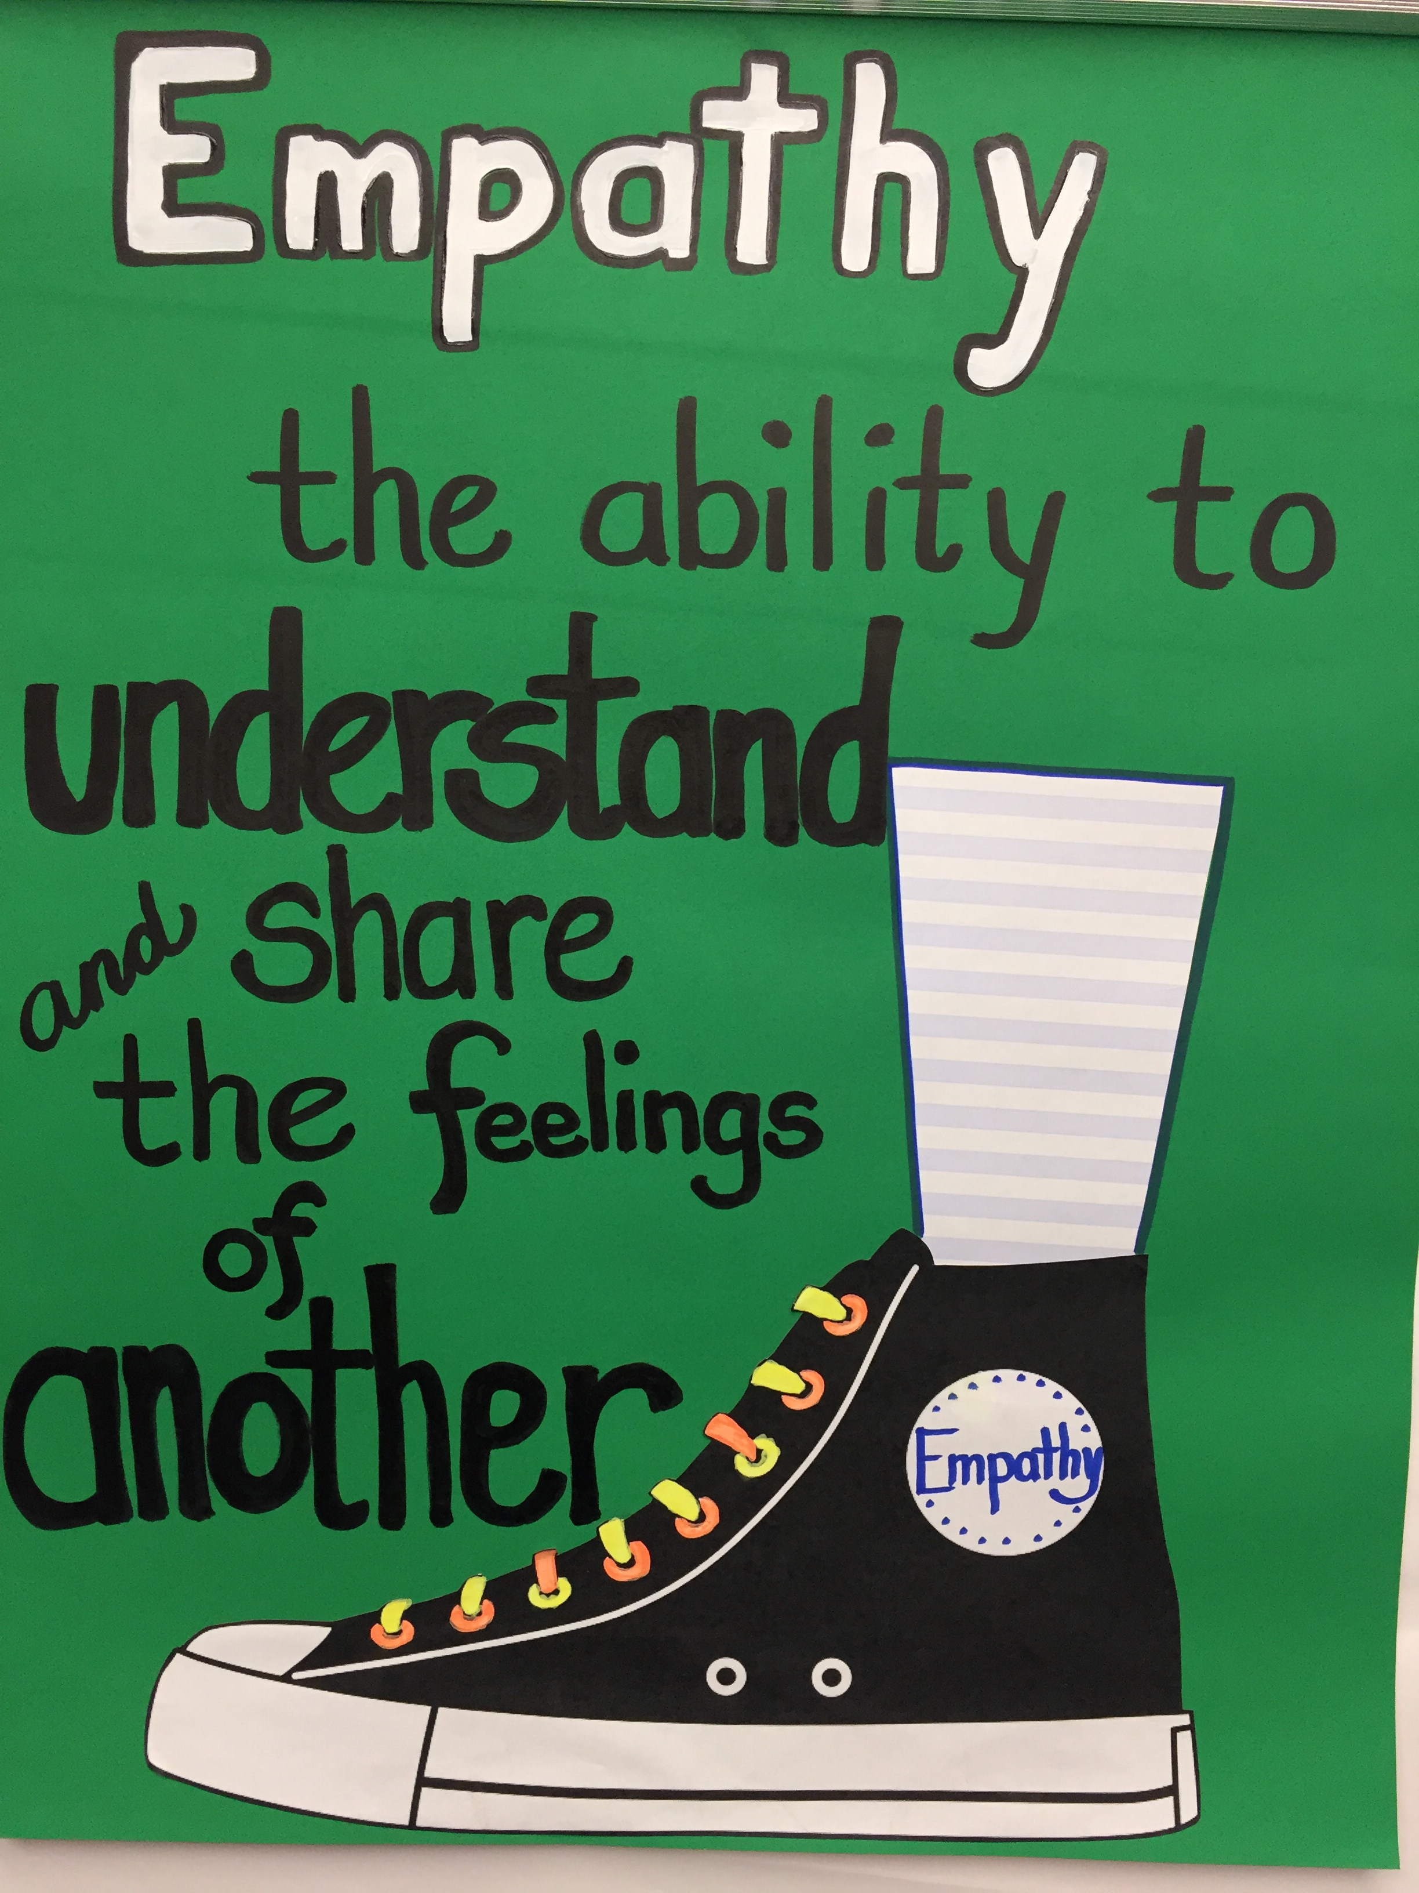
ABC Toolkit:
ABC Theme: Connect with Empathy
Notes:
Refer to Champion Year Review, Resources, Toolkit
The ABC theme for this year is Connect with Empathy. These books and ABC lessons taught a variety of skills and strategies to help youth navigate the complexities of our social and emotional lives.
With these skills and strategies in place, youth have the tools they need to become empathy ambassadors. We call the skills and strategies taught in the ABC program our ABC Toolkit.
Use the toolkit to remind the volunteers, staff, students, and parents all that they have learned this year. Every year we will add to our toolkits to grow into our best selves. You can:
Send home the toolkit to parents to review through out the summer.
Use as a prompt for students to create book posters.
Print and post in classrooms for rest of year and next year to remind them of the tools.
Paint the tools on ball walls and post on bulletin boards.

Slide 3
Conversation
Starter

Slide 4
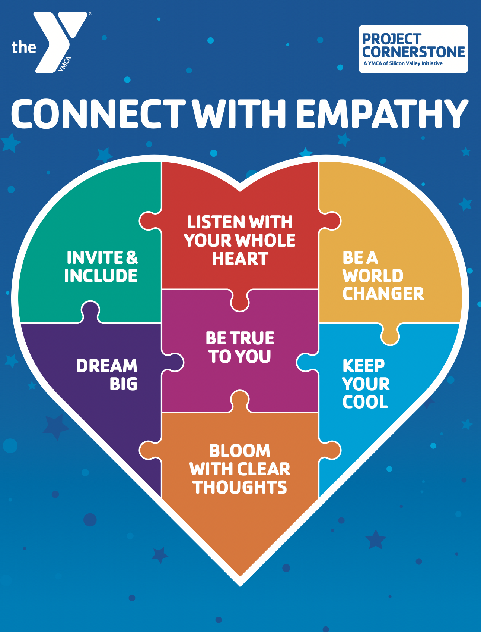
Conversation Starter: Grades K-2
ABC Toolbox
Notes:
Refer to Champion Year Review, ABC Toolkit Handout
View the Pre-recorded Conversation and Activity, website, Overview
Refer to BIG. Talk about what they learned.
Since this is your last visit with the class, let them know that even though there is no book to read this month, you wanted to have one more visit to enjoy their company and review all you’ve learned together this year.
Explain that today you plan to review all the books and what they learned from them.
A fun idea is to bring in a toolbox and have an item that represents each book.
Some ideas for the box: invitation, heart, globe, tea cup, mirror, jar, paint brush, and a calendar.
They now have Empathy tools to put in their toolkit.
For second graders and older you can also bring in last years toolbox and review those tools as well.
Put the items in the box. Pull them out in random ways and ask students what book and tag line they represent.
Choose one of the activities for follow up.

Slide 5
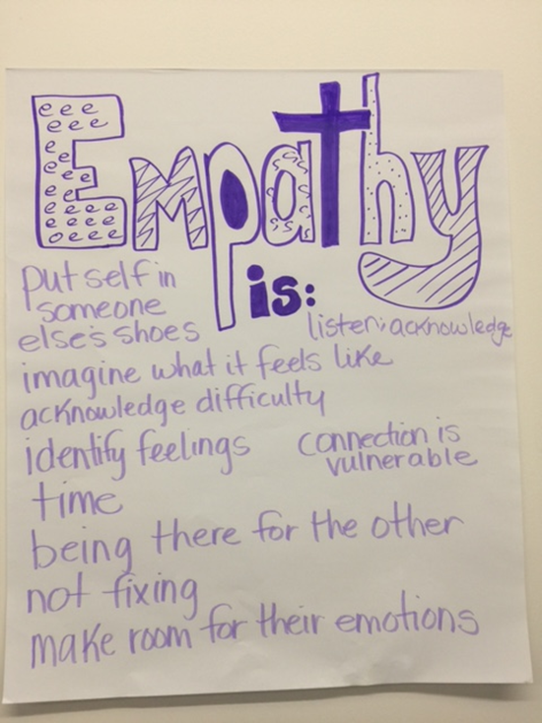
Conversation Starter: Grades 3-6
What is Empathy?
Use 5 Senses to Brainstorm about Empathy.
Ask students to share what they have learned this year.
Use the toolkit to remind students about their ABC Tools.
Today we will review the books, tools, and skills learned this year.
Notes:
Materials: music to walk about the classroom, chart paper, markers
Refer to BIG. Talk about what they did to be BIG.
Since this is your last visit with the class, let them know that even though there is no book to read this month, you wanted to have one more visit to enjoy their company and review all you’ve learned together this year.
Explain that today you plan to review all the books and what they learned from them.
Before you start explain that you want to get their brains firing great ideas. So, you are going to do an activity called milling to music. I will put on music and as you walk around you can chat with each other about what you have learned about empathy. (See link below for more information.)
After, they mill around, have them return to desks. Ask them to tell you what it sounds, looks, feels, tastes, and smells like.
Record their ideas on a chart paper.
Go to the activity section to follow-up with their brainstorming.
Milling to Music Video:
https://www.edutopia.org/video/writing-brainstorm-playful-learning-music?utm_content=linkpos1&utm_source=edu-newsletter&utm_medium=email&utm_campaign=weekly-2023-04-19

Slide 6
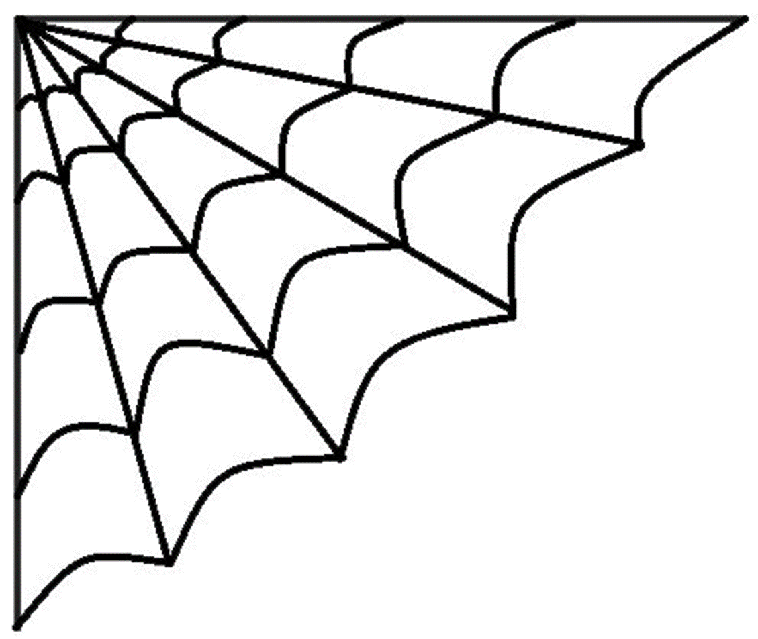
Conversation Starter: Grades K-2
Mindfulness Activity
Spiderman Breathing
Stand up straight and tall.
Reach your arms above your head.
Ready your hands to sling some webs. (Fold over two middle fingers on each hand).
Bring your arms down slowly as you sling webs (okay to make a slinging sound “pfew, pfew, pfew”).
Repeat 2 to 3 times.
Notes:
Mindfulness Activity-Spiderman Breathing
Have students follow the above directions.
Do again, but this time think of how you can be an Empathy Ambassador and spread kindness and caring.
As they sling webs, have the students say/whisper what acts of kindness they have done. You can have them do this silently as a group or say it individually.
Follow up with Acts of Kindness/Service Activity or Web of Kindness.
Video for Grades 3-6:
The Science of Kindness (Life Vest Inside) - YouTube

Slide 7
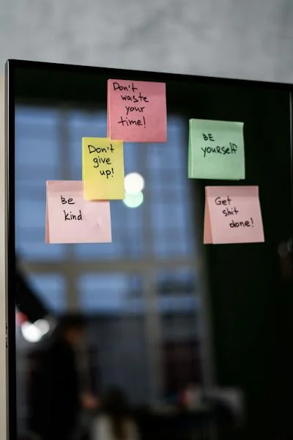
Conversation Starter: Grades 3-6
Just Like Me Mindfulness
This person has a body and mind, just like me.
This person has feelings and thoughts, just like me.
This person worries, just like me.
This person is learning, just like me.
Notes:
Mindfulness Activity-Just Like Me
This mindful activity works on self compassion. Accepting yourself for who you are and building skills of love and understanding for one's self.
Have students take a few deep breaths and close their eyes.
Tell them to think that there is a person just like them in their mind.
Say the phrases softly above first. Have the students sit and think about each phrase. Then have them whisper it aloud. Continue with these phrases:
This person wants to be caring and kind, just like me.
This person wishes to be safe, strong, and healthy, just like me.
Send these wishes to that person:
May you be loved because you are a person, just like me.
Take a moment and notice the sensations in your body. As you breathe, feel the sensations of being connected to those that are “just like you.” When you are ready, open your eyes.

Slide 8
Review
The Books
Notes:
For Upper Grades 5th-6th that are Moving to Middle School:
Review the books and tools in context of moving to Middle School.
Refer to the Moving to Middle School Lesson on the Website for more ideas.

Slide 9
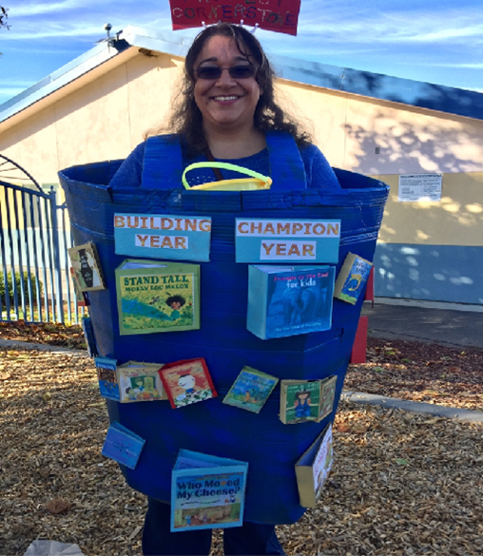
Review: Grades K-6
Take the Cornerstone Challenge
Notes:
Materials: Book Covers from the year, way to display them,
Toolkit for Champion Year
Show the book covers. Talk briefly about the book.
Divide students into teams. Have them select a recorder, timer, reporter, and leader.
Explain that they are going to be given a book. As a team they must think of as many things that they learned from this book.
Give them 5-8 minutes to discuss and brainstorm as a group.
Have the reporter give a report on their answers.
Write the skills on a large chart paper.
If time, have students write on a piece of paper how they used one of the tools this past year.
For Kinder to First Grade:
Do together as a group. Write their ideas on a chart paper.

Slide 10
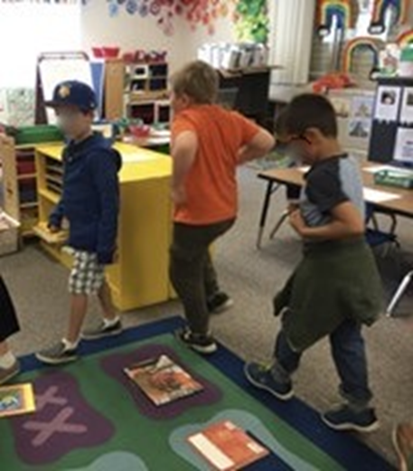
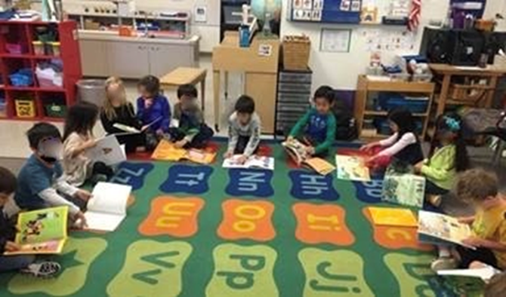
Review Grades K-6
Book Walk
Notes:
Refer to Website, Champion Year Review, Book Quiz
Name that Book
Give a clue and then have students answer. Do with actual books for Kinder-2.
Book Walk
This works similar to a cakewalk. Collect books that the students have heard for the year. Arrange the books in a circle.
Say to the students, “We are going to do a book walk today. When I play the music, I want you to walk around the circle and when the music stops, you can stop and pick up the book next to you and look at it.” Give the students a minute to look at the book. Say, “Let’s take another walk around the circle.” Repeat for 4 to 5 times.
Say, “Think about your favorite book you saw today. I want you to draw a picture about the book on this paper.” Combine drawings to make a book, poster, or banner.

Slide 11

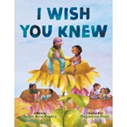

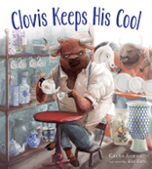



Review Grades K-6
4 Corners Game
WHAT WAS YOUR FAVORITE BOOK?
Notes:
Refer to Website, Materials, 4 Corners Game
Materials: Print out the handout and post on color backing paper in 4 areas of the classroom, Skittles
Divide students into 4 teams. See Skittle description.
Read the posters posted in 4 areas of the classroom.
Students with red Skittles go to the red question, etc.
Students are given 5 minutes to discuss.
At sound of buzzer, students report out their answers.
Students can rotate to all 4 areas or you can choose to do another activity.

Slide 12
Activity Ideas

Slide 13
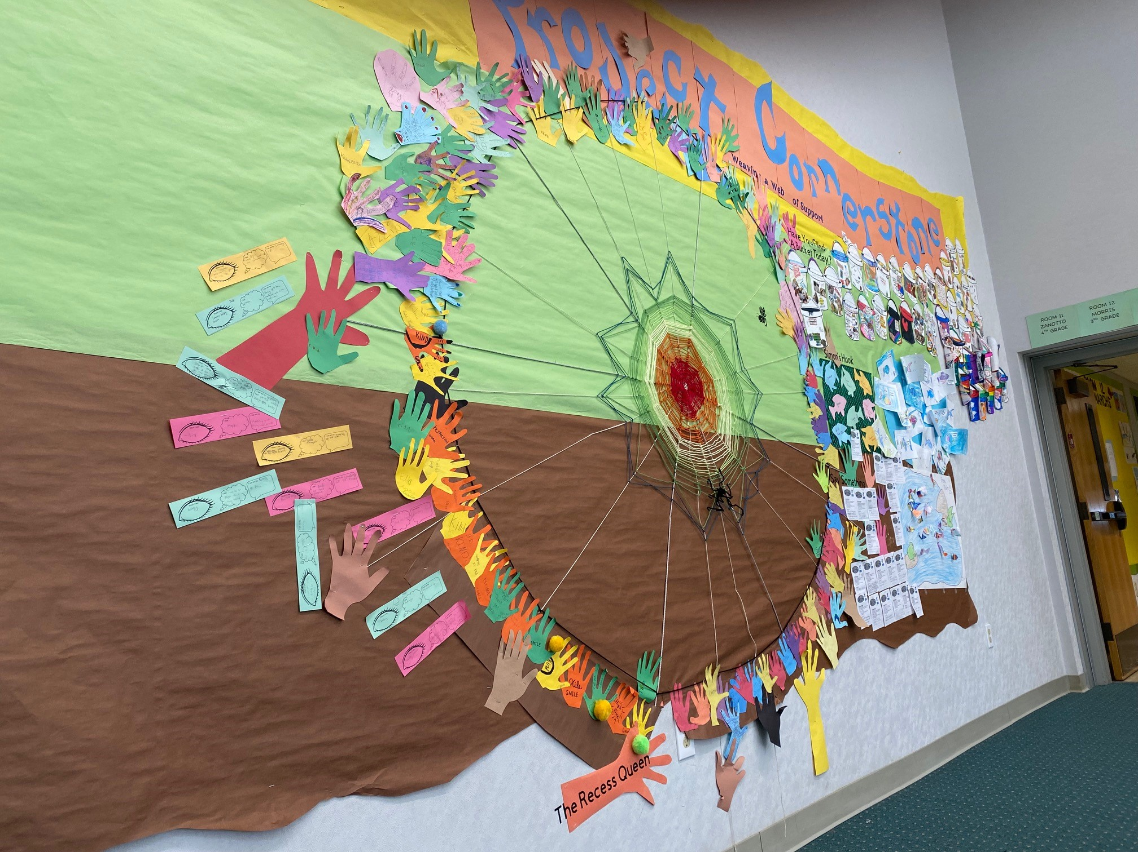
Activity Idea: Grades K-2
Web of Kindness
Notes:
Web of Kindness
Materials: Web of Kindness handout, yarn or string in different colors, glue, pencils.
Discuss the importance of empathy and kindness using Spiderman as an example. Talk about how Spiderman uses his powers to help others and how being kind is a superpower. Have students stand in a circle, hold a ball of yarn and say what they did or will do to be kind. Then toss the yarn to another student.
Print out a handout for each student. Follow the directions.
Cut yarn (red and blue if you want Spiderman colors) in lengths to match the web. Glue along the web lines. Younger students can just do the long, straight lines.
As an alternative to yarn have students trace the web lines with red and blue markers instead.
Have students think of ways they can be kind to others. Write these ideas in the spaces of the web or below it.
Close by reminding students how each act of kindness contributes to making the world a better place, just like Spiderman does with his heroic deeds.
Video: Show you Care: https://www.youtube.com/watch?v=P4mSkTzxIb8

Slide 14
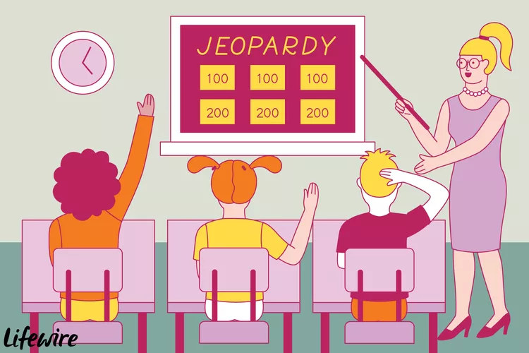
Activity Ideas: Grades 3-6
Jeopardy
Notes:
Refer to Website, Champion Year Review, Materials, Review Questions
Jeopardy
For those of you interested in playing Jeopardy, there's a great website you can use to enter your questions/answers, and it provides the format for you.
Once the questions are answered, you indicate which "Team" gets the points, and then it removes that tile/topic for you.
You have to remember to add or subtract points in order for it to be removed. It even keeps track of the points for you. https://jeopardylabs.com/
To help with making the jeopardy game, use the Review Questions found under materials in Champion Year Review.

Slide 15
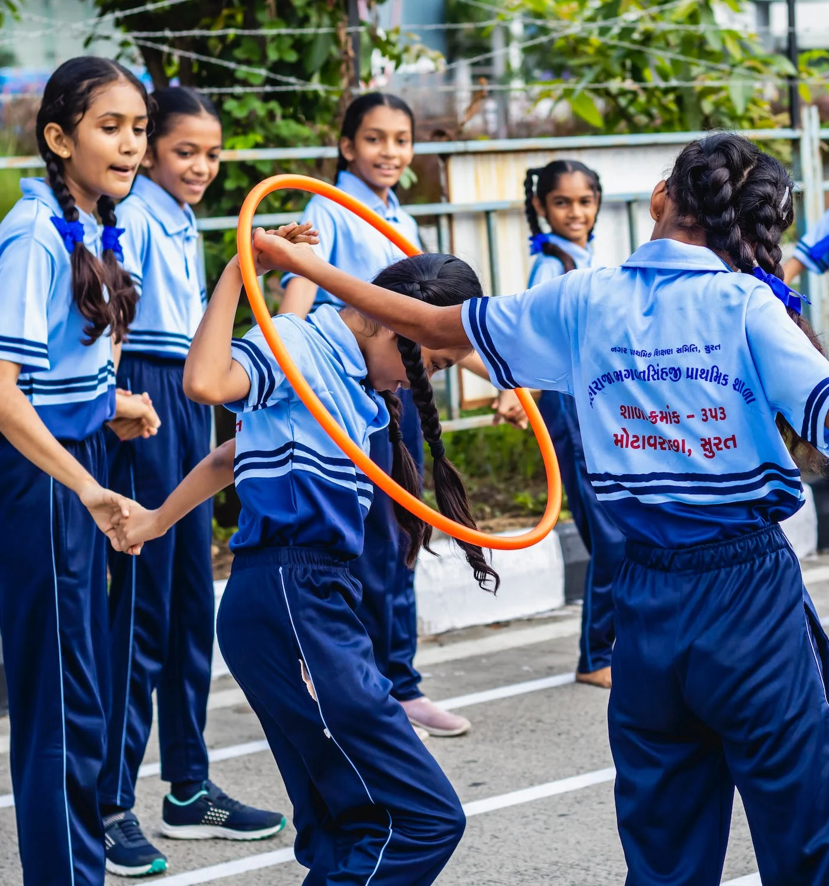
Activity Ideas: Grades K-6
Scavenger Hunt
Challenge kids have to do when they first reach you:
It’s time to make sure everyone is included!
With your teammates, hold hands in a circle. Work together to pass a hula hoop all the way around the circle WITHOUT dropping your hands.
Notes:
Refer to Champion Year Review, Materials-Scavenger Hunt
Scavenger Hunt
Materials: Map of campus from the office, clues, directions, materials to go with the action items
This fun activity needs a bit of prep. It will remind the students everything that they have learned from the Project Cornerstone lessons this school year. Students are meant to work in teams and work together to solve challenges.
Once they answer the clue, there is an activity challenge that goes with the clue.
You will need helpers to be at each station to set up, monitor, and reset before each group goes through.

Slide 16
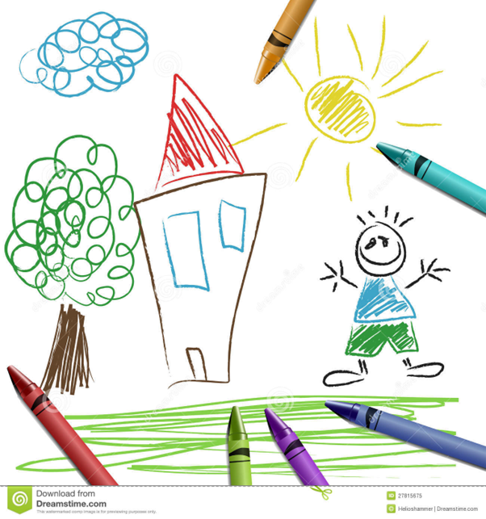
Activity Ideas: Grades K-6
You’re the Illustrator
Notes:
You’re the Illustrator
Materials: crayons, drawing paper, book covers or Champion books
For older students use most of the books. For K-2 students, select 1-3 books. Name the illustrators in the books. Ask students to look at their individual drawing styles by showing a book and a few pages.
Have the students tell you about the style and what they can learn from the drawing. Discuss the medium. Talk about the colors. Do they also tells part of the story?
Ask the students how important the drawings are to telling the story.
Pass out paper and crayons and let the creativity and imagination flow. Try any of the following prompts:
Draw your favorite book.
Draw a page from one of the books with your illustrator style.
Draw the covers of all the books.
Draw your favorite character.
Draw yourself into your favorite story.
Draw what inspires you to be an Empathy Ambassador.
Have students pair share what they drew and why.

Slide 17
Closing:
3-Minute Huddle

Slide 18
Closing: Grades K-6
Notes:
Pass the Hello Grades K-2
Have students brainstorm all the feeling words they have learned this year. As they name them, write the word on a slip of paper and put into a bag. Choose one paper. Have the students pass the feeling by using the word hello around the circle. As it goes around the circle, they embody the feeling in their voice, face, and gestures. Once it goes around the circle, start a new feeling.
Debrief Questions:
What did you learn from this activity?
Did you express emotions in the same way as the others here?
How does identifying and naming feelings help us communicate with others?
Make a Wordle for Grades 3-6
Brainstorm with students to think of 3-4 words or phrases they think of in relation to ABC reading and the lessons this past year. Put those into a Wordle on this site: https://wordart.com/
You can make the wordle into stickers or patches as a gift to students.

Slide 19

Closing
Cornerstone Cheer
We’re Cornerstone Kids and we’re here to say
Connect with empathy everyday!
Invite and include.
Listen with your whole heart.
We’re Cornerstone Kids and we’re here to say
Connect with empathy everyday!
Be a world changer.
Keep your cool.
We’re Cornerstone Kids and we’re here to say
Connect with empathy everyday!
Be true to you.
Clear thoughts.
Dream BIG!
We’re Cornerstone Kids and we’re here to say
Connect with empathy everyday!
Notes:
Refer to Champion Review on website, Champion Cheer
As part of the closing, you can have the students do the cheer. Have students recite the cheer at the end of your lesson with them. You can also have them fill in the blanks. You say part of the phrase and they shout out the missing word.
Challenge them to work in small groups and create body movements to go with the words. They can perform their groups cheer at a school assembly or for their buddy class. They could also use musical instruments to accompany the cheer.

Slide 20
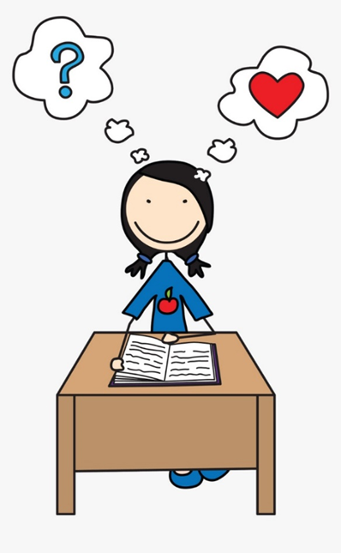
Closing: Grades 4-6
Surveys
Have students fill out the questionnaire on Survey Monkey .
Volunteers will receive one
through Constant Contact.
Due May 20th.
Notes:
Refer to Lead Materials, End of Year, Student Questionnaire
Materials: Computers, Chrome Books, Tablets etc.
The student survey link can be found on the website under Lead Materials, End of Year.
Many schools have done this survey in the past for Project Cornerstone. All information is complied and used for grant applications and reports. If you are a new school, be sure to check with the teacher or principal.
It is ok to review the books before the students take the survey. If you did not read all the books, it is still fine to administer the survey.
Volunteer Surveys were sent out as Constant Contact email to all volunteers with an application. Please remind your volunteers to fill out. Due May 17th.

Slide 21
School Wide
Extensions

Slide 22
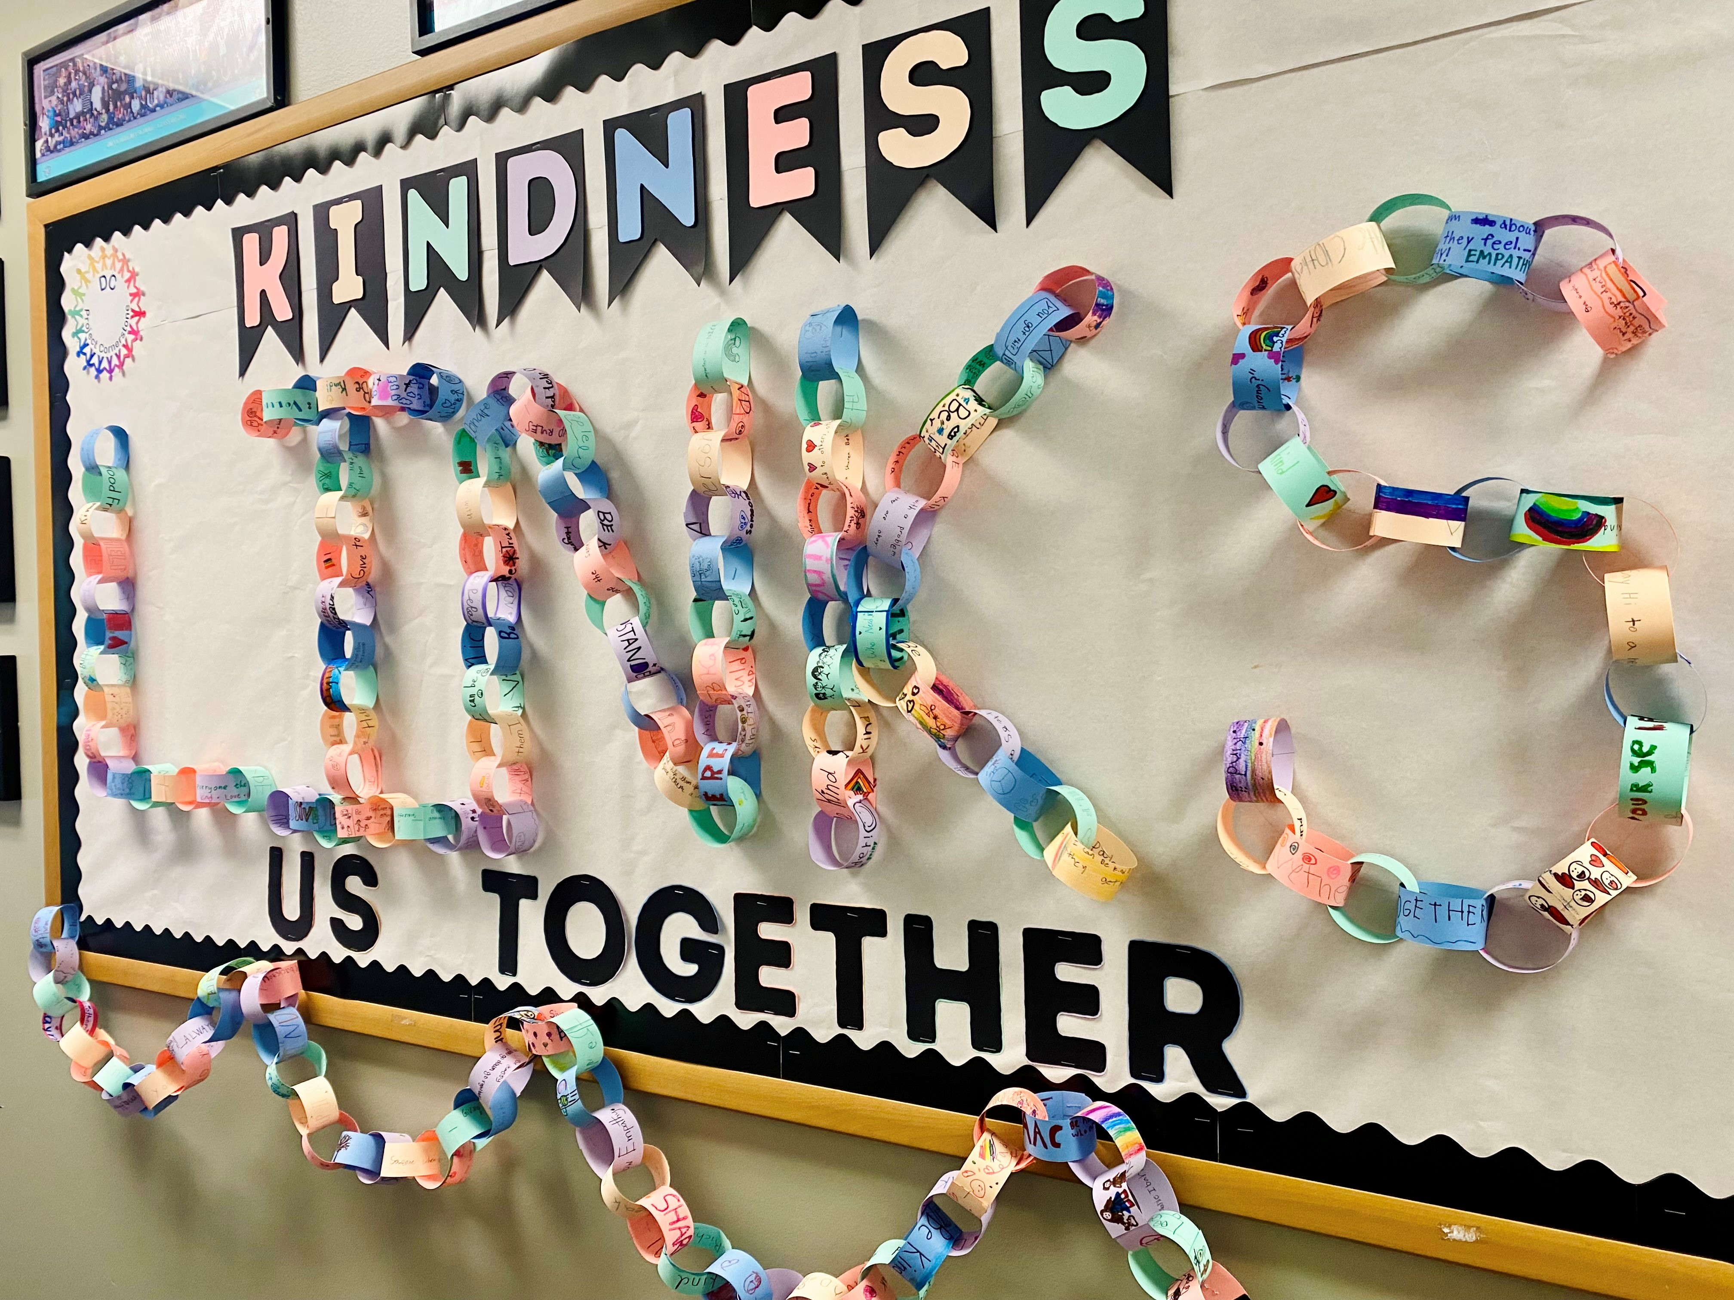
School Wide Extensions
Kindness Links Us Togehter
Notes:
Kindness Links Us Together TK-6th
Do one activity each day:
Kindness Grams-students to write a kind message for parents, grandparents, teachers, caregivers, siblings, classmates, friends.
Kindness Sticky Notes-words of kindness or anything positive that they could think of. Use all those notes to make a rainbow in your auditorium/cafeteria with the message- Be a Rainbow in Someone's Cloud.
List of Kind Acts-small acts of kindness to do throughout the week.
Choose Kindness-wristbands to wear as a pledge to continue to keep a kind, caring, and safe climate at our school.
Kindness Links Us Bulletin Board - Pass out slips of paper to teachers or have all ABC volunteers bring to their classrooms. Have students write on a slip of paper a way that they could show kindness. Collect the slips of paper and ask volunteers to link them together to form a kindness chain. Display them for parents to see. Read one or two each day over the PA system.

Slide 23

School Wide Extensions
Notes:
FUNvisor Extensions:
Chalk Messages
Whole school draws and writes messages on the black top that they have learned from ABC this year. Assign each grade a book. You can also divide the playground into grids by grade levels.
Friendship Bracelets with Beads or Duct Tape
Set up stations for students to rotate through at lunch.
Have embroidery thread, pipe cleaners, and beads to use to create their bracelets
Demonstrate how just like duct tape, UPstanders can stick together with a classmate who needs empathy. Let them make their own sticky bracelets with the designer duct tape to demonstrate that they can be sticky as an UPstander to all friends and classmates.
Tear a piece about 1 foot long off of the roll.
Fold the foot long piece upon itself reserving about an inch of the sticky part.
Starting at the non-sticky end, tear the bracelet into 2 pieces down the center.
Storytelling - Read books from the Complementary list as a way to reinforce the messages from the ABC books.

Slide 24
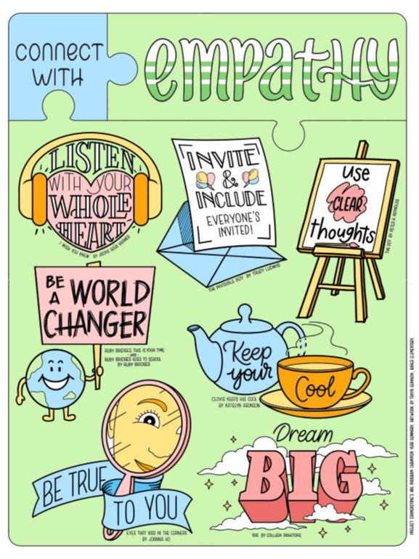
School Wide Extensions
Vote for Favorite Book
Notes:
Set up 2 tables at lunch time recess for 2 days in a row. Have a big colorful display that shows the book covers and summary of each book. On the second table have two "voting booths" (two cardboards set up to block the view). In each voting booth, put seven cans, fully covered with a slit in the top and labeled with one of the books .
At the display table, students check in and get their names checked off on sheets by classrooms provided by the office. Give them one craft stick that they will use to cast their vote in the voting booth. Have a parent monitor the booths.
Students who vote could also be entered into a drawing to win one of the PC books and the poster that goes with it. The winners are announced along with the favorite book at an assembly later in the month.

Slide 25
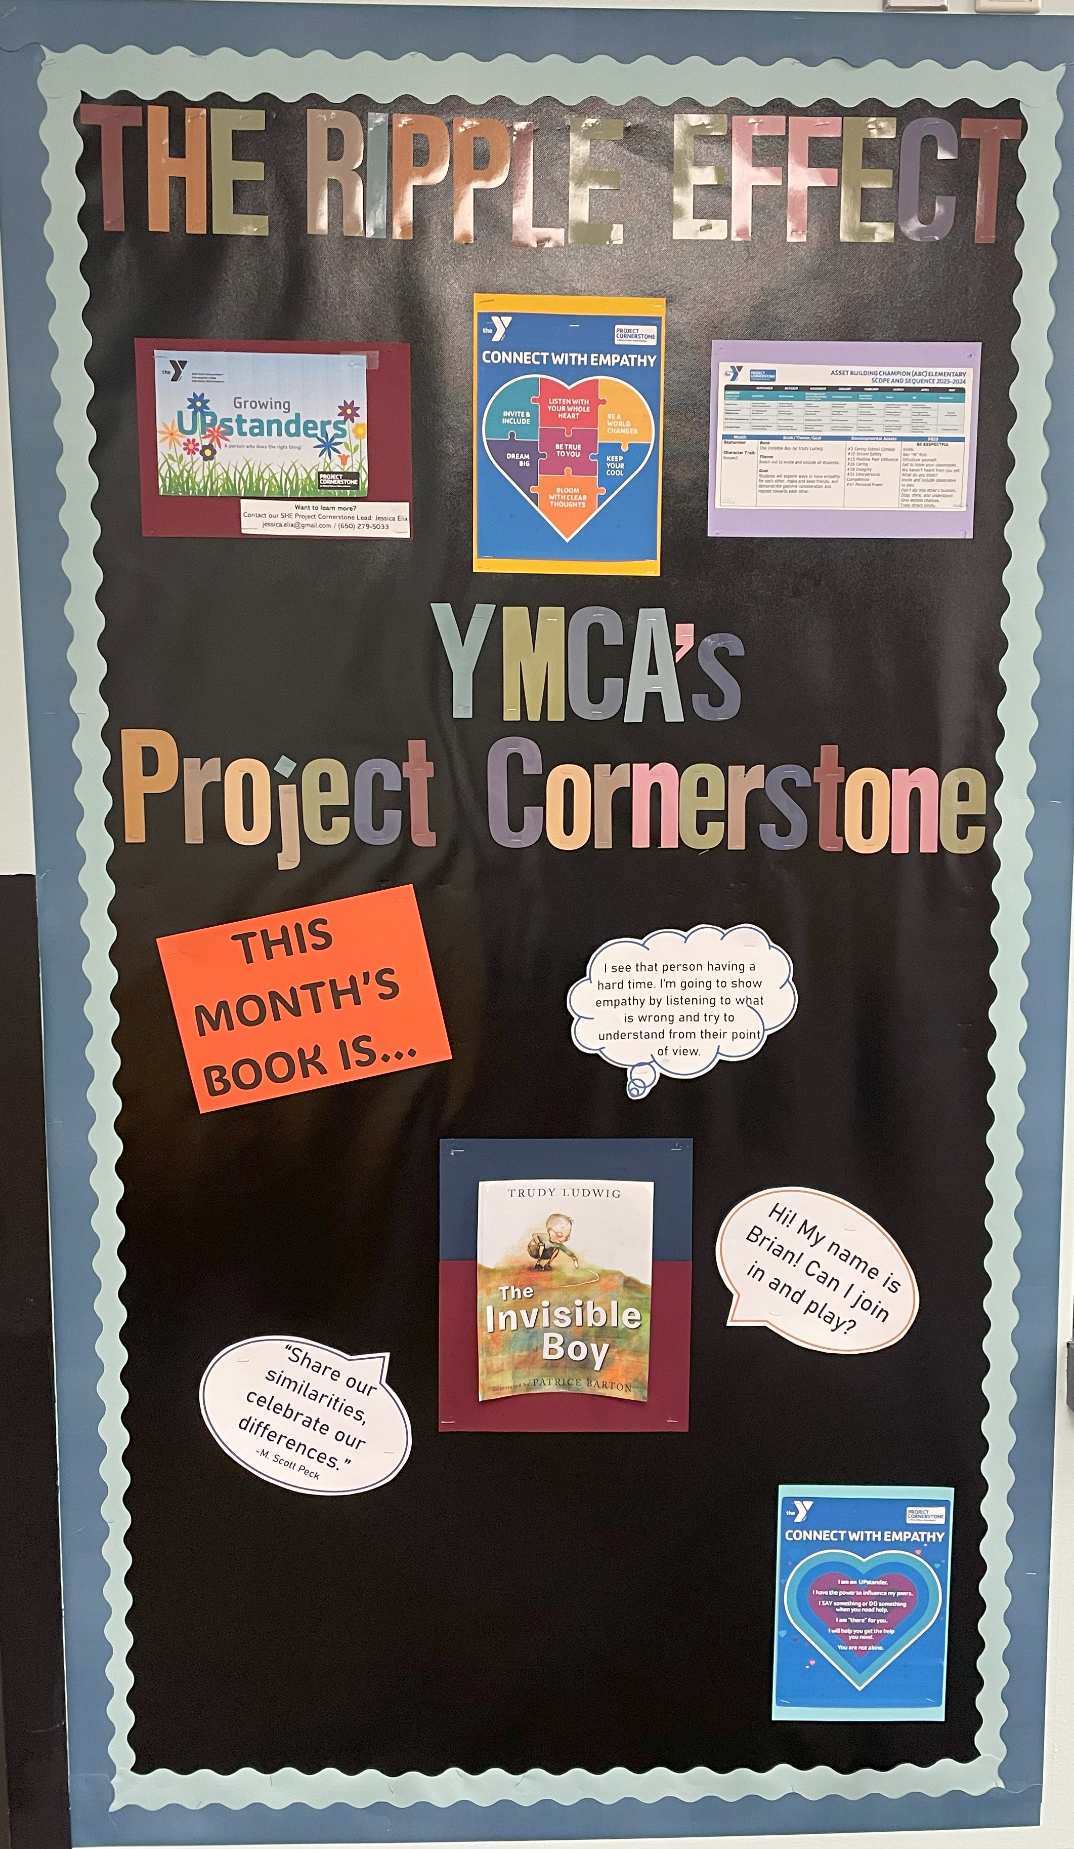
School Wide Extensions
Staff Challenge
Notes:
Staff Guessing Game
Materials: markers, poster board, ABC Building Toolkit
Draw poster-sized representations of each book and the main concepts written on separate poster boards.
Ask 5th graders to draw the poster and the main concept poster.
2 posters per book could be made.
Ask the principal, teachers, librarian etc. to be the contestants. Have students hold the poster boards(14 in all). Ask the contestants to match the concepts to the books by placing the child with the concept with the child with the correct book. Encourage participants to ask for help from the audience. This can be done with just the principal or with staff teams.
Extra staff can lead cheers and students can cheer all participants to encourage good sportsmanship. Pom poms can be made out of newspaper and masking tape.

Slide 26
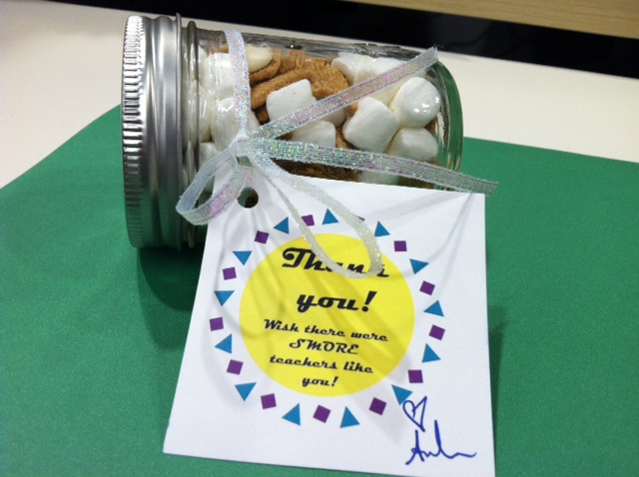
School Wide Extensions
Celebrating Teachers and Staff
Notes:
Make a final effort to boost the enthusiasm and momentum you have created around asset building! Notice, name, and celebrate staff.
Everyone has continued to build student assets by standing up as caring adults. Their investments of time and energy have made a lasting impact on individual students and your school community. Show your gratitude by:
Ask students to write a note or make a card for staff members, principals, and teachers.
Have the classroom volunteers get together and make a small gift.
Pinterest has some great ideas under Project Cornerstone Volunteer Appreciation: https://www.pinterest.com/projcornerstone/volunteer-appreciation/

Slide 27

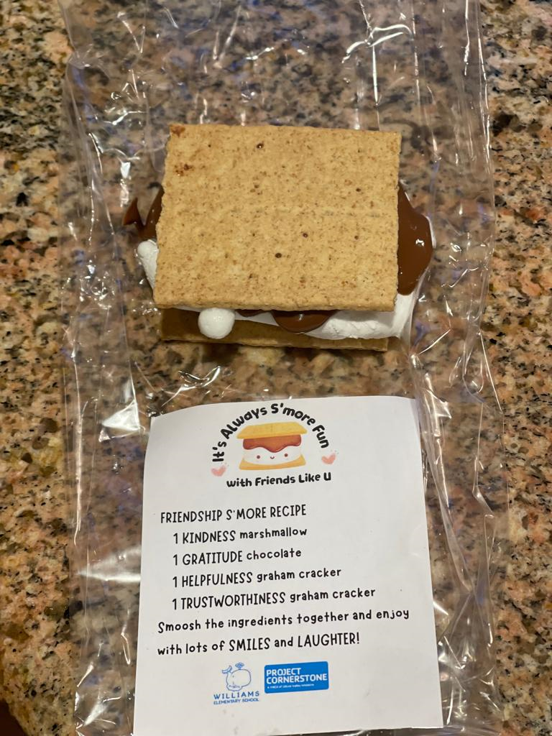
School Wide Extensions
Celebrating Volunteers
Notes:
Ways to celebrate your volunteers can be found:
Ideas, and certificates can be found on the Website https://www.ymcasv.org/ymca-project-cornerstone/materials-lessons/abc-materials-lesson-plans/abc-lead-materials (scroll down to the End of the Year activities).
Order tote bags for their volunteers with the no book title handout attached here on the front. Volunteers can color in the symbols with sharpies and students can sign the bags next year.
https://www.amazon.com/Promotional-Tote-Bag-Quantity-Customized/dp/B07YTZJD6K/ref=sr_1_13?dchild=1&keywords=tote&m=A3KAMWV7OVHVNA&qid=1588100550&s=merchant-items&sr=1-13&th=1
The most meaningful gift can be giving kind words of thanks and appreciation and spending time together to celebrate. Come as a school to the Project Cornerstone Volunteer Celebration.

Slide 28
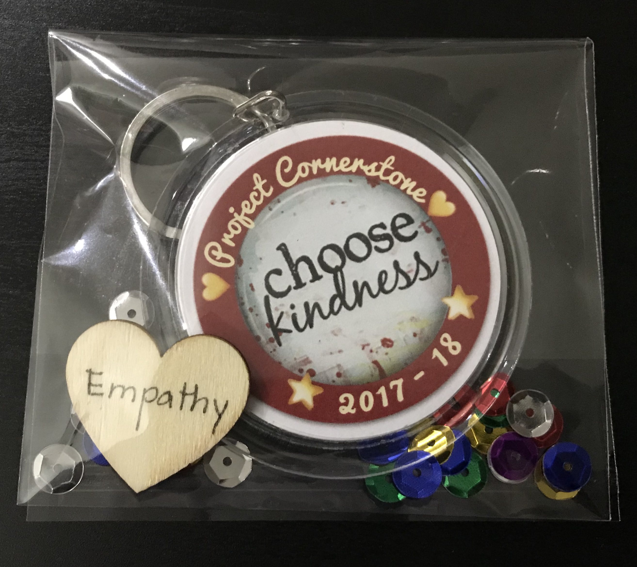
School Wide Extensions
Celebrating Students
Notes:
Refer to Champion Year Wrap-Up, Materials
Student Certificates are available to print.
End of year review of books coloring page and bookmark.
Create a patch.
Shrinky Dink button
For 5/6th Graders:
Bags with their tools printed.
Make a tool kit in a pencil box for taking to Middle School.
Clipboards with names and ABC Tools on the back.
Look on Pinterest for more student ideas
https://www.pinterest.com/pin/student-bulletin-board-showing-appreciation-for-the-project-cornerstone-volunteers--416864509240792972/

Slide 29

Home and School Communication
Newsletter Blurb
Student Stickers
Parent Letter and Email Blurb
Tool Kits
Family Movie Night
SUMMMER FUN
Notes:
Make the Home-School Connection:
Email Blurb
Give the teacher the email blurb to include in her class email note or make it into the newsletter blurb.
Newsletter Blurb
The blurb is a great way to write a short paragraph for the school newsletter or Parent Loop etc.
Parent Letter
Promote Summer Fun with 8 weeks of fun family activity ideas based on each book from the Champion Year. Send home the final letter with the coloring page for the Summer Fun.

Slide 30

Closing Comments:
Wrapping It Up!
    Recruit now
    Training Dates
    Volunteer Celebration
    Moving to Middle School
Notes:
Prepping for Next Year
Recruiting
Open House, Kinder Orientation, End of Year events are all times to use to recruit for next year.
Invite current and prospective volunteers to Volunteer Celebration
Trainings for ABC on Zoom on Wednesdays.
Kinder Training on Tuesdays at 10:00.
Project Cornerstone’s Volunteer Celebration
All Project Cornerstone Volunteers Invited.
Middle School
Moving to Middle School as a Volunteer.
Project Cornerstone’s Middle School SEL Program Modules
Contact Angie Hansen for more information:
Angie@projectcornerstone.org

