Slide 1
Project Cornerstone
JANUARY
Clovis keeps his Cool

Slide 2
Mindful Activity
OPTIONAL
CONTROL YOUR REACTION
Ask the students to say their name when you say “name” and clap when you say “clap”. Try it for a few seconds changing the words in a fast pace. Then tell them to clap when you say “name” and say their name when you say “clap”. Keep the fast pace. Try again with the words changed but wait a few seconds between commands this time around.
Discuss with your class how the space gave them time to react better. Highlight the importance of “think and then respond”

Slide 3
Conversation Starter
Angry Iceberg
What Other Emotions are Hidden Under Anger?
Icebergs are large pieces of ice floating in the open ocean. What you can see from the surface can be misleading. Most of the iceberg is hidden below the water.
ANGRY

Slide 4
Conversation Starter
This is how anger works. Often when we are angry, there are other emotions hidden under the surface.
If you are experiencing anger, you need to stop and reconsider why you might be feeling this way.
Talk it out, with yourself! Try to apply a hopeful, “Growth Mindset”- you can change your own attitude and outlook.
Consider other reasons for behaviors or situations.
Make active efforts to improve your own mood.
ANGRY
embarrassed
scared
anxious
grief
nervous
stressed
attacked
regret
guilt
worried
annoyed
hurt
exhausted
disappointed
insecure

Slide 5
Empathy
Click on the play button to see the videos
Stop and Think
1-2
Practice Self Control
Reconsider before responding.
This strategy is a cognitive process that influences your feelings and how you express them. It helps regulate emotional responses by changing how a person thinks about a behavior or situation before reacting. Learning this skill is key to being able to give second chances to yourself and others.
3-5
Practice Self Control

Slide 6
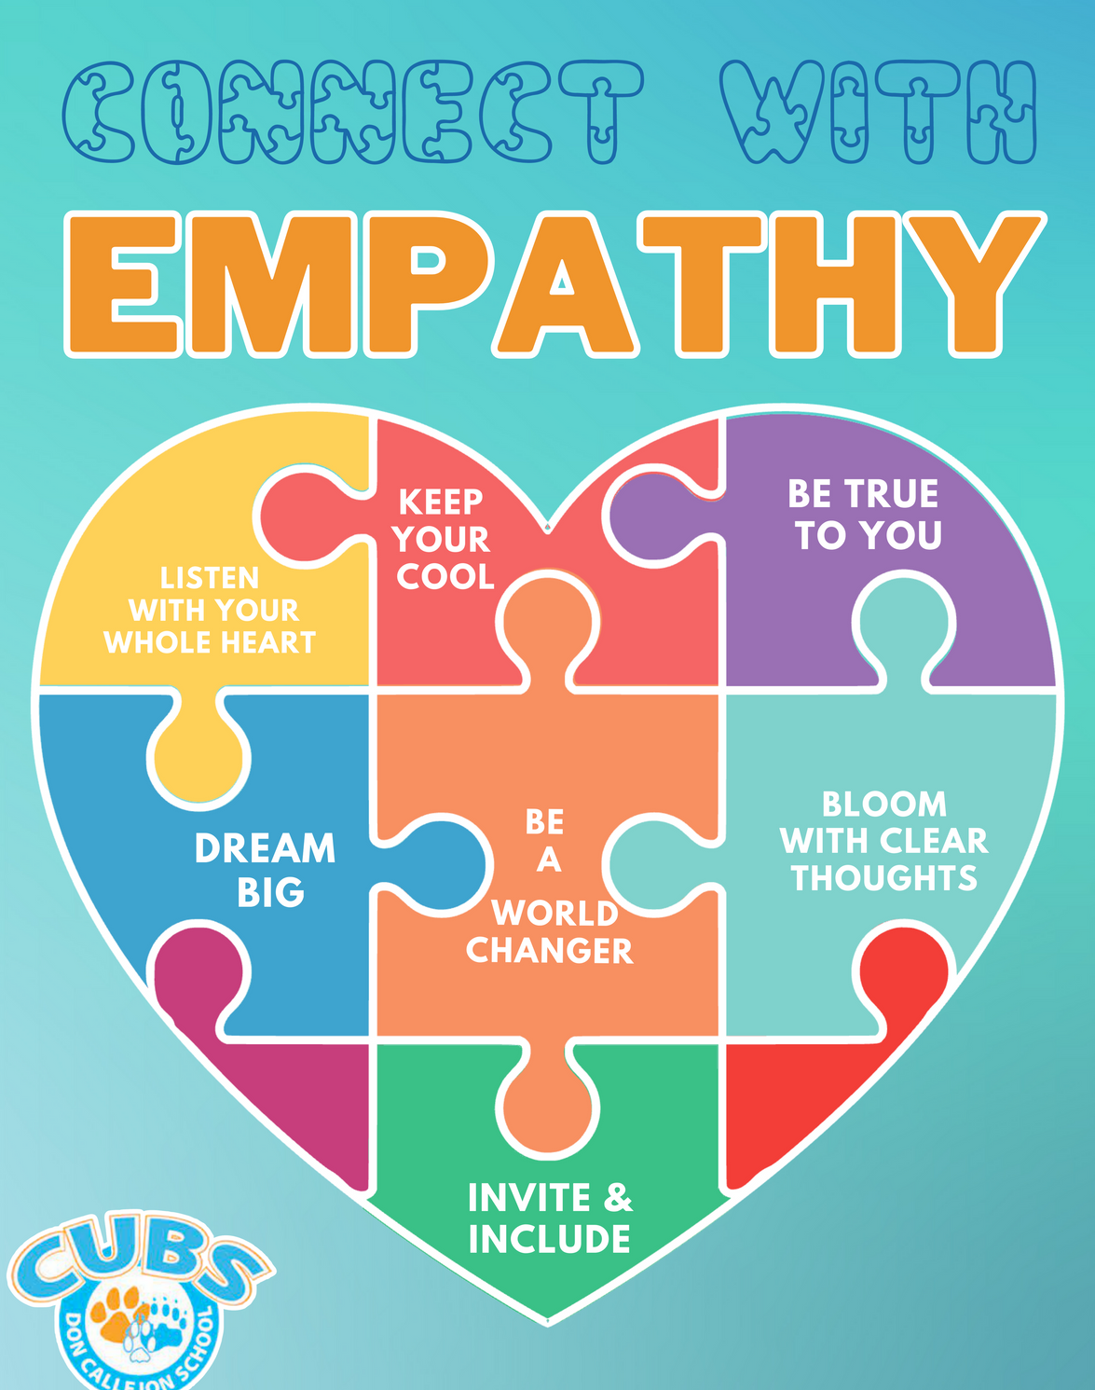
Key Phrases
Reconsider before responding
Stop and think
Show empathy
Give second chances
.

Slide 7
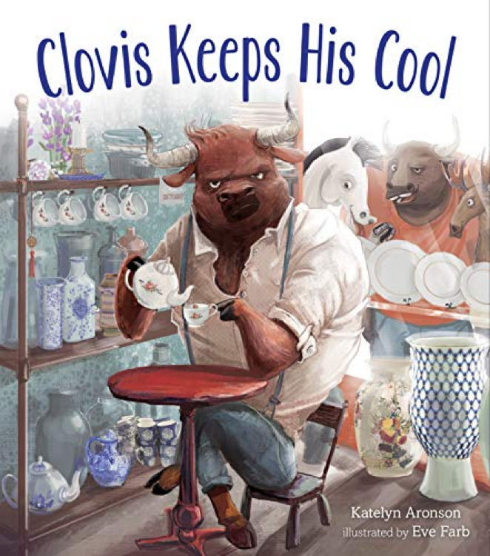
Book
Click on the Speaker to go to the read aloud version
Clovis used to struggle with his temper, but ever since he took over his grandmother’s china shop, he’s been learning how to manage it. However, when rivals from his football days tease him at the shop, Clovis faces a big challenge to keep his cool and is unable to use his coping tools. The result is the destruction of the tea shop. After he loses his cool, Clovis honors his grandmother’s memory by reconsidering and giving second chances to his rivals. Clovis offers himself a second chance at keeping his cool and the result is a discovery of how offering second chances can lead to building new relationships.
The author, Katelyn Aronson, writes, “In this story, grace is something of a legacy bestowed on Clovis by a loved one. It isn’t until he embraces that forgiveness for himself that he can extend it to his rivals.” By the end of the story, Clovis demonstrates the strategy of reconsidering before he responds. This strategy is a cognitive process that influences your feelings and how you express them. It helps regulate emotional responses by changing how a person thinks about a behavior or situation before reacting. Learning this skill is key to being able to give second chances to yourself and others.

Slide 8
Discussion Questions
1-2
3-5
Who was a caring adult in Clovis’ life?
What did this caring adult teach him?
Who was teasing Clovis? What happened?
How do you feel when you get angry? What signs does your body show?
After Clovis lost his cool, what did he do?
What does Clovis do to keep his cool?
We call this reconsidering or stop, think, and choose to react. When have you tried this? Tell us about it.
How do the football players react after having tea with Clovis?
What tools do you use to help when you experience strong feelings?
Do you remember how to make a genuine apology?
What feelings were under the anger iceberg for Clovis?
What technique did Clovis use to control his reaction when he was being teased?
Have you ever used the reconsidering tools to control your own reaction to strong emotions?
When Clovis could no longer control his emotions, what stopped him from harming the football players?
How does Clovis forgive himself?
How did forgiveness and second chances change the relationship between Clovis and the football players?
Have you ever found yourself in a similar situation as Clovis? What happened?
Now that you have heard about reconsidering and second chances....how could you apply them to your life?
When others are showing their emotions, how can you respond with empathy? What can you say or do to acknowledge their feelings?

Slide 9
Activity
HOPE
sad
HAPPY
angry
OPTION 1
Heart full of Emotions
Do a picture walk of the book and highlight the body language and facial expressions and colors used for the illustrations. Make note of the emotions and feelings the students recognize.
Discuss how some feelings are associated with some colors. (Happy = yellow, Sad = blue, Anger = Red). As a class choose a color for every emotion / feeling you discussed.
Have students decorate their heart with the emotions they are feeling that day. Each heart will look different. Each column is a place to write the feeling

Slide 10
Activity
OPTION 2 (4-5 grades)
Reconsidering Role Play
Brainstorm different tools they have learned to regulate their emotions. Write their ideas on a board or chart paper. Here are some tools that can be implemented:
Recognize anger triggers
Stop and Take 5
Say, “I need a minute…”
Wave anger away
Use visualization
Walk away
Take deep breaths
Count down... SLOWLY
Get active!
Activity Prompts:
Your teacher asks everyone to line up. Two students ignore the direction and now you must miss 5 minutes of recess!
You’re walking down the hall when someone pushes you from behind. You smash into the wall and fall to the ground. When you look up, the person who pushed you is laughing.
You are reading in the library when someone comes from behind you and takes your book. You are trying to get it back when the librarian orders you to go to the office, no questions asked.
You are shooting hoops at lunch when a basketball comes at you and hits you in the head. The person who threw the ball comes up and says, “Sorry- accident.” It is another student that you do not get along with, and they are smiling.
Ask for 2 volunteers at a time and let them recreate the scene and find a solution using one of the tools you talked before.

Slide 11
Closing
Practice reconsidering before acting
Forgive and give second chances as a way to experience emotions and move through them.
Mastering this skill will make a huge difference

Slide 12
Thank you!

