Slide 1
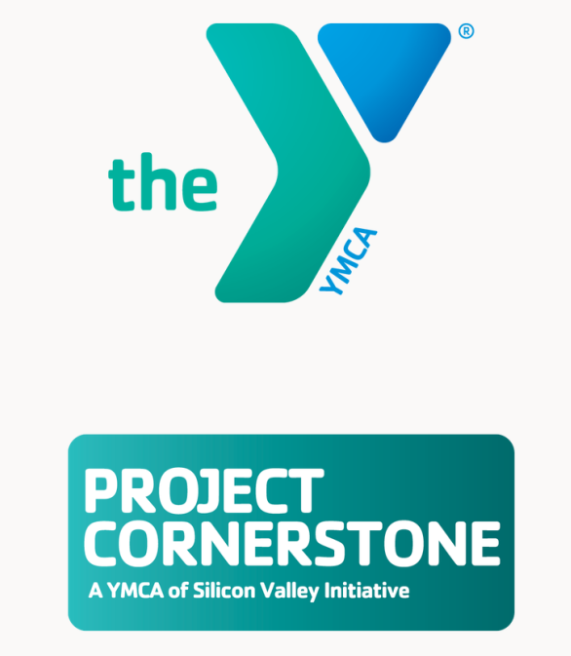
Starting the Year with Positive Intentions

Slide 2
NORMS/COMMUNITY AGREEMENTS
Be present and open
Listen actively and intentionally
Share the air
Be respectful
Be responsible
Guiding Questions:
How am I showing up for students?
How am I showing up for myself and others?
Am I being a positive role model for youth?

Slide 3
NORMS/COMMUNITY AGREEMENTS Individual and Group Expectations
Be Respectful:
Actively listen and participate
Practice empathy
Use a “no name” policy
Be Responsible:
Use positive language
Share the air
Speak your truth (use “I” statements)
Be Safe:
Follow directions
Keep your hands and feet to yourself
© 2023-24 YMCA Project Cornerstone
Notes:
These norms are formatted to align with PBIS (Positive Behavioral Interventions and Supports) frameworks - Be respectful, be responsible, be safe. Norms should support and reinforce existing class and school rules. For some classrooms, a review of class rules will replace these norms, or you can use these three simple norms.
Pro tip: When talking about norms/community agreements, the statements should be formatted in a positive way. They should state what students should do and not what they shouldn't do. Instead of lists that begin with “Don’t” or “Stop”, the list should be focused on what behaviors students should do and how they should behave.
“No Name” policy: This is an agreement that we will not use specific names of other people when we share stories or experiences. We will use “I” statements and keep the identity of others anonymous. Stories are wonderful ways to learn about tricky social interactions. Using the “No Name” policy allows us to learn about other students while respecting the privacy and safety of others.
It is essential to start your time with students with clear community agreements and expectations. We want to give students clear, concise, and consistent boundaries so that they know what appropriate behavior would look like, sound like, and feel like during Project Cornerstone modules. We want to create a “safe space” for students to express their feeling and opinions, and also a “brave space” where we are able to acknowledge and embrace fear or discomfort in order to commit to learning and take positive action.
The goal would be to have individuals and the group agree to a set of behavior expectations. You may want to do a thumb survey to get a commitment from students to adhere to these norms. (“Thumbs up if you agree to following these three behavior expectations/norms.”)

Slide 4
Project Cornerstone is committed to practicing kindness, being inclusive, showing empathy, and being UPstanders. We affirm the importance of Asset 41: Positive Cultural Identity, which states that youth feel comfortable with and proud of their identity, including but not limited to ability status, body size, ethnicity, faith/religion, family status, gender, gender expression, gender identity, immigration status, language, race, and sexual orientation. Project Cornerstone condemns hate in all forms.
The YMCA of Silicon Valley is committed to advancing equity for all so that you have an opportunity to reach your full potential and live life to its fullest. We nurture and intentionally promote a culture free of bias and injustice. We recognize the uniqueness of each individual person and celebrate all dimensions of diversity. We are committed to dismantling oppressive systems, and hold ourselves accountable to identify and put in place long term policies designed to eliminate racism and inequity.

