Slide 1
Eyes That Kiss in the Corners
ABC CHAMPION YEAR LESSON 5 PROJECT CORNERSTONE
Notes:
This presentation is intended for use by ABC Leads who have attended the monthly ABC Lead training.
ABC GPS
Use this to help with planning for your school training. It will help you select the goals and activities for your readers.
Parent Letter or Email Newsletter Blurb
Available to use in emails or newsletter to parents at home. Available in Spanish, Vietnamese, Russian, and Ukrainian.
Yard Duty Tips and Lanyards
Post the yard duty tips. Pass out the lanyard tags to wear.
Invite yard duty to the trainings. Ask them to read in the classroom.
Staff Letter
Email all school staff about the lesson. Lesson plan can be included.

Slide 2

ABC: Champion Year
Key Phrases:
Be True to You
Find Your Authentic Self
Notes:
Refer to Lesson Plan, pages 1-2
This book builds the Developmental Relationships:
Express Care - Listen, Believe in Me, Be Warm, Encourage
Expand Possibilities – Inspire, Broaden Horizons, Connect
Social and Emotional Learning: Self-Awareness
(identify emotions, self-perception/identity, recognizing strengths, sense of self-confidence, and self-efficacy)
In our lesson today, our goals are:
Students will express gratitude for the people in their lives.
Students will celebrate their authentic self and their contribution to the diversity in our world.
Students will develop a greater understanding and respect for people from different backgrounds.
Narration of the book:
https://www.youtube.com/watch?v=VFz0wktGr2k

Slide 3
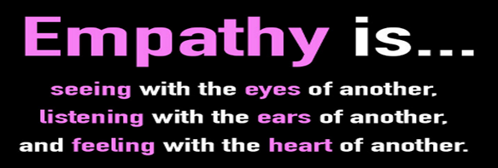
Empathy:
Connect with Empathy
Focus on These Empathy Skills:
Compassion
Celebrate your authentic self
Relate and care for others by understanding more about them
Notes:
Refer to Lead Guide, Empathy, pages 7-8
Empathy is the ability to understand and share the feelings, perspectives, and experiences of others. It’s important that we guide children in understanding and caring for people who are different from them and who may be facing challenges very different from their own challenges. Empathy builds healthy relationships, promotes social connections, and fosters community.
Ask for examples of what they did as a result of the last book. Did they:
identify and name their own feelings?
respond to the emotions of others in an empathetic manner?
reconsider and offer second chances?
How to help students become Empathy Ambassadors:
Express gratitude for the caring adults in their lives.
Celebrate uniqueness and diversity in the world.
Learn about others and respect people that are unique and come from other cultures.

Slide 4
Information for ABC Readers
Notes:
View this video for adults only:
When People Speak Up
https://youtu.be/b1nJqpqgzR0
It is important to be mindful and reflective of your own identity. Understand that you bring your own background, beliefs, behaviors, and biases into the classroom. Some of these biases may cause microaggressions to be exhibited without really realizing it.

Slide 5
Background Information:
Key Points
Microaggressions are subtle, often unintentional actions or comments that convey negative messages toward individuals or groups based on race, gender, sexual orientation, or religion. These everyday slights could be insensitive jokes, backhanded compliments, or implicit bias.
Notes:
Refer to Lesson Plan, Key Ideas, page 2
It is important to be mindful and reflective of your own identity. Understand that you bring your own background, beliefs, behaviors, and biases into the classroom. Some of these biases may cause microaggressions to be exhibited without really realizing it.
Microaggressions may not be overtly hostile or even intended to cause harm, but they reinforce stereotypes and create an environment that marginalizes others. The cumulative impact of microaggressions can be emotionally damaging, contributing to a pattern of systemic discrimination and inequality.
One way to shield yourself from microaggressions is to learn to be your authentic self. This means embracing who you are and all that you are. It means living in alignment with your true values, beliefs, and identity without fear of judgement or societal expectations. It is about your heritage. Take your heritage with you wherever you go and share it with the world.

Slide 6



Background Information:
Key Points
Have you ever experienced micro-aggressions?
What is the story of your family and connection to America?
Does your family have rituals that promote cultural values?
Notes:
Refer to Lesson Plan, Key Ideas, page 2
To get a better idea of your cultural reference points you can ask yourself:
How did your family identify ethnically growing up?
What did your culture teach you about success?
We are all layers of stories. Share your story by speaking up and being seen and heard, never assuming others understand or know you. It is up to each person to be authentic. By representing your authentic self to the world, you belong without conforming to the dominant culture or popular way of being. We can feel connected to our ancestors and histories and bring these beautiful parts of ourselves to our present selves.
As we love ourselves and share ourselves with others, we can build a diverse community where everyone, including those people with a wide variety of identity markers, is valued, celebrated, and known. Remember that being authentic is a lifelong journey that involves ongoing self-reflection and refinement. Believe in yourself and be confident in your ability to shape your life, leading to a path of discovery for your authentic self.

Slide 7
Conversation
Starter

Slide 8
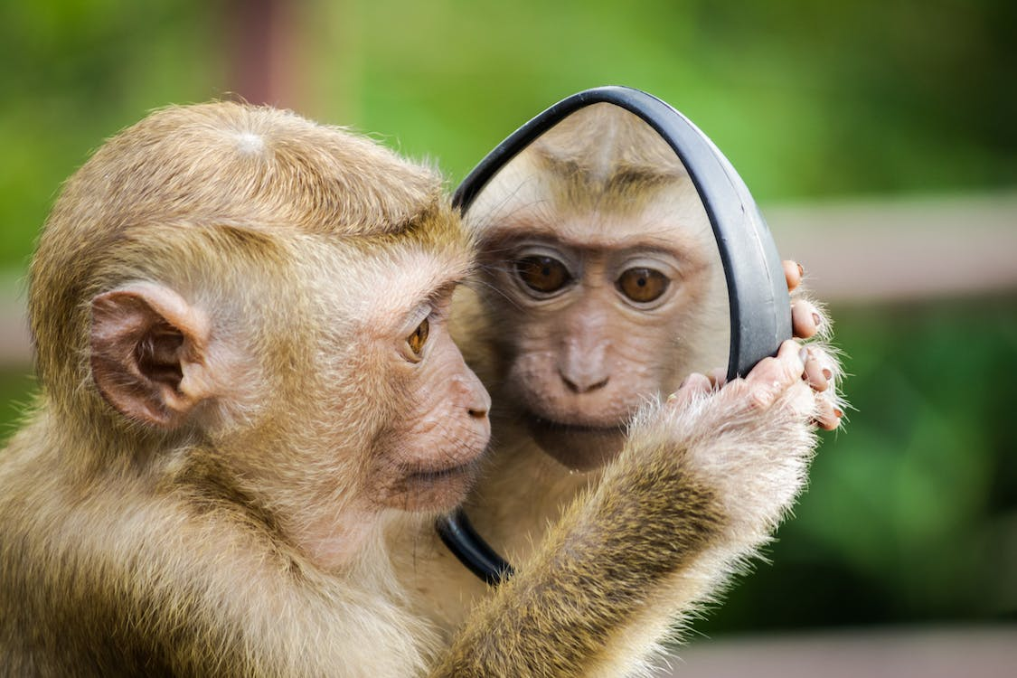
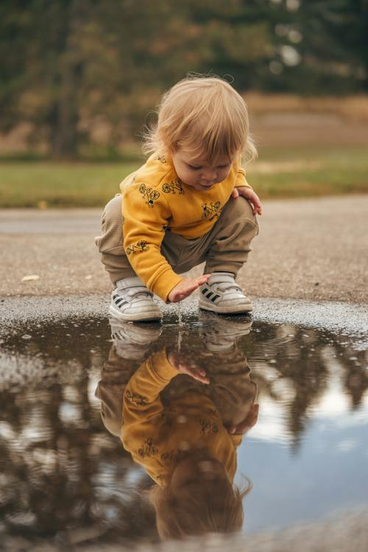
Conversation Starter: Grades K-2
Your Reflection is You
Notes:
Refer to Lesson Plan, Conversation Starter, pages 2-3
Have students close their eyes and imagine themselves in their best state. Imagine what they’re doing, who they’re with, how that environment makes them feel. Pass out the mirrors:
Ask: Who do you see? Say your name! Say it louder. Say it with pride. Whisper it…
Close your eyes. Take a few breaths. Open them and look at your face. What do you see? Have each child look in the mirror and make observations about their features.
Encourage them to view their features as wonderful and unique.
Ask what wonderful features do they see? Talk in detail (shape, colors, size, etc.) about their eyes, noses, faces, smiles, hair, etc.
Put the mirrors down and as a group look at your hands, what do they see? Yes, a variety of skin tones.
Say we are all unique and different. It makes us interesting, authentic, and wonderful human beings.
Discuss with students the idea of being true to yourself or your authentic self.
Show this video: The Reflection of Me
https://www.youtube.com/watch?v=D9OOXCu5XMg

Slide 9
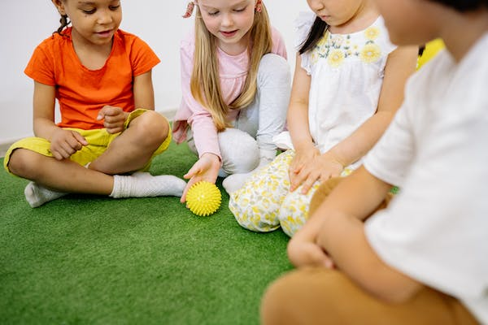
Conversation Starter: Grades K-6
Restorative Justice Circle
What is your favorite color?
What is something fun to do?
What is your favorite meal?
Notes:
Refer to Lesson Plan, Conversation Starter, page 3
The circle focuses on welcoming newcomers, helping students get to know each other, and building bridges between different cliques and ethnic groups. Have students form a circle and sit comfortably. Remind them of the rules about not using names, showing respect by using active listening, and agreeing to maintain confidentiality.
To warm up the students, throw or roll the ball to students. Only the student who is holding the ball may speak.
Once you feel that the students are feeling comfortable, ask students more personal questions.
What emotion are you feeling right now?
What is something you like about yourself?
What is something you would like to change?
Let students talk and share about themselves. If some students show disrespect: “I’m hearing some of you disrespect your classmates. That’s hurtful to use those words. Try to think before you use words like that.” If students put themselves down, remind them of positive affirmations, and turning mud thoughts into clear thoughts.

Slide 10
Reading
The Book
Notes:
This is a new book to the ABC Program. Read the book to the students and ask the discussion questions. Focus on the concepts If time, a video can be shown to extend the lesson.
Reading to Grades 3-6
Show these videos:
Steve Hartman this month is: Gratitude
https://www.youtube.com/watch?v=zfd6vtNEfrs
Pre-recorded Conversation Video by Austin is on the website.
Let’s Eat (8 minutes)
https://www.youtube.com/watch?v=0MX_fJAhmEE
Follow up with discussion and choose one activity:
Unique Me in a Diverse World-Identity Map
Gratitude Circle
Gratitude Tree
Speech Bubbles

Slide 11
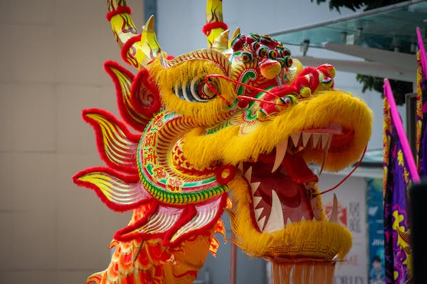
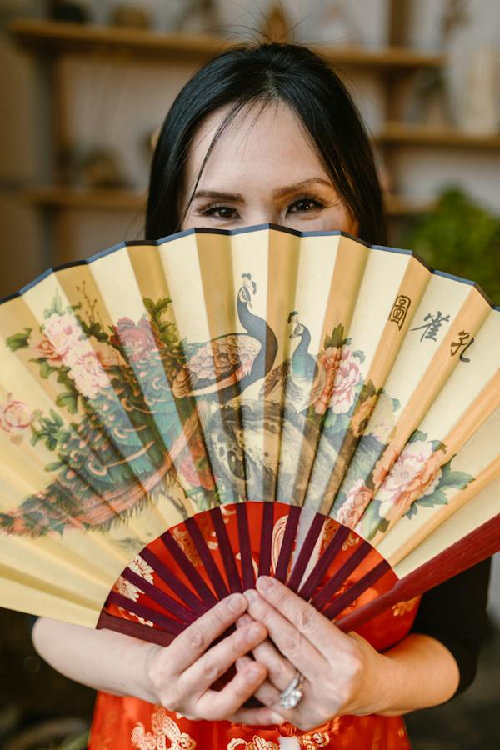
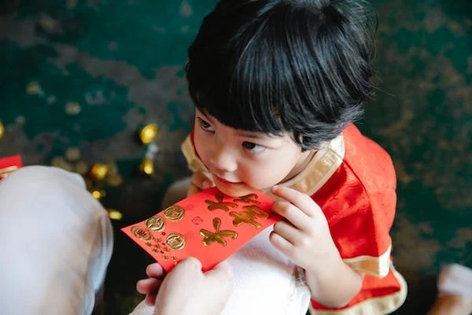
Reading the Book
Notes:
Refer to Lesson Plan, Read the book, pages 3-4
Show the cover of the book and read the title, author, illustrator, and publisher. (For younger students explain what these are.)
Ask students to think about the title. What do they think the book will be about? What gives them clues? What does the title mean?
As we read, really look at and appreciate the illustrations. Imagine this story without the illustrations. Read a few pages without showing the pictures and then show them.
How does seeing the pictures effect the understanding of the story? There are important clues about the main character’s authentic self revealed in the illustrations. (Note: girl in the mirror, significance of flowers, phoenix, butterfly, etc.)
Look for details of Chinese culture that appear in the illustrations. Discuss the possible meaning and substance of these illustrations.
Read the book slowly to appreciate the descriptive language.

Slide 12
Discussing
The Book
Notes:
Let the discussion of the book be a relationship booster! Look to the discussion questions as ways to begin relationships and learn about each other.
The conversations, connections and insights gained through conversation about the book are crucial to internalizing the skills of the lesson. Don’t rush.
Here is one of the techniques from the Classroom Management Workshop:
In order to promote more students being involved with the discussion, have students turn to a neighbor and discuss a question. Make sure they know how you will call them back to the group. Practice doing a waterfall:
Waterfall (move hands from top to bottom and say shh, shh, shh,)

Slide 13
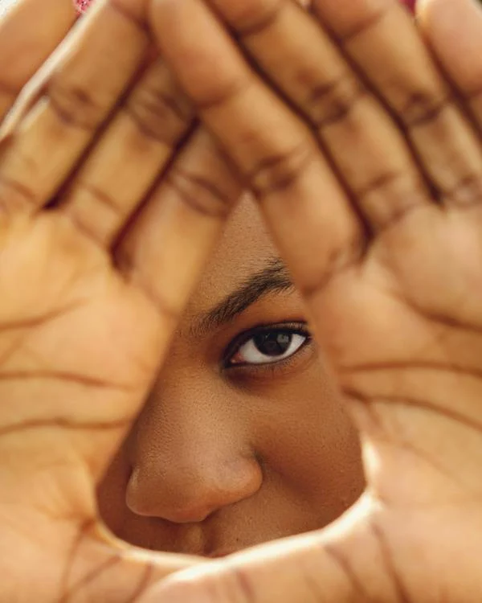
Discussion: Grades K-2
The author writes that the family in the book has “eyes that kiss in the corners”. How are other eyes described in the book?
What words would you use to describe your eyes?
How do eyes show different emotions?
Notes:
Refer to Lesson Plan, Discussion, page 4
Why is the girl looking in the mirror at the beginning?
The author writes that the family in the book has “eyes that kiss in the corners”. How are other eyes described in the book? What words would you use to describe your eyes?
How do eyes show different emotions?
What else makes us each unique and different?
What do you know about families? Who is in your family? (Be aware that families come in many shapes and sizes.)
How does your family show love? What are some of your favorite family moments? What do families give or share with each other?
How do you appreciate or show gratitude for your family?

Slide 14

Discussion: Grades 3-6
Notes:
Refer to Lesson Plan, Discussion, page 4
In the story we learn about the girl’s family and how it relates to her. What would you share about your family and how it makes you, you? What stories have you heard from the elders in the family?
How does your family show gratitude for each other?
Why is it important to show gratitude to others?
What rituals does the author write about in the book?
Do you have any rituals that ground you in your heritage?
What would you share about your culture with the class?
What are some ways to learn about other cultures? (books, documentaries, attend cultural festivals or museums, try new foods, learn new dances, etc.)
Have you ever experienced microaggressions (subtle put-down, back-handed compliment or insensitive joke)?
How did they make you feel?
How does being your authentic self shield from the sting of these comments?
What is good about being part of a diverse community and sharing your authentic self with others?

Slide 15
Activity Options
Notes:
Choose one activity to match your intent/goals for the lesson.
This part of the lesson can be done if you have 45 minutes or longer.
If your discussion takes longer, it is ok to go directly to the Closing.
You can leave the activity for the teacher to, ask to come back for a second visit, or do at recess time.

Slide 16
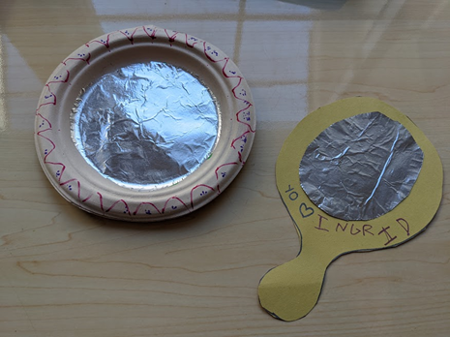
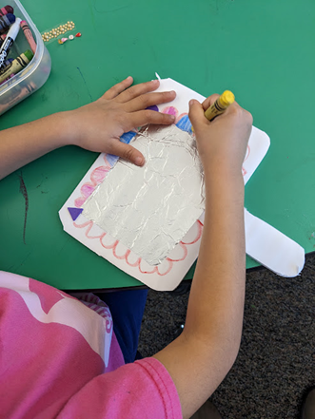
Activity Options: Grades K-6
Mirror, Mirror on the Wall
Positive affirmations are positive thoughts about YOU!
Notes:
Refer to Lesson Plan, Activity Ideas , pages 4-5
Discuss with students what positive affirmations are and give some examples. Brainstorm ideas and make a list. Then have them quietly reflect on what positive things might they say about themselves? Hold up the large or small mirror and say positive affirmations about your self. Give students these sentences to fill in to help them:
I’m an awesome ___________
Most people really like my ____________
I am a good friend because ___________
I am a kind person because _____________
I know I am loved because ____________
I am proud of _____________
Have students glue the reflective paper on to the paper plate or the mirror template. Decorate the edges of the mirror. On the back of the mirror, students can draw something that they like about themselves or something they want to stand out about themselves. As a group, hold up the mirrors and say we are all unique and different. It makes us interesting, authentic, and special human beings.

Slide 17
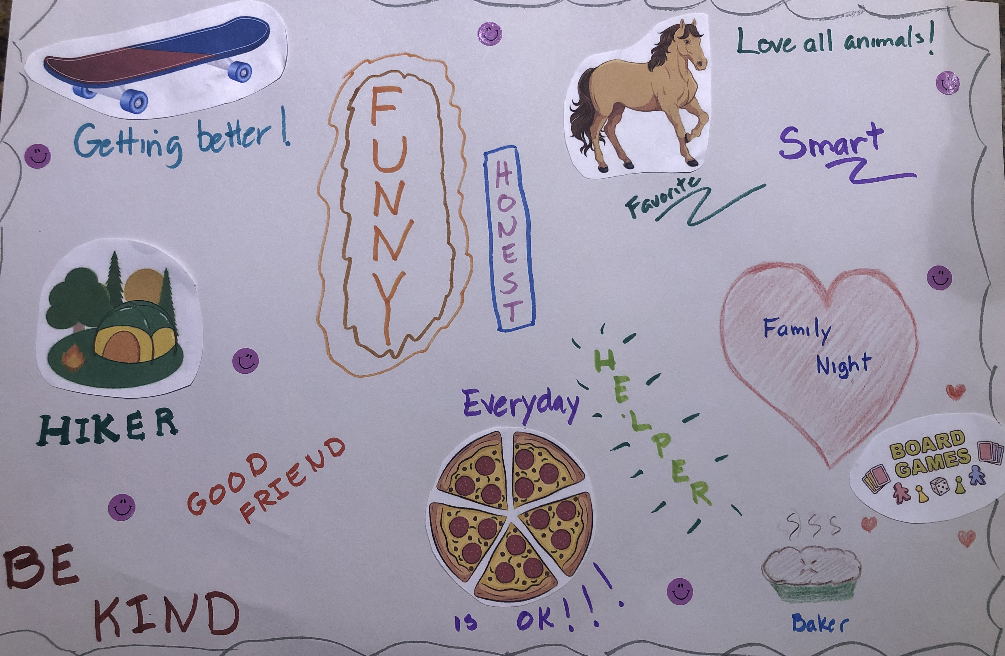
Activity Options: Grades 3-6
Unique Me in a Diverse World
Create an Identity Map that celebrates you!
What makes you unique?
What talents, interests, values, and personal traits contribute to your story?
Notes:
Refer to Lesson Plan, Activity, page 5
Emphasize the importance of appreciating individuality and understanding the positive impact it has on the world. Ask each child to reflect on what makes them unique. Have them close their eyes and think about their authentic selves. What talents, interests, values, and personal traits contribute to their individuality? What is their story?
Ask them to create a self-portrait or a poster using symbols, phrases, words, or images that represent themselves. Each student can explain what they have created and share a few words how this relates to their authentic self.
Explain that this poster represents the diverse contributions of each child, forming a beautiful mosaic of uniqueness.
What do you notice about the diversity and beauty of our collective creations?
How does this poster represent the uniqueness and contributions of each individual?
How does celebrating our authentic selves contribute to a diverse and inclusive world?
How can we appreciate and respect the authentic selves of others?

Slide 18
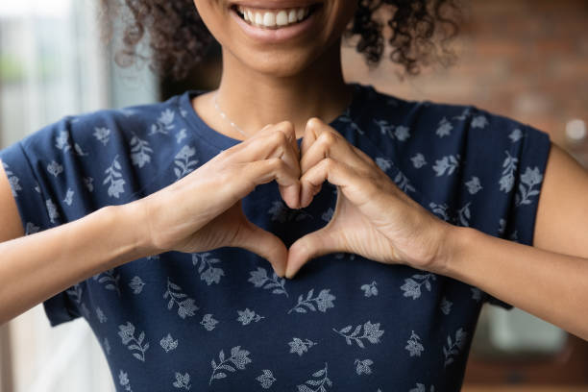
Activity Options: Grades K-6
Gratitude Circle
I am grateful for …
Notes:
Refer to Lesson Plan, Activity Options, pages 5-6
Have the students sit in a circle. Begin by explaining to the children what gratitude means and why it is important to appreciate and express gratitude for the people in their lives. Discuss how expressing gratitude can make both the giver and receiver feel good and strengthen relationships.
Hold the gratitude wand and share something they are grateful for and briefly explain why.
Pass the gratitude wand or ball to someone in the circle and say "I pass the gratitude to ____"
Each student shares what they are grateful for and continues passing the wand to another person. Continue until all students wishing to participate have had a chance to express gratitude.
If time allows, follow up by creating a classroom or school gratitude tree.

Slide 19
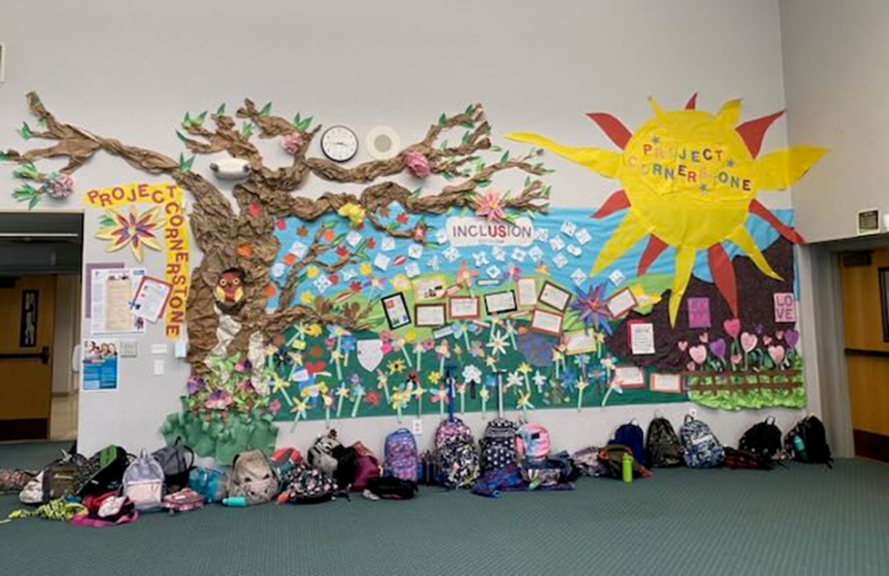
Activity Options: Grades K-6
Gratitude Tree
Notes:
Refer to Lesson Plan, Activity Options, page 6
Prepare the Gratitude Tree base:
Take the large poster paper or cardboard and cut it into the shape of a tree trunk and branches. Do this ahead of time. Attach the tree to a wall.
Cut out multiple leaf shapes from construction paper of various colors. (See leaf handout on the website.)
Discuss who in their lives have made a positive impact, such as family members, friends, teachers, or community helpers.
Encourage the children to think about specific actions or qualities that they appreciate about these individuals. For example: I’m grateful to my grandmother for letting me help bake cookies.
Have the children write or draw the names of the people they are grateful for on the leaves.
They can also write or draw something specific they appreciate about each person on the leaves. Using glue or tape, attach the decorated leaves to the branches of the Gratitude Tree.
Invite students to write in their first language as a way to celebrate their authentic selves.

Slide 20
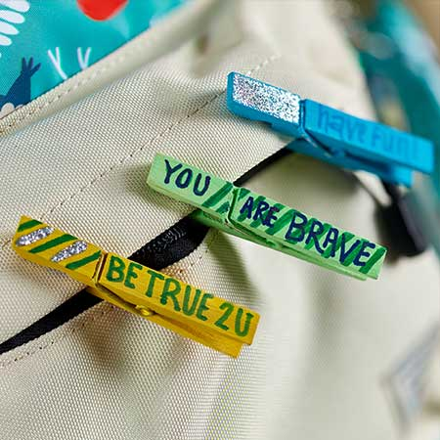
Activity Options: Grades 3-6
Be True and Be Kind Pins
Notes:
FUNvisor Idea
Refer to video:
https://www.crayola.com/crafts/kindness-clothespins-craft/
Be True and Be Kind Clothespins
Materials: paint, brush, glitter pens, permanent markers, clothespins
If you have students paint the clothespins this will be a 2 part activity as they will need to dry. You can also purchase pre-colored clothespins.
Brainstorm phrases that students can write on the clothespin. These phrases should reflect their authentic self. They can wear them on their own backpack.
Students can also make a kindness clothespin to share with a friend or caring adult.

Slide 21
Closing
Notes:
Refer to Lead Materials on website, Champion Year Cheer
Think of how you want to end the lesson. What skill did your lesson focus on? Use the Closing to coach youth on ways to take these skills from the classroom to the playground. One idea is to always end with the cheer as final closing moment:
We’re Cornerstone Kids and we’re here to say
Connect with empathy everyday!
Invite and include others
Listen with your whole heart.
We’re Cornerstone Kids and we’re here to say
Connect with empathy everyday!
Be a world changer.
Keep your cool.
Be true to you.
We’re Cornerstone Kids and we’re here to say
Connect with empathy everyday!

Slide 22
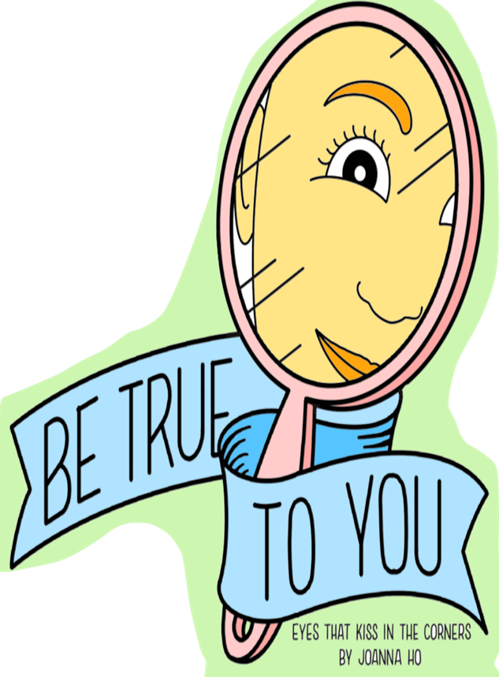
Closing:
  Call to Action: BE TRUE TO YOU AND SHARE YOUR STORY
Notes:
Refer to Lesson Plan, page 6
Have students close their eyes, take a deep breath. Take a moment to think about their authentic selves and what makes them proud of who they are. Using the Share Stories Speech Bubbles handout, have students cut out a speech bubble and attach a craft stick. They can attach two speech bubbles one on either side of the stick if they want to do more than one. Have students select a speech bubble that speaks to them. After it’s completed, hold it up and share with a partner or the class. Take a photo of the class holding up their speech bubbles.
I’m an awesome ___________
My authentic self is ______________
I am a kind friend because ___________
I am unique and beautiful because _____________
I know I am loved because ____________
I am proud of _____________
I would like to share this about my culture ________
This can also be completed verbally if time is short.

Slide 23
School Wide
Extensions

Slide 24
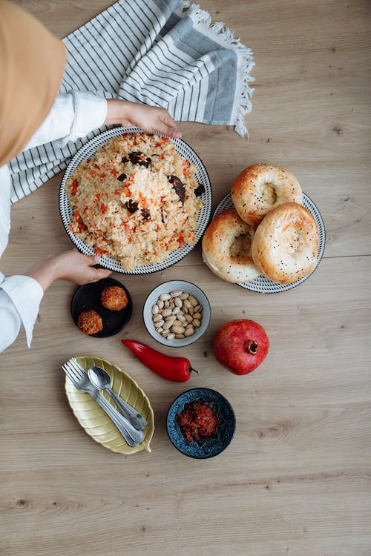
School Wide Extensions:
Multi-Cultural Festival
Set up an art walk.
Ask for families and restaurants to contribute foods that reflect the community.
Encourage all to dress in traditional clothes that represent their culture or heritage.
Set up stations to teach games, dances, or arts from different countries.
Students can be encouraged to do live cultural performances.
Notes:
Refer to Lesson Plan, School Wide Extensions, page 7
Diversity skills help develop a more culturally inclusive lens. This lens may give you a stronger understanding of different languages, cultures, and experiences. It helps you be ready to listen when others stand up and share their authentic self.
Cultural Displays
Learning about diversity helps to create an environment where everyone feels respected and valued. It’s important for students to see themselves represented at school. It also reminds them and others about the richness of culture and different ways to learn from our heritage. By celebrating heritage, people may appreciate each other and develop stronger relationships.
Choose a place to set up displays of various cultures. Ask families in the school to loan the school different items to share in the display. Establish a “loan” procedure where parents allow borrowed cultural artifacts to be displayed for a period of time. This could be a table, book shelf, or other space in a common area of the school. It should be an area that has some monitoring like the office, library, or lab area. Have the families come in and talk about the items they loan to the school at an assembly or flag pole ceremony.

Slide 25
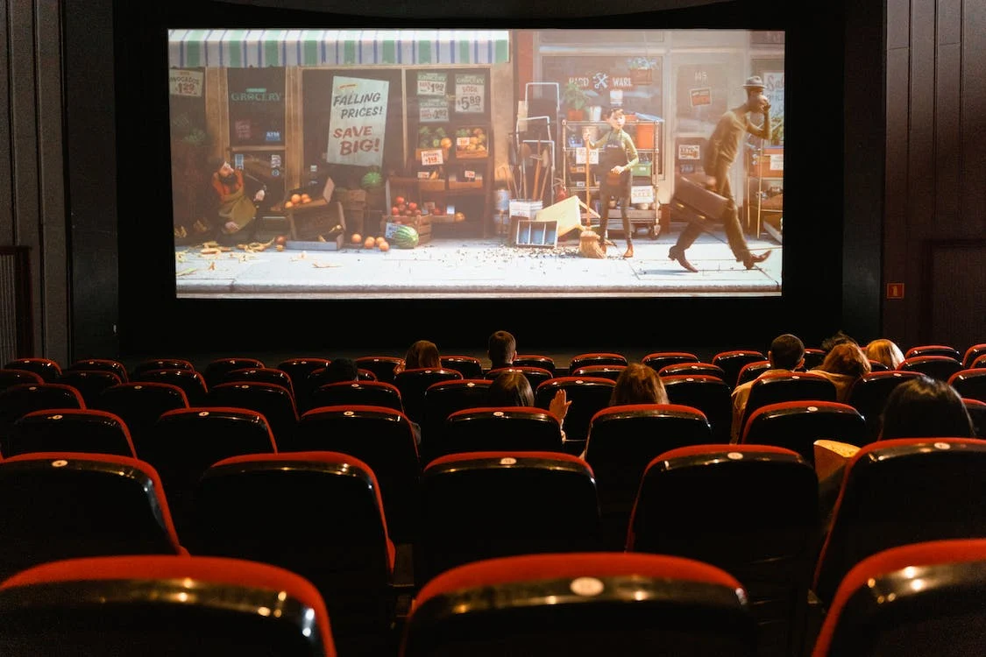
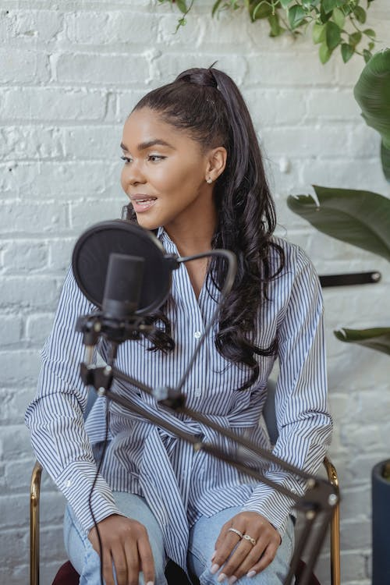
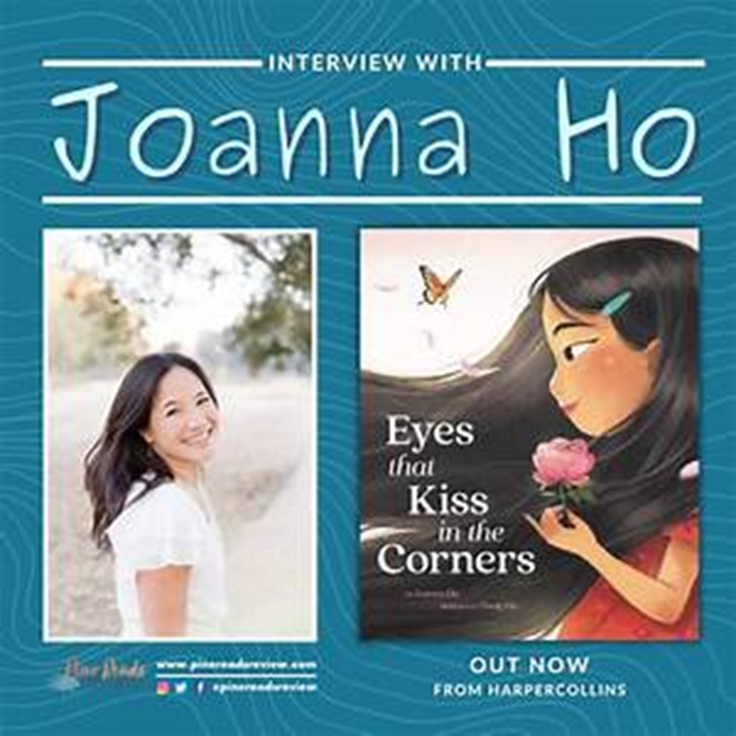
    School Wide Extensions
  Film Festivals
Storytelling Circles
Guest Speakers
Eyes That Kiss in the Corners ©2023PROJECT CORNERSTONE
Notes:
Refer to Lesson Plan, School Wide Extensions, page 7
Inclusive Film Festival
Screen a series of movies or documentaries that highlight diverse cultures and perspectives. This can spark meaningful conversations and promote empathy. Provide families with discussion questions to use at home.
Guest Speaker Series
Invite individuals from different backgrounds, professions, and experiences to speak at school. The sharing of their stories and insights can be empowering. Look for former graduates of the school to return and share their journeys.
Story Telling Circles
Organize storytelling circles where students, parents, staff, and community members can share personal experiences related to their backgrounds, challenges they’ve overcome, or inspiring stories that have shaped their lives. This can be an inter-generational event where elders of the community can share their stories and make history come alive.

Slide 26

Home and School Communication
Newsletter Blurb
Student Stickers
Parent Letter or Email Blurb
Family Movie Night
Be true to you
Notes:
Make the Home-School Connection:
Email Blurb
Give the teacher the email blurb to include in her class email note or make it into the newsletter blurb.
The blurb is a great way to write a short paragraph for the school newsletter or Parent Loop etc.
Parent Letter
Available in English, Spanish, Vietnamese, Russian, Ukrainian and sometimes Mandarin.
Student Stickers
Give to students to stick on their backpack, special note pad, or article of clothing to bring home.
Family Movie Night
Every lesson has a handout to a suggested Family Movie Night.
This is another way to remind parents about the book of the month.
Bulletin Boards and Marques
Ask for volunteers to help post student art or tag lines.

Slide 27
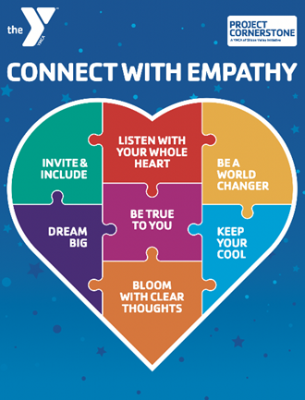
Closing Comments
  Refresh ABC Group Norms
Budget for New Books
Asset Champion Breakfast March 15!
Notes:
Remind your ABC Readers :
Set group norms to create a safe place at trainings.
February is a short month.
Make plans to attend the Asset Champion breakfast.
ABC Lead Support
Share ideas in ABC Leads Facebook group.
Ask volunteers for help with leadership roles and to shadow you.
Talk with PTO/HSC/PTA about budget needs.
Top 3 Action Items for January
Valentines Day provides a heartfelt opportunity to thank teachers. Host a reader/teacher tea.
Think about next year. Start recruiting new leads if needed.
Matching grants for campaign will add towards $1,000 for banner.

