Slide 1
Project Cornerstone
OCTOBER
I Wish You Knew

Slide 2
Mindful Activity
OPTIONAL
Mindful activities can be helpful. I’ll include one option each month and you can decide to use it or skip it depending on what your group needs.
Hum that tune
Ask the students to hum the tune of ‘Twinkle Twinkle Little Star” all together.
Humming can fight stress and bring a sense of calm. The increased oxygenation of the bold causes feelings of relaxation.

Slide 3
Conversation Starter
Beach Ball Toss Icebreaker
Materials: beach ball or other soft ball
Ask students this question: What do you wish grown-ups knew about kids? Pause. Tell students that you will toss the ball to one of them. When you catch it, shout out your idea. Then pass the ball to another student. Continue until everyone has had a chance to answer. You can change the question mid-way through the students, if needed. Some additional questions could be:
What would you do if you won the lottery?
If you were in charge of the school, what would you change?
What advice do you wish someone had given you when you were in kindergarten?
If you had a magic wand, what would you change about the world?

Slide 4
Empathy
Focus on these Empathy Skills:
Focus on perspective taking.
Listen actively without judgement.
Be welcoming, accepting, tolerant,
patient, and finally, be brave.

Slide 5
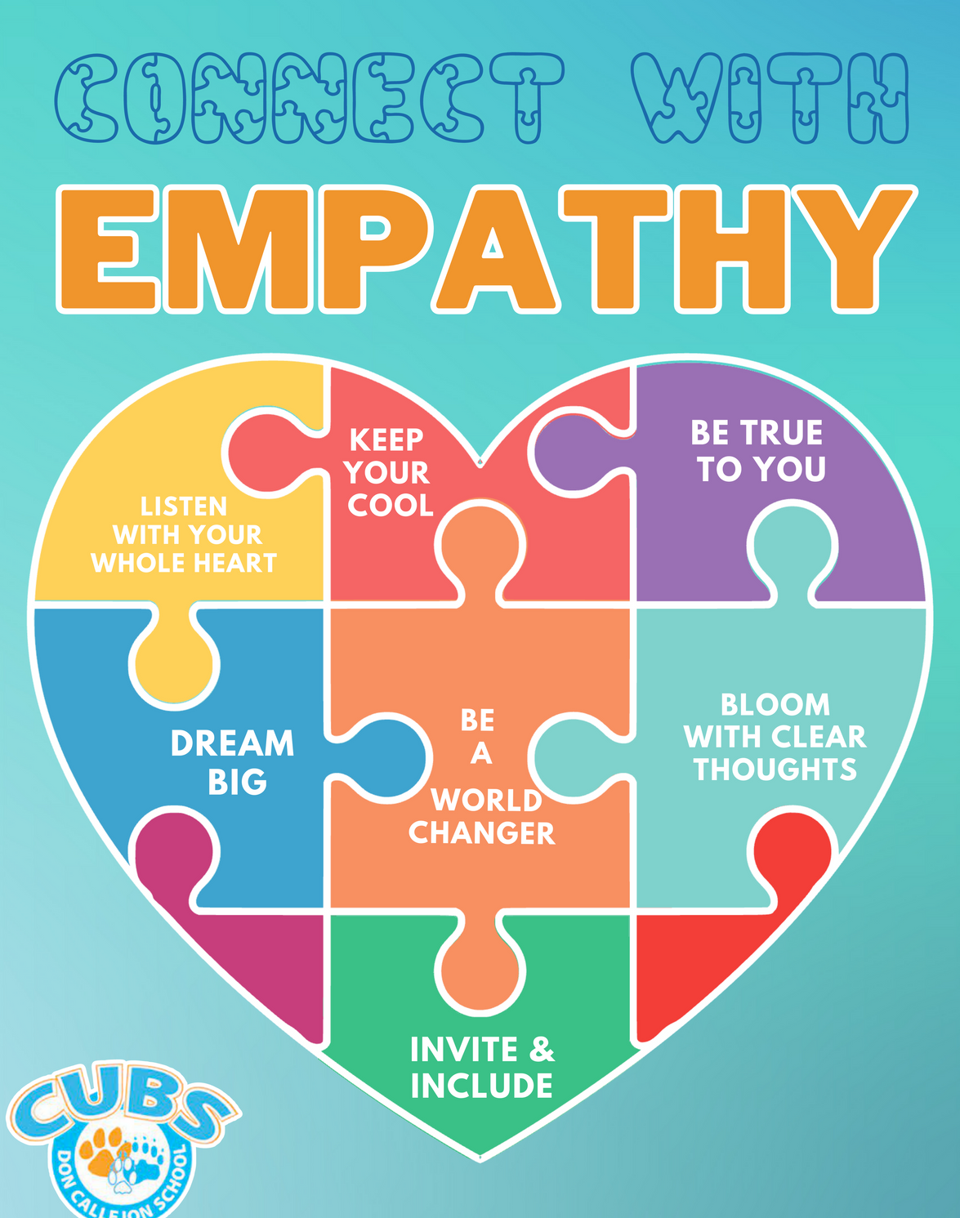
Key Phrase
Develop and practice empathy skills, such as active listening, perspective-taking, and compassion.
Examine their own biases, assumptions, and prejudices that may hinder their ability to empathize with others.
Promote empathy as a means of resolving conflicts, reducing stress, and building stronger connections with others.
Identify caring adults and become aware of support systems available to advocate for them.

Slide 6
Book
Show the pictures on the book without reading the story and ask the students to guess what is happening on the story
Estrella misses her dad when he has to leave because he was not born in this country. She feels alone and wishes she could share her angst with someone. Other students and staff at her school also have worries. Because Estrella opens up about her situation, other students and adults feel comfortable to share their stories under the branches of the oak tree where compassion and empathy grow. This old oak tree represents a caring community and demonstrates that “no one is alone if others are willing to listen.”

Slide 7
Good to know
Key ideas are respect, empathy for others, active listening, examining biases, and perspective-taking. The power of connection and empathy helps students improve their mental health by learning to understand underlying issues in a person’s life. Active listening skills allow the students to:
Better understand the situation
Improve retention of information
Enhance engagement
Refine communication skills
The use of active listening allows students to gain insight into the speaker’s experience. Thus, perspective-taking builds empathy.

Slide 8
Discussion Questions
K-2
3-5
Why is Estrella sad? How do you know she is sad?
Can you always know how someone is feeling by just looking at them? What can you ask someone to find out how they are feeling?
Estrella misses her father and wished he knew things. What would you wish to tell a special person in your life?
Why does Estrella “sit alone at lunch and cry over things”?
What happens to make her feel better?
What would you share in a sharing circle?
What are some signs of nature in the book?
How does being outside in nature help your mindset?
Who are the caring adults in the book? Who are your caring adults at school and at home?
What does the title of the book, I Wish You Knew, mean to you?
How does Estrella’s sense of loss over her father affect her?
What are some of the things students in her class wished others knew?
Discuss the influence of nature on Estrella, her dad, and the teacher.
What is the power of the sharing circle?
What things do you wish adults knew about you?
Look at the illustrations in the book. Can you tell how someone is feeling? Why are the illustrations drawn like that? What point is the author and illustrator making?
Have you ever made an assumption about someone? What happened?
How can we stop making assumptions? (Stop, THINK, and Understand why they might be acting that way.)
What can you say or do to be thoughtful and kind to others?

Slide 9
Activity
WALK IN MY SHOES
1-3
Make a copy of different types of shoes (I will left some in the PC bin) and have the students discuss what it means to “walk in someone else’s shoes” Ask them to describe how someone else might feel if they were in their shoes for a day. Let them color one page. Write some prompts for words or phrases on the whiteboard and help them include one on their shoes.
4-5
Have the students fill out the page and color their shoe in a way that will reflect on their style and personality.
Use the time to talk about the meaning behind “walk in someone else’s shoes”. How does your point of view affect the way you think about and feel in different situations?

Slide 10
Closing
ASK
Why is it important to try to understand how other people feel?
Have you ever change your feelings toward someone after you understood their perspective?
Why do you think people see the same situations differently?

Slide 11
Thank you!

