Slide 1
Clovis Keeps His Cool
ABC CHAMPION YEAR LESSON 4 PROJECT CORNERSTONE
Notes:
This presentation is intended for use by ABC Leads who have attended the monthly ABC Lead training.
ABC GPS
Use this to help with planning for your school training. It will help you select the goals and activities for your readers.
Parent Letter or Email Newsletter Blurb
Available to use in emails or newsletter to parents at home.
Yard Duty Tips and Lanyards
Post the yard duty tips. Pass out the lanyard tags to wear.
Staff Letter
Email all school staff about the lesson.

Slide 2
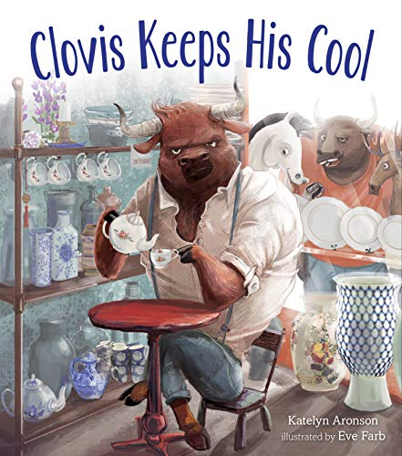
ABC: Champion Year
Key Phrases:
Keep Your Cool
Reconsider, resolve, and offer second chances
Notes:
Refer to Lesson Plan, pages 1-2
This book builds the Developmental Relationships:
Challenge Growth-Expect my Best, Hold me Accountable, Reflect on Failures
Share Power-Respect me, Collaborate
Social and Emotional Learning: Self-Management
(ability to harness one’s emotions, thoughts, and behaviors effectively to achieve goals)
In our lesson today, our goals are:
Students will recognize emotion by looking inside themselves and in others to identify and connect with feelings being expressed.
Students will allow the feelings to stand and move through them in appropriate ways.
Students will learn ways to reconsider, resolve conflict, and offer second chances.
Students will understand the different ways people express their emotions and how to respond to these expressions in an empathetic manner.
Narration of the book:
https://www.youtube.com/watch?v=IqZx_1EVQlg

Slide 3
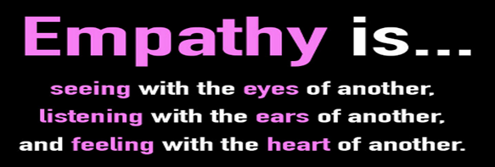
Empathy:
Connect with Empathy
Focus on These Empathy Skills:
Notice and name feelings
Reconsider, resolve conflict, and offer second chances
Respond to the emotions of others with empathy
Notes:
Refer to Lead Guide, Empathy, pages 7-8
Empathy is the ability to understand and share the feelings, perspectives, and experiences of others. It’s important that we guide children in understanding and caring for people who are different from them and who may be facing challenges very different from their own challenges. Empathy builds healthy relationships, promotes social connections, and fosters community.
Ask for examples of what they did as a result of the last book. Did they:
Listen actively with compassion.
Encourage dialogue about racism, discrimination, and prejudice.
Model how to be a world changer.
Understand that other people can have different and equally valid perspectives.
How to help students become Empathy Ambassadors:
Take time to understand the emotions expressed. Respond with understanding and compassion.
Be mindful of your emotions. Let them stand and move through them when appropriate.
Learn ways to reconsider, resolve conflict, and offer second chances.
Accept genuine apologies.

Slide 4
Information for ABC Readers
Notes:
This story begins as the proverbial bull in a china shop. While the origin of the expression is not definitively known, it is believed to have originated in the 19th century. The phrase as we know it today was first seen in political cartoons in the 1800’s. One popular theory is that the phrase was inspired by actual events. The image of a powerful and unwieldy creature in a setting of fragile, breakable objects became a metaphor for someone who moves through life with little regard for the consequences of their actions. Sharing this metaphor with your students will increase their understanding of Clovis’ story about love, respect, and empathy.
Empathy is the ability to understand and share feelings, perspectives, and experiences of others.
When we empathize with others we can stop and think about the situation.
To understand more, we can ask clarifying questions, such as, “Can you help me understand how you see this?”
However, this should be done without telling the person how they should feel or are feeling. It is better to ask, “I am imagining that you feel this way, am I right?”
Empathy allows us to connect with others and plays a crucial role in building and maintaining healthy relationships.

Slide 5

Background Information:
Key Points
Reconsider before responding
Stop and think
Show empathy
Give second chances
Notes:
Refer to Lesson Plan, Key Points, page 2
The author, Katelyn Aronson, writes, “In this story, grace is something of a legacy bestowed on Clovis by a loved one. It isn’t until he embraces that forgiveness for himself that he can extend it to his rivals.” By the end of the story, Clovis demonstrates the strategy of reconsidering before he responds. This strategy is a cognitive process that influences your feelings and how you express them. It helps regulate emotional responses by changing how a person thinks about a behavior or situation before reacting. Learning this skill is key to being able to give second chances to yourself and others.
Here are videos about self-control and self-regulation:
K-2 Self-control https://www.youtube.com/watch?v=esAUQW8w1Ww
3-6 Cookie Monster Practices Self-Regulation https://www.youtube.com/watch?v=j0YDE8_jsHk

Slide 6
Conversation
Starter
Notes:
This lesson has one conversation starter for K-6. Instructions are given on how to break it down for K-2 and 3-6.
The K-2 activity is 2 slides long and the 3-6 is also.
For Kindergarten shorten the story with the red balloon and green balloon. Also, only teach them 1 tool. One tool that is easy is to “smell the flowers and blow out the candles.”

Slide 7
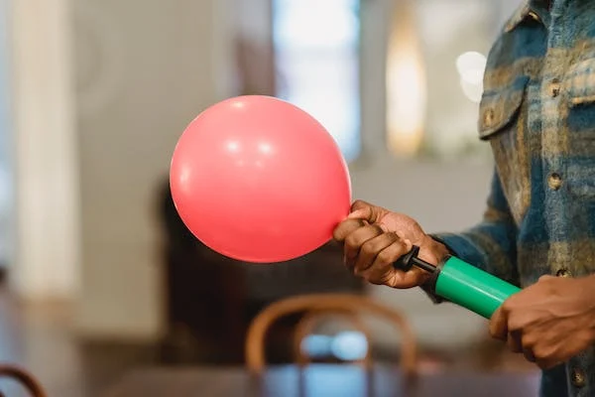
Conversation Starter: Grades K-6
A Day with Red Balloon
Blow up red balloon slowly as you tell the story of a bad day.
What happens if you meet someone who feels like this red balloon?
Notes:
Refer to Lesson Plan, Conversation Starter, pages 2-3
Take a feelings survey. Ask students give a thumbs up or down:
Have you ever been angry?
Does anyone feel angry now? (If yes, have students smell flowers and blow out candles.)
Have you ever had a bad day? How did you feel? (sad, mad, frustrated, teary)
Is anyone having a bad day today?
I’d like you to meet RED. Use a red balloon and inflate it a little at a time as you tell the story of a bad day. This is a story of RED’s day:
We arrived as the bell rang and RED was late to school. (Blow up the balloon.) Ask students to name the emotion that RED felt
At recess, someone cut in line, the whistle blew and RED didn’t get a turn. (Blow up the balloon.) Name the emotion RED felt.
When RED arrived home, they found out that someone let their pet frog out of the box and it was missing. (Blow up the balloon.) Ask students to name the emotion that RED felt.
Ask students, “What will happen if RED keeps getting full?” “How much more can happen?” Walk around and have students lightly touch the balloon to understand the stress.
“What might happen if you encounter someone who feels like RED?” You can either hold up the balloon to block your vision or pop it.

Slide 8
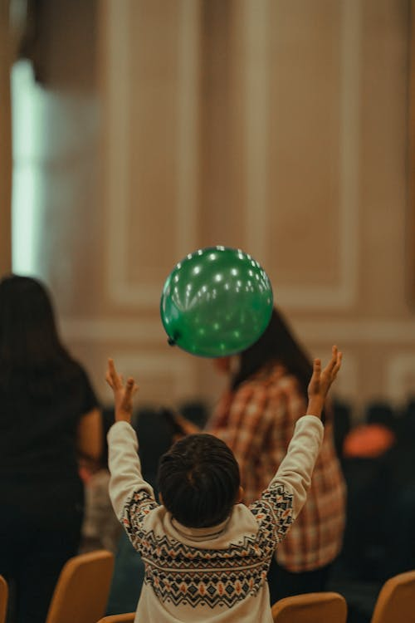
Conversation Starter: Grades K-6
A Day with Green Balloon
Blow up the green balloon slowly as you retell the story.
How does green balloon keep cool?
1. Takes 5 breaths
2. Do belly breathing
3. Smell the flower
4. Takes 5…
5. Finger trace and count
Notes:
Refer to Lesson Plan, Conversation Starter, pages 2-3
Now I want you to meet GREEN. Bring out a green balloon and blow it up and hold it so the air does not escape.
Retell the story, but add ways to accept the feeling and move through it.
For example, say when GREEN arrives late to school, “GREEN was worried they would be in trouble. Their tummy started to feel all rumbly, but then they remembered to (Have students do one of these as you blow up the balloon)”:
take 5 breaths
do belly breathing
smell the flower and blow out the candles
take 5 - count to 5-10 slowly and take deep breaths
trace my hand with a finger moving over each finger while breathing slowly
Each time, as you do some of the calming techniques, let air out of the balloon until is it calm and deflated.
Ask students to discuss what to do when they see another person become RED. How can they show empathy for the person and help them become GREEN?
After reading the book, the “I Get Angry When” handout is a good follow up activity.

Slide 9

Conversation Starter: Grades 3-6
What Other Emotions are Hidden Under Anger?
Angry
Notes:
Refer to Lesson Plan, Conversation Starter, page 3
Tell students you are going to talk about anger. Anger is a big emotion.
Blow up a red balloon a little bit and talk about a time you felt really angry. Ask them to think of a time they felt angry and share with group.
Blow up balloon with each example.
Then just sit quietly and be in the moment for 15-25 seconds. Think about the example.
Show the Emotion Iceberg Handout so only the top part is showing. Ask, “What do you think this is person feeling?”
Icebergs are large pieces of ice found floating in the ocean. What you can see from the surface can be misleading. Most of the iceberg is hidden below the water.
Think about a time you have been angry. What other emotions are hidden under this anger?
Write them on your white board or a piece of paper and show us.
(Go to next slide.)

Slide 10
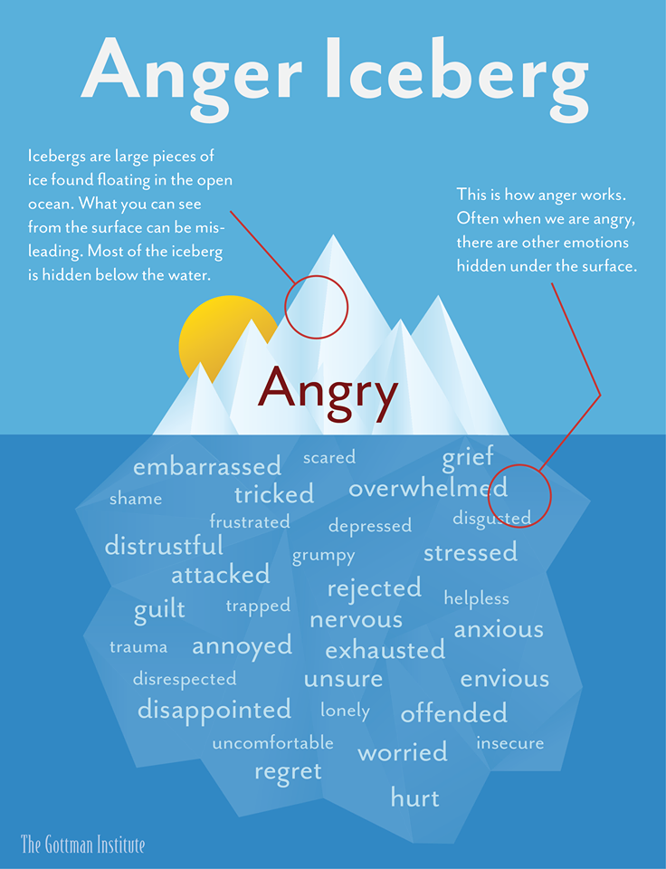
Notes:
Refer to Lesson Plan, Conversation Starter, pages 3
Let’s look and see if we named many of the underlying feelings here. This list is very complete. When people are expressing anger they could be feeling one of these emotions. That is why it is important to remember what we have learned about empty buckets. We need to stop and think about why someone might be angry. Once we realize this, we can control how we respond to them.
Also if you are person experiencing anger, you need to stop and reconsider why you might be feeling this way. Reconsidering is a brain process that influences your feelings and how you express them. When you encounter a stressful situation, here are 3 ways to reconsider:
Talk it out, with yourself! Try to apply a hopeful, “Growth Mindset”- you can change your own attitude and outlook.
Consider other reasons for behaviors or situations.
Make active efforts to improve your own mood.
Give students a moment to think about it. What tools do you think you could use?

Slide 11
Reading
The Book
Notes:
This is a new book to the ABC Program. Read the book to the students and ask the discussion questions. Focus on the concepts of reconsidering and second chances. If time, a video can be shown to extend the lesson.
Reading to Grades 3-6
Show these videos:
Steve Hartman this month is: Self-Improvement
https://www.youtube.com/watch?v=IXrnAZGSaa0
Managing anger facts for kids with quiz https://www.youtube.com/watch?v=TWc_36yRoJU
Pre-recorded Conversation Video by Austin:
https://youtu.be/gEatZm5iHkw
Follow up with discussion and choose one activity:
Mindfully Moving through Feelings
Second Chance Jar or Bag
Reconsidering Role Play
Heart full of Feelings

Slide 12
Introducing and Reading the Book
Talk it out with yourself.
Is your bucket low or full?
Try to apply a growth mindset.
Consider other reasons for behaviors.
Make active efforts to improve your own mood.
Notes:
Refer to Lesson Plan, Read the book, pages 3-4
Ask the students to listen to this story and see what they notice about Clovis’ emotions. Watch what he says and does. Take note of how his anger escalates in the story and then what happens next.
Reconsidering is a cognitive process that influences your feelings and how you express them. When you encounter a stressful situation, here are ways to reconsider:
Talk it out with yourself. Is your bucket low or full? Do you have a lid on your bucket?
Try to apply a growth mindset. You can change your own attitude and outlook.
Consider other reasons for behaviors or situations.
Make active efforts to improve your own mood.
Another way to state reconsidering, is to stop, think, and choose how to react. (Kindergarten to 2nd grade students may understand this better.)
As we read this book, look for ways that Clovis used one of these strategies. Every time you see or hear him reconsider give a thumbs up.

Slide 13
Discussing
The Book
Notes:
The Discussion of the book is a chance to connect. Sharing a story about a time when you were angry or offered a second chance builds relationships with your class.
Remember to use the techniques from the Classroom Management presentation. Use a pause after asking a question for students who require more time to process their answer. Give chances for others to answer. “Charlie, I see you are ready with an answer, but I’m looking to give someone else a chance. Use discussion time to reflect on new tools and perceptions gained from the story.

Slide 14
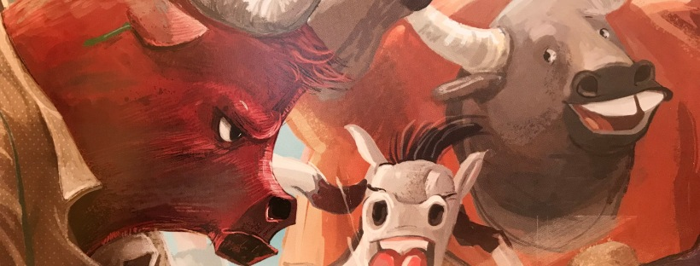
Discussion: Grades K-2
Notes:
Refer to Lesson Plan, Discussion, page 4
Who was a caring adult in Clovis’ life?
What did this caring adult teach him?
Who was teasing Clovis? What happened?
How do you feel when you get angry? What signs does your body show?
After Clovis lost his cool, what did he do?
What does Clovis do to keep his cool?
We call this reconsidering or stop, think, and chose to react. When have you tried this? Tell us about it.
How do the football players react after having tea with Clovis?
What tools do you use to help when you experience strong feelings? (Show Positive Mood Changes Handout)
Do you remember how to make a genuine apology? (Review the steps here.)

Slide 15
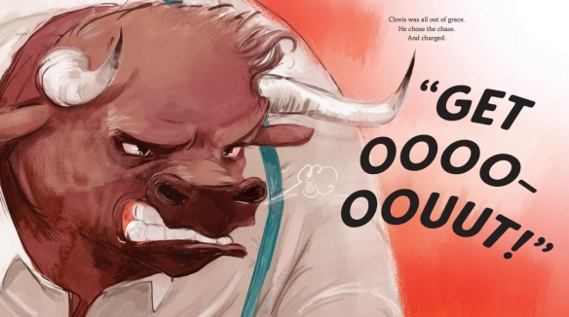
Discussion: Grades 3-6
Notes:
Refer to Lesson Plan, Discussion, page 4
What feelings were under the anger iceberg for Clovis?
What technique did Clovis use to control his reaction when he was being teased?
Have you ever used the reconsidering tools to control your own reaction to strong emotions?
When Clovis could no longer control his emotions, what stopped him from harming the football players?
How does Clovis forgive himself?
How did forgiveness and second chances change the relationship between Clovis and the football players?
Have you ever found yourself in a similar situation as Clovis? What happened?
Now that you have heard about reconsidering and second chances….how could you apply them to your life?
When others are showing their emotions, how can you respond with empathy? What can you say or do to acknowledge their feelings?

Slide 16
Activity Ideas
Notes:
Choose one activity to match your intent/goals for the lesson.
This part of the lesson can be done if you have 45 minutes to do the lesson.
If your discussion takes longer, it is ok to go directly to the Closing.
You can leave the activity for the teacher to do at a later time or ask to come back for a second visit.

Slide 17
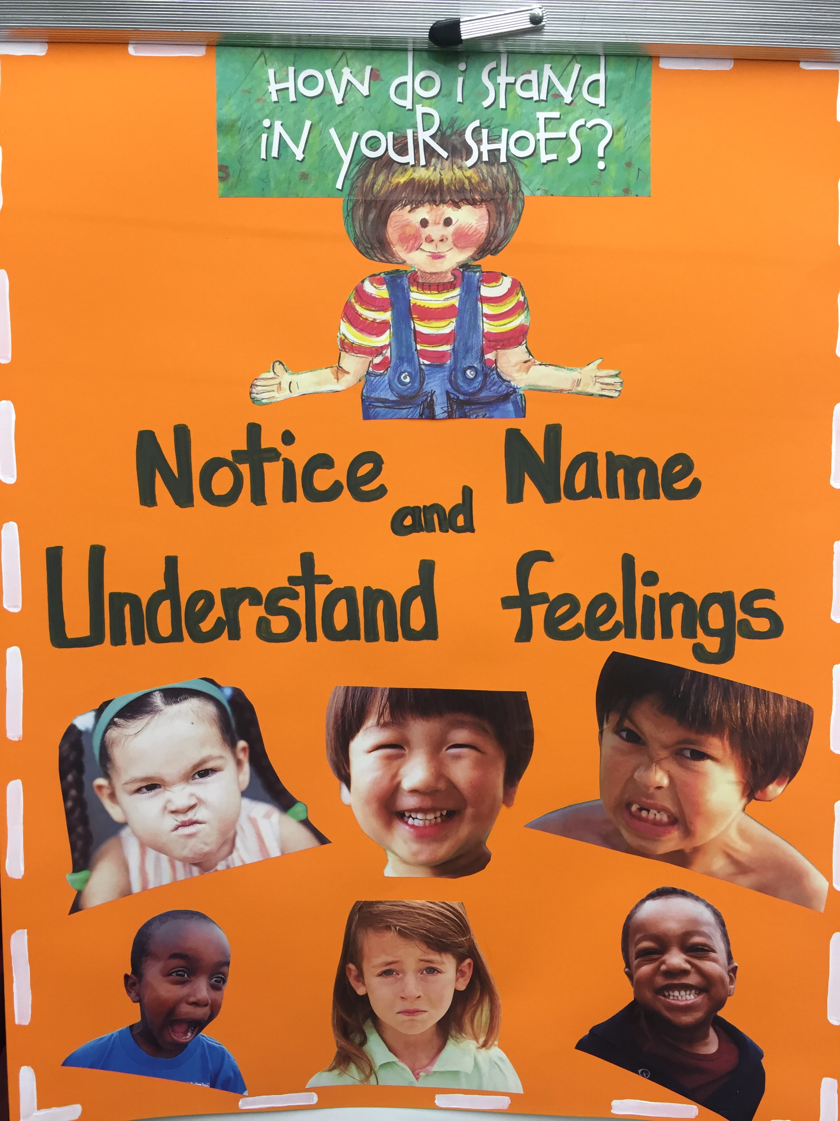
Activity Ideas: Grades K-6
Mindfully Moving Through Feelings
Emotions are messengers that give us feedback on something we need.
Notes:
Refer to Lesson Plan, Activity Ideas , pages 4-5
Think about the following questions:
What are some emotions you have felt recently?
How do you react when you experience strong emotions?
Can you think of a time when you felt overwhelmed by your emotions? How did you handle it?
We will be doing an activity to explore different emotions mindfully.
Write down different emotions on separate sheets of paper.
Have the students choose one emotion at a time. Ask the children to sit comfortably, close their eyes, and take a few deep breaths.
Invite students to recall a time when they experienced that specific emotion. Encourage them to notice how it felt.
After a moment of reflection, ask them to draw or write on their paper what comes to their mind when they think about that emotion. Depict that emotion through colors, shapes, words, or symbols.Repeat with other emotions as time allows.
Allow students to explain the meaning behind their drawing, any mental or physical sensations associated with the emotion, and any insight gained from the activity. As part of the debrief, discuss ways to recognize, understand, and show care for others.

Slide 18
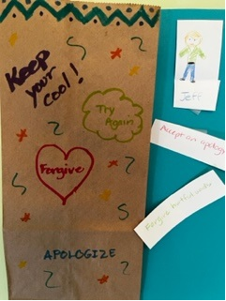
Activity Idea: Grades K-6
Second Chance Jar or Bag
Decorate a bag or jar with ways to keep cool.
Add Second Chance phrases:
Accept an Apology
Listen and Understand
Forgive Hurtful Words
Notes:
Refer to Lesson Plan, Activity, page 5
Explain what a second chance means. Emphasize that it’s about giving someone another opportunity, even if they made a mistake or behaved in a way that was hurtful to others.
Provide examples of situations where someone might deserve a second chance such as when a friend says something hurtful, when someone forgets to include others in a game, or when a sibling accidentally breaks a toy.
Have students decorate a jar, paper bag, or small container with stickers, markers, cool down phrases etc.
Encourage the children to think about people in their lives who might deserve a second chance. They can draw the person, write down the names of those individuals on the slips of paper, or write a brief note about why they want to give that person a second chance.
Fold the papers and put them in the jar or bag.
Explain the Second Chance Jar/Bag will serve as a visual reminder to be open to giving others another opportunity.
Conclude the activity by having a discussion about how second chances can positively impact relationships, promote forgiveness, and create a more understanding and caring school.

Slide 19
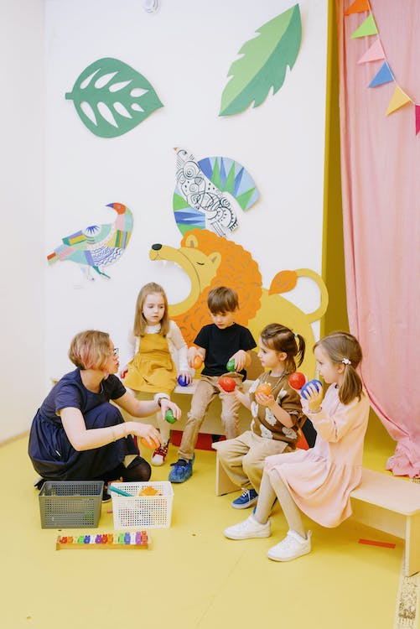
Activity Ideas: Grades K-2
Calming Counting Bag
Stop
Think
Reconsider as you count
Check in with your body
Feel calmer
Notes:
Refer to Lesson Plan, Activity Options, page 5
Have students write “Calming Counting Bag” on the bag. Then have them draw and write ways to stay calm to decorate their bag. (Prewrite the titles for kindergarteners.)
Give each student 10 cotton balls or pom poms to use.
Role play how to use the Calming Counting Bag.
Give them a scenario from the Conversation Starter or make up a new one.
Walk them through these steps:
Stop (think quietly how they would feel in that scenario.)
Think (name their feeling.)
Reconsider as they count each cotton ball with slow breaths.
Check in with your body After 10, ask if they feel calm.
Feel calmer? If not, check body reactions, and recount slowly.

Slide 20

Activity Ideas: Grades 3-6
Reconsidering Role Play
Tools to regulate emotions:
Recognize anger triggers
Stop and take 5
Say, “I need a minute…”
Wave anger away
Use visualization
Walk away
Take deep breaths
Count down... SLOWLY
Get active!
Talk it out with olive branch phrases
Notes:
Refer to Lesson Plan, Activity Options, page 6
In a large area divide the class in half. Have students stand facing each other with about 4 feet between lines.
Tell students we are going to practice ways to reconsider our behavior when faced with difficult emotional situations. Enforce a “no touching rule” to keep everyone safe.
Ask students in Line A to take the role of the instigator. The students in Line B will take the role of the target.
Read an Activity Prompt from the lesson plan.
Invite students in Line B to act out their first, impulsive reaction.
Pause the activity and ask students to return to their lines.
Reconsider This! Lines A and B now have the chance to reconsider their actions.
Give students a moment to think about it. Then, ask Lines A and B to re-play the action, after reconsidering their options, and use one of the above techniques.
When finished, ask students to return to their pre-activity seating area. Many may have experienced unexpected consequences of reconsidering their impulsive, first reaction.
Have one or two pairs share out their experience with the group.

Slide 21
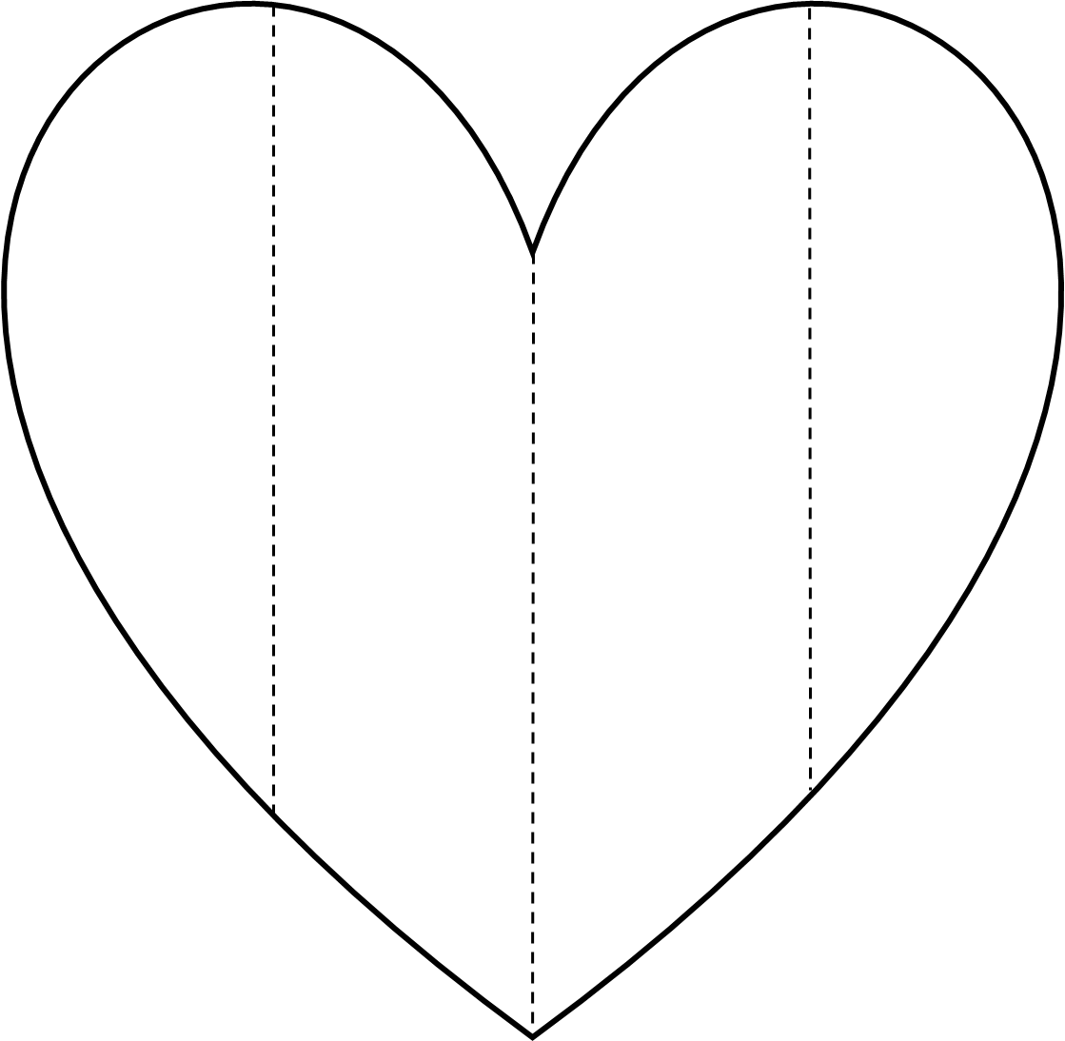
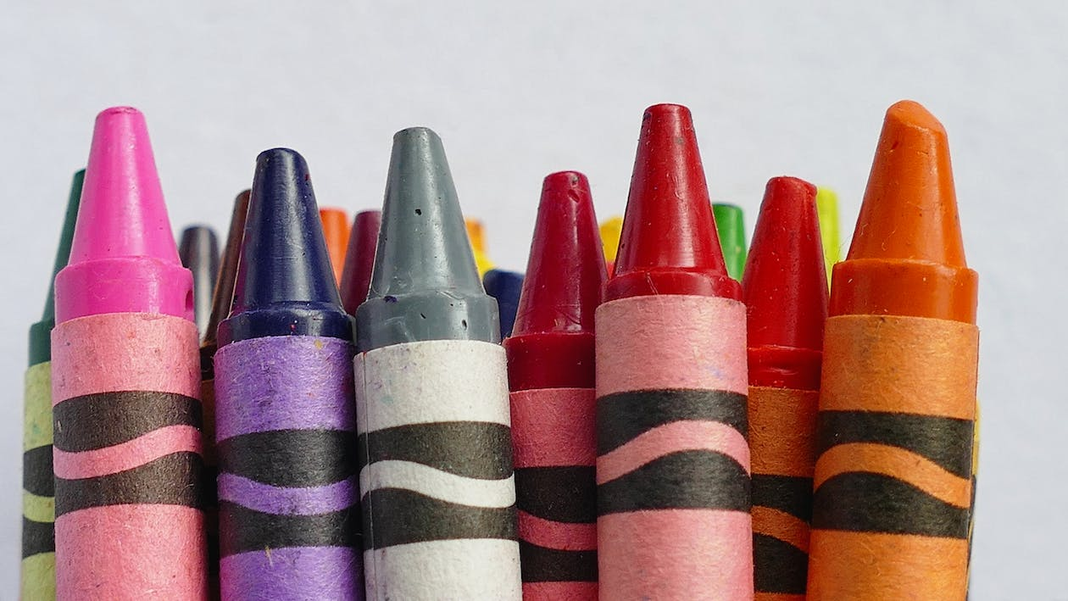
Activity Ideas: Grades K-6
Heart Full of Feelings
Angry
Notes:
Refer to Lesson Plan, Activity Options, page 6
Do a picture walk of the book. Have students look at the body language and facial expressions and colors used for the illustrations.
What clues do they see that helps them connect with the emotions expressed in the story?
Write down the feeling words.
Show students the handout. Discuss how some feelings are associated with some colors. From a box of crayons, hold up a crayon and ask what feelings it makes them think of. (There are no correct or wrong answers).
Have students decorate their heart with the emotions they are feeling that day. Each heart will look different.
Each column is a place to write the feeling word. Encourage students to use block letters and different graphics that go with the feeling.
(Older students can draw their own hearts, write words decoratively, and cut out on plain construction paper instead of using the handout.)
Pre-recorded video:
https://youtu.be/gEatZm5iHkw

Slide 22
Closing
Notes:
Refer to Lead Materials on website, Champion Year Cheer
Think of how you want to end the lesson. What skill did your lesson focus on? Taking the skills and concepts of the ABC book and discussion and putting them to action is a big step. Use the Closing to coach youth on ways to take these skills from the classroom to the playground. One idea is to always end with the cheer as final closing moment:
We’re Cornerstone Kids and we’re here to say
Connect with empathy everyday!
Invite and include others
Listen with your whole heart.
We’re Cornerstone Kids and we’re here to say
Connect with empathy everyday!
Be a world changer.
Keep your cool.
We’re Cornerstone Kids and we’re here to say
Connect with empathy everyday!

Slide 23
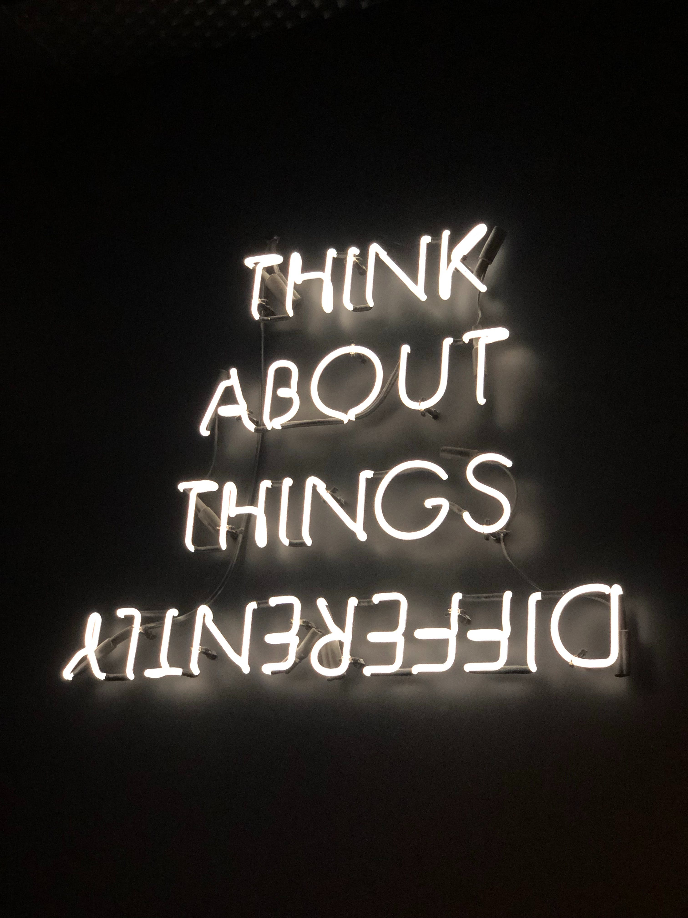
Closing:
Reconsider
Stop and Think
Choose a Tool
Show Empathy
Make a Genuine Apology
Give a Second Chance
  Call to Action: How will you reconsider and give second chances?
Notes:
Refer to Lesson Plan, page 7
This month ask students to practice reconsidering before acting or forgiving and giving second chances as a way to experience emotions and move through them. Taking this skill from the classroom to the playground is a big step.
Materials: print out the handout, Positive Mood Changes or Olive Branch Phrases handout
Choose one of the topics below to focus on. Ask everyone to close their eyes. Have them think of ways that Clovis reconsidered his feelings into calmer controlled feelings.
Choose one reconsidering tool from Positive Mood Changes handout to help you stop, think, and react in stressful situations.
Practice making a genuine apology to offer forgiveness and second chances to reconnect with a new person and build a positive relationship.
Use olive branch phrases to diffuse a possible social conflict.
Have students turn to a partner and share what specific tool they plan to practice on. If you have time you can call out some ideas and have students raise their hands if that is their plan of action.

Slide 24
School Wide
Extensions

Slide 25
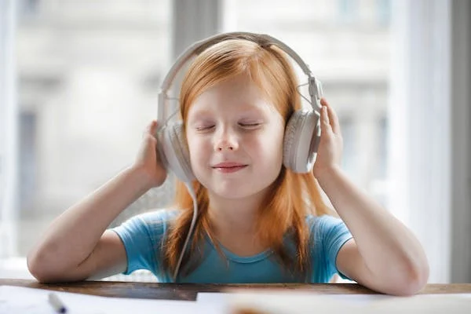
School Wide Extensions:
Student Council Management Areas
Cool Down Spots
Peace Stations
Conflict Managers
These spaces help students develop essential self-regulation skills and normalize managing emotions in a healthy way.
Notes:
Refer to Lesson Plan, School Wide Extensions, page 7
Involve students in designing and designating Cool Down Spots. Assign student peace monitors or conflict managers to check in with students and offer help. Some things to include are mind jars, stuffed animals, scented markers, puzzles, etc.
Student Conflict Management Areas (Peace Stations)
Set up areas where students involved in a conflict can go to use peaceful resolution skills to deal with their conflict. Student conflict managers can assist at Peace Stations. This can be an area on the playground.
If students are not calm, redirect them to a Cool Down Spot.
The most important contributions the kids make on the play yard are as positive role models and good listeners. They can give positive tickets when they see UPstanders in action
When they see peers in need, they can approach the kids with offers of support.
Review the conflict manager script on the website.
View this video:
https://www.edutopia.org/article/incorporating-calming-corner-station-rotation?utm_content=linkpos1&utm_campaign=weekly-2023-11-15&utm_medium=email&utm_source=edu-newsletter

Slide 26
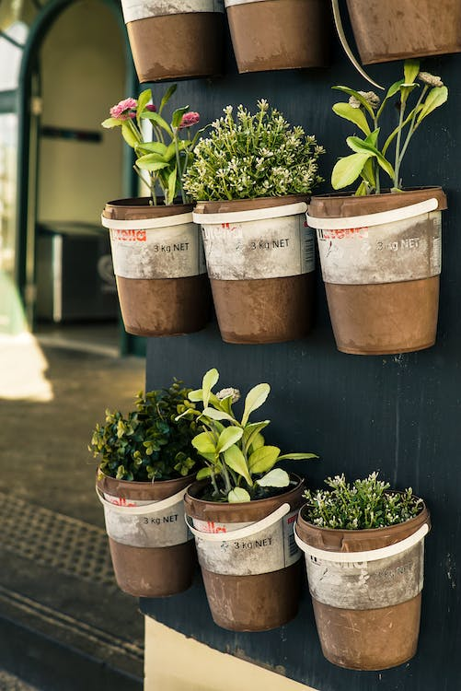
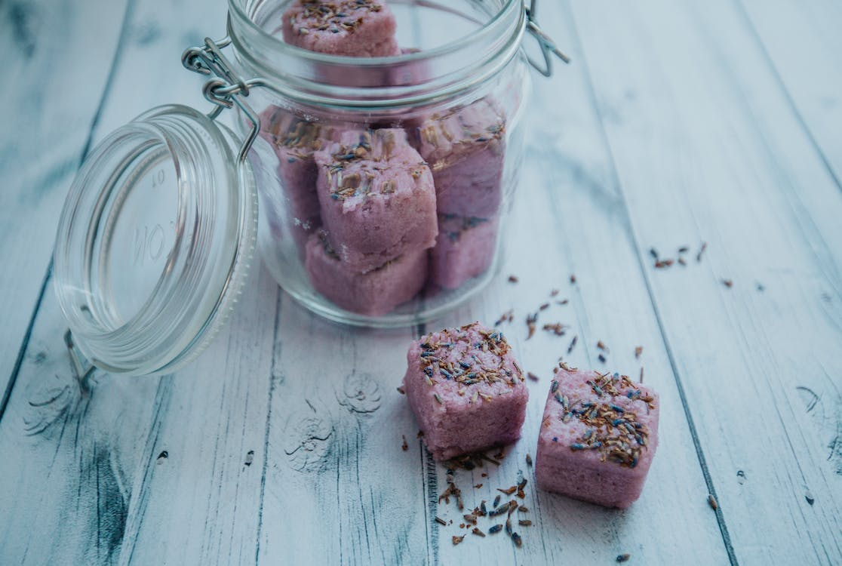
    School Wide Extensions
    Plant a Social Emotional Garden
  Plant herbs and lavender.
Make sachets or bath scents.
Clovis Keeps His Cool ©2023PROJECT CORNERSTONE
Notes:
Refer to Lesson Plan, School Wide Extensions, page 8
Plant a Social Emotional Garden
Social and emotional herb gardens offer students a sensory learning experience and chance to explore feelings. There are countless benefits to gardening with children, including spending time in nature, experiencing life cycles in real time, and improving attention spans.
Select strong smelling herbs like chamomile, lavender, mint, rosemary, lemon balm, and sage.
Designate an area for students to plant the herbs. Encourage students to reflect on the planting experience and note how interacting with the herbs impacts their energy.
Because it will be some time before herbs can be harvested, obtain dried versions of the same plants.
Cut cheese cloth or fabric into 3-4 inch squares. Have students put their selected dried herbs into the square, bring corners together and tie with ribbon to create a sachet.
Students can write about their special blends, draw pictures of the herbs they chose, and record how the scents of the herbs affected their emotions.

Slide 27

Home and School Communication
Newsletter Blurb
Student Stickers
Parent Letter or Email Blurb
Family Movie Night
Keep your cool
Notes:
Make the Home-School Connection:
Email Blurb
Give the teacher the email blurb to include in her class email note or make it into the newsletter blurb.
The blurb is a great way to write a short paragraph for the school newsletter or Parent Loop etc.
Parent Letter
Available in English, Spanish, Vietnamese, Russian, Ukrainian and sometimes Mandarin.
Student Stickers
Give to students to stick on their backpack, special note pad, or article of clothing to bring home.
Family Movie Night
Every lesson has a handout to a suggested Family Movie Night.
This is another way to remind parents about the book of the month.
Bulletin Boards and Marques
Ask for volunteers to help post student art or tag lines.

Slide 28
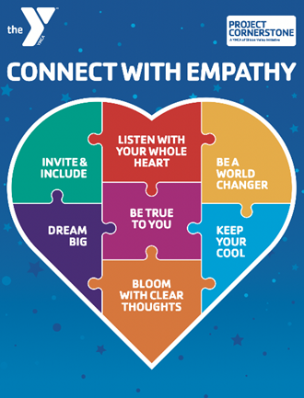
Closing Comments
  Reconnect with Volunteers
Plan out Campaign
Connect with staff
Notes:
Remind your ABC Readers of:
Refresh everyone with positive outreach to all volunteers to confirm their involvement.
Start the new year by setting calendar for classroom reading for the year.
ABC Lead Support
Attend or watch trainings
Attend coffee collaborations for in-person connection.
Plan out annual campaign events.
Ask volunteers for help with leadership roles and to shadow you.
Top 3 Action Items for January
Reconnect and communicate with each volunteer.
Have a new year meet and greet to build community.
Ask for assistance with campaign.

