Slide 1
I Wish You Knew
Ojalá Supieras
ABC CHAMPION YEAR LESSON 2 PROJECT CORNERSTONE
Notes:
ABC Lesson and Los Dichos Lesson
This lesson is for both programs. The books and all materials are available in English and Spanish. If you have both programs at your school we suggest working together as a way to model building community.
ABC GPS
Use this to help with planning for your school training. It will help you select the goals and activities for your readers.
Parent Letter or Email Newsletter Blurb
Available to use in emails or newsletter to parents at home.
Yard Duty Tips and Lanyards
Post the yard duty tips. Pass out the lanyard tags to wear.
Staff Letter
Available to print or email all school staff about the lesson.

Slide 2
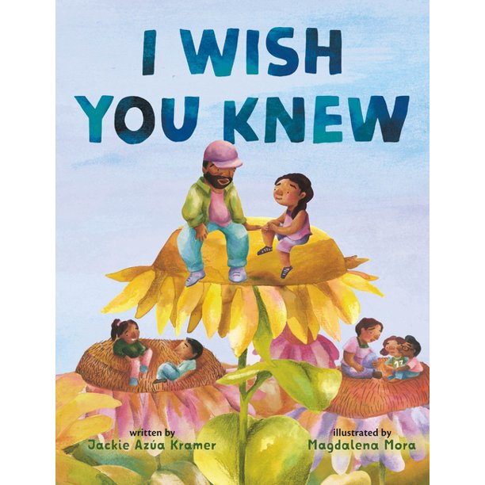

ABC/Los Dichos: Champion
Key Phrases:
Listen with Your Whole Heart
Perspective Taking
Notes:
Refer to Lesson Plan, pages 1-2
This book builds the developmental relationships:
Express Care - Listen, Believe in Me, Encourage
Provide Support - Navigate, Empower, Advocate
Social and Emotional Learning: Social Awareness (Tolerance, Acceptance, Belonging, and Safety)
This is the ability to understand the perspectives of others and also empathize with others.
In our lesson today, our goals are:
Students will develop and practice empathy skills, such as active listening, perspective-taking, and compassion.
Students will examine their own biases, assumptions, and prejudices that may hinder their ability to empathize with others.
Students will promote empathy as a means of resolving conflicts, reducing stress, and building stronger connections with others.
Students will identify caring adults and become aware of support systems available to advocate for them.
Narration of the book:
English Readaloud Video
Spanish Readaloud Video

Slide 3
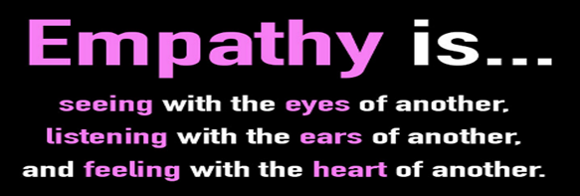
Empathy:
Connect with Empathy
Focus on These Empathy Skills:
Focus on perspective taking.
Listen actively without judgement.
Be welcoming, accepting, tolerant, patient, and finally, be brave.
Notes:
Refer to Lead Guide, Empathy, pages 7-8
Empathy is the ability to understand and share the feelings, perspectives, and experiences of others. It’s important that we guide children in understanding and caring for people who are different from them and who may be facing challenges very different from their own challenges.
Ask for examples of what they did as a result of the last book. Did they:
Get to know people before making judgements?
Intentionally invite or include new people?
Look for common interests in those they met?
Spend time talking and doing things together?
Have lunch with someone new?
How to help students become Empathy Ambassadors:
Identify caring adults who can advocate for them.
Examine your own biases and model how to do this.
Promote empathy as a way to build deeper relationships.

Slide 4
Information for ABC Readers
Notes:
In 2016, educator Kyle Schwartz wrote a book called I Wish My Teacher Knew: How One Question Can Change Everything For Our Kids, based on a getting to know you class exercise where she asked her third graders to write something they wanted her to know about them. She received the usual, adorable responses like, “I love my family” and “I love animals”, and she also received deeper feedback that gave her insight into the children in her care: “my mom and dad are divorced”; “I live in a shelter”; “my mom might get diagnosed with cancer this year”. Kids are dealing with a lot; we need to be better at listening.
This month, we explore the key ideas of respect, empathy for others, active listening, examining biases, and perspective-taking. The power of connection and empathy helps students improve their mental health by learning to understand underlying issues in a person’s life Be aware that this book may bring up sensitive information. It is suggested that you be sure to remind volunteers about confidentiality and not to share anything with friends or parents. They should refer all questions back to the teacher.

Slide 5

ABC Readers:
Key Ideas
Active listening skills allow the students to:
Better understand the situation
Improve retention of information
Enhance engagement
Refine communication skills
Notes:
Refer to Lesson Plan, Key Ideas, page 2
The use of active listening allows students to gain insight into the speaker’s experience. Thus, perspective-taking builds empathy.
As you discuss the key points, sensitive topics may be introduced by the students. Remember that as a caring adult your superpower is to listen. Be an active listener, encourage students to express themselves without interrupting or judging. Use age-appropriate language in response and validate their feelings that it is normal to feel scared, sad, angry, or confused sometimes. Most importantly, be honest about your own feelings. This will help children understand that it’s okay to feel vulnerable and that they are not alone.
It is important that volunteers understand that they will not be able to resolve some of the deeper issues students are experiencing. Realize that being heard will help students process the situation. If you hear concerning information about the safety or welfare of a student, be sure to report this to the teacher, so that resources can be provided. Art of Listening Video:
https://www.youtube.com/watch?v=qpnNsSyDw-g

Slide 6
Conversation
Starter
Notes:
Continue to build a relationship with the students.
Identify yourself as someone youth can count on.
Offer to partner a new volunteer with a veteran volunteer.
Learning students’ names is key to building a relationship.
Ask them their names.
Make sure they are wearing nametags every time you read.
Go over the ABC Rules or classroom rules.
Post the ABC Rules Sign in a designated area.
Make sure to discuss the “no name” rule.
Start and/or end your lesson with a cheer, song, or attention getter.

Slide 7
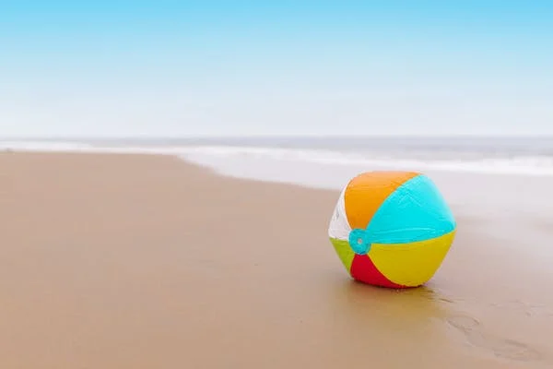
Conversation Starter: All Grades
Ask students: What do you wish grown ups knew about kids?
Notes:
Refer to Lesson Plan, Conversation Starter, page 2
Beach Ball Toss Icebreaker Materials: beach ball or other soft ball
Ask students this question: What do you wish grown-ups knew about kids? Pause. Tell students that you will toss the ball to one of them. When you catch it, shout out your idea. Then pass the ball to another student. Continue until everyone has had a chance to answer. You can change the question mid-way through the students, if needed.
Some additional questions could be:
What would you do if you won the lottery?
If you were in charge of the school, what would you change?
What advice do you wish someone had given you when you were in kindergarten?
If you had a magic wand, what would you change about the world?

Slide 8

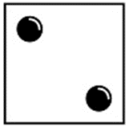
Conversation Starter:Grades 3-6
D-icebreakers
Which of your personality traits do you admire the most?
What is the most difficult time you have had?
Notes:
Refer to Lesson Plan, Conversation Starter, page 3
D-Icebreakers
Materials: D-Icebreaker handout for each group, 10 dice
You can use this icebreaker activity in a group setting or in pairs. This activity supports students getting to know each other. All you need is a dice! Each number they land on corresponds to a different question on the handout. As students answer the questions, they will learn more about each other.
Divide the class into 10 groups of 3 or 4.
Pass out a handout to each student.
Have students take turns to roll the dice and then answer the question that corresponds with the number rolled.
Debrief with the students: What did they learn from this game? Was it hard to listen? Did some of your assumptions prove different than you thought?
After you read the book, have students play the game again in different groups.

Slide 9
Reading
The Book
Notes:
Reading to Grades 3-6
Read the book to the students and ask the discussion questions. If time, a video can be shown to extend the lesson.
Show these videos:
Steve Hartman this month is Listening.
https://www.cbsnews.com/video/kindness-101-a-lesson-in-listening/
When More People Speak Up, More People Listen
https://www.youtube.com/watch?v=b1nJqpqgzR0
Reverse Assumptions (3:50 they see each other)
https://www.youtube.com/watch?v=zxbWpr0laMA
Follow up with discussion and choose one activity:
Helping Hand Activity
Active Listening Partners
Walking in Someone Else’s Shoes
I Wish Sharing Circle
Mandalas in School Wide section
Stand Together in Empathy

Slide 10
Reading the Book
How to do a picture walk to engage all students:
Show the cover and read the title.
Ask what they think the story will be about.
Flip through the book or a few pages, without reading a word.
Ask questions about each picture.
Describe what they see.
Notes:
Refer to Lesson Plan, Read the book, pages 3
Before reading the book, take a picture walk through the story. With a picture walk you are looking at the illustrations and not reading the text.
The title of the book is I Wish You Knew. What does the word wish mean?
What do you notice?
What emotions can you detect in the characters?
Are there recurring themes? How would you describe the illustrations?
What do you notice about the use of color in the book?
Now read the story. Every time someone in the story says “I wish you knew”, touch your heart or make a heart with your hands.

Slide 11
Discussing
The Book
Notes:
Let the discussion of the book be a relationship booster! Look to the discussion questions as ways to begin relationships and learn about each other.
The conversations, connections and insights gained through conversation about the book are crucial to internalizing the skills of the lesson. Take your time. Use pauses to give students opportunities to share.

Slide 12
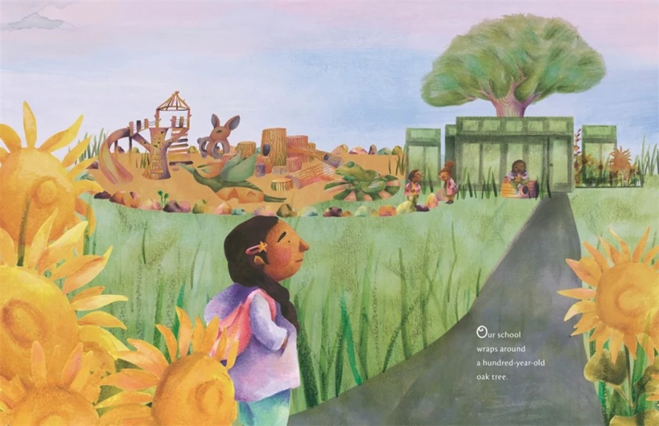
Discussion: Grades K-2
Notes:
Refer to Lesson Plan, Discussion, page 3
Why is Estrella sad? How do you know she is sad? Can you always know how someone is feeling by just looking at them? What can you ask someone to find out how they are feeling?
Estrella misses her father and wished he knew things. What would you wish to tell a special person in your life?
Why does Estrella “sit alone at lunch and cry over things”?
What happens to make her feel better?
What would you share in a sharing circle?
What are some signs of nature in the book?
How does being outside in nature help your mindset?
Who are the caring adults in the book?
Who are your caring adults at school and at home?

Slide 13
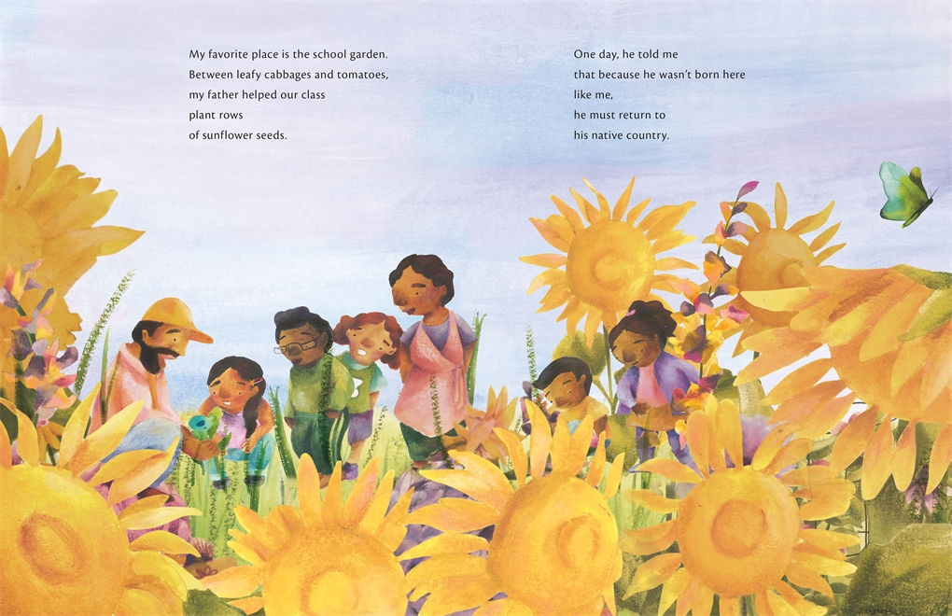
Discussion: Grades 3-6
Notes:
Refer to Lesson Plan, Discussion, pages 3- 4
What does the title of the book, I Wish You Knew, mean to you?
How does Estrella’s sense of loss over her father affect her?
What are some of the things students in her class wished others knew?
Discuss the influence of nature on Estrella, her dad, and the teacher.
What is the power of the sharing circle?
What things do you wish adults knew about you?
Look at the illustrations in the book. Can you tell how someone is feeling? Why are the illustrations drawn like that? What point is the author and illustrator making?
Have you ever made an assumption about someone? What happened?
How can we stop making assumptions? (Stop, THINK, and Understand why they might be acting that way.)
What can you say or do to be thoughtful and kind to others?

Slide 14
Activity Options
Notes:
Choose one activity to match your intent/goals for the lesson.
The best type of activity is one that allows students to practice a skill.
This part of the lesson can be done if you have 45 minutes to do the lesson.
If your discussion takes longer, it is ok to go directly to the Closing.
You can leave the activity for the teacher to do at a later time or ask to come back for a second visit.

Slide 15
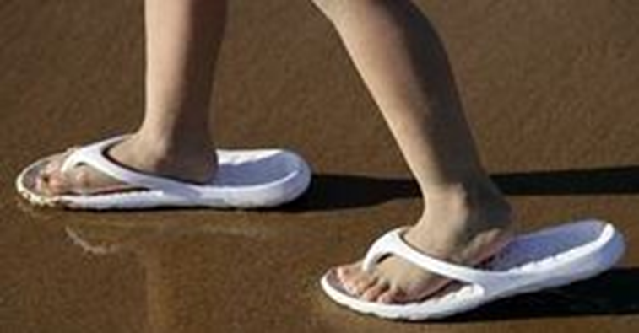
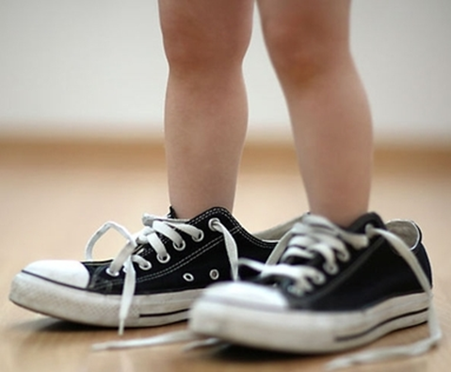
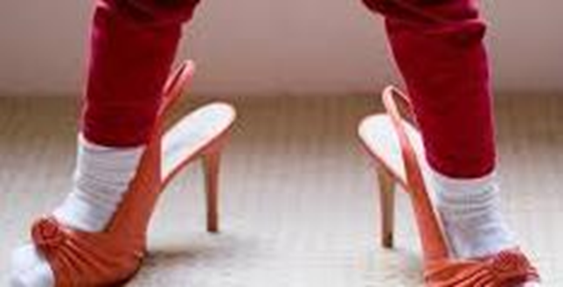
Activity Options: Grades K-2
Who Wears This Shoe?
Notes:
Refer to Lesson Plan, Activity Options , page 4, part 1
Set out the shoes. Ask students to think about these questions. What do the students see? Who might wear those shoes?
Hold up a tennis shoe.
Who wears tennis shoes?
What does a person do while wearing tennis shoes?
Is it ok to say that all people who wear a tennis shoe do active things, like play sports, walk, run etc.?
Hold up a ballet shoe.
Who wears this shoe?
Is it ok to say that only kids wear this type of shoe? Do adults wear them?
Stop and discuss their answers. Explain that we often make guesses or assumptions about people based on the way they look or what they wear, without real information.
Hold up the tennis shoe again. Who could wear this shoe? Let’s think of all the people that might wear this shoe.
Was our guess or assumption that only people who are active wear tennis shoes correct?
No, we discovered that many people wear tennis shoes.
We made a wrong guess (assumption).
Do same with ballet and other shoes.

Slide 16
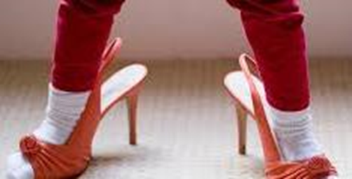
Activity Options: Grades K-2
Who Wears This Shoe-Part 2
Observe body language, facial expressions, tone of voice
Ask questions to learn more about people
Listen to them
Respond to the questions
Do things together so you get to know each other
Notes:
Refer to Lesson Plan, Activity Options, page 4, part 2
When we look at shoes, it only gives us a piece of information about someone. Discuss ways to challenge initial guesses and broaden how to get to know others in a real way without guessing.
Stop, think, and understand before speaking
Observe body language, facial expressions, tone of voice
Ask questions to learn more about people
Listen to them
Respond to the questions
Do things together so you get to know each other
Have students look at their own shoe and think about who they are. What would they like others to know about them? Have students:
Trace the sole of their shoe. Cut out the shoe. Write their name on the back.
Dictate to an adult or fill in this sentence, My shoe likes to _______.
Draw a picture of your shoe doing this on the front.
If there is time, collect the shoes and read a few of the backs and have students guess whose shoe it is.
End the activity by reminding students to stop, think, and understand before making an assumption about others.

Slide 17
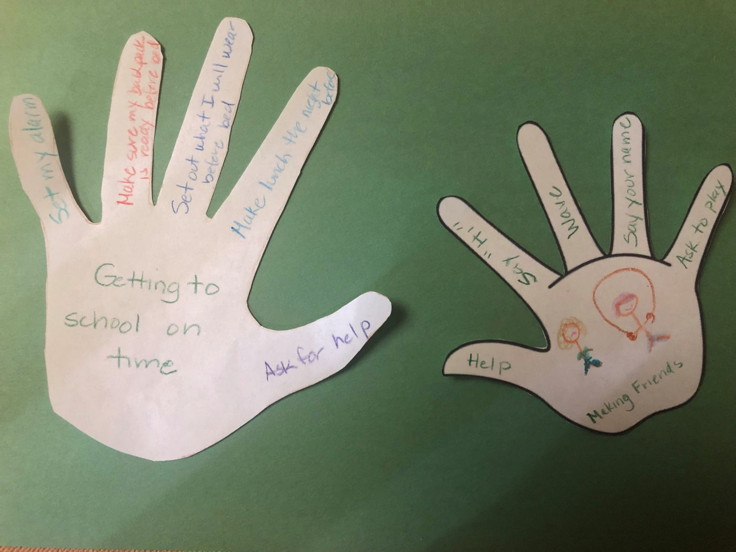
Activity Options: Grades K-6
Healing Hand
Notes:
Refer to Lesson Plan, Activity, page 5
Healing Hand Activity
After your discussion about the different situations that Estrella and her classmates experienced, have students’ popcorn some of their thoughts about what a child might worry about. Have students trace their hands on a white piece of paper. Cut out the hand. In the middle of their hand have students write their worries and challenges. Then on each finger have them write a way to cope with their challenges. Not every challenge has an easy solution. Encourage students to think of how to ask for help and from whom as a step to helping with the challenge. This process will give them a sense of agency over their situation.
*Kinder to First graders can trace their hand with a pencil or use the hand handout and draw a picture. Then they can dictate what they would like have written to a caring adult.
After students have finished, offer options to share with the group, a peer partner, or an adult. Give students the option not to share as some things may be too personal. This allows reflection and opportunity to connect on a deeper level with their peers. It provides a way to connect with empathy towards others. This also promotes the classroom as a safe space.

Slide 18
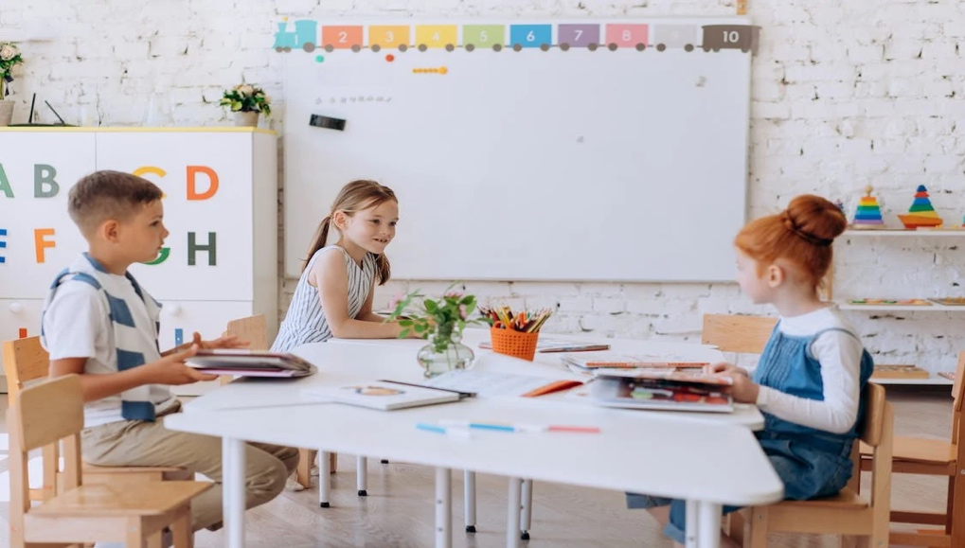
Activity Options: Grades 3-6
Active Listening
The speaker will talk about a personal experience, a feeling, or a topic they are passionate about, while the listener will actively listen without interrupting.
  Describe your experiences in school when you were young.
  Has anyone dipped into your bucket? What happened?
Notes:
Refer to Lesson Plan, Activity Options, pages 5-6
Explain to the class that they are going to practice mindful listening, which means paying full attention to what the other person is saying without interruption or judgement. One person speaks, while the other person listens mindfully. Pair up students and have them sit facing each other. One student is the speaker and the other the listener.
Set a timer. Start with short time periods.
While they are listening, have the student practice their nonverbal body language: eye contact, head nodding, smiling, and gestures.
After the speaker has finished talking, the listener will then repeat back what they heard to make sure they fully understood the speaker’s message.
Take a breath and pause for a few seconds.
Paraphrase what you heard in a neutral tone. Say,
“What I hear you saying is ….”
“So, you are saying that …”
“What I understood was …”
Ask a question for clarification if needed.
Adapted from Jeff Zwiers, in Next Steps with Academic Conversations (2019)

Slide 19
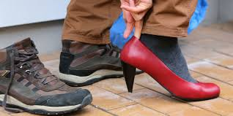
Activity Options: Grades 3-6
Walking In Someone Else’s Shoes
Notes:
Refer to Lesson Plan, Activity Options, page 6
Walking in Someone Else’s Shoes This activity allows students to apply their understanding to real world situations and encourages children to see things from another person’s perspective. This may lead to discovery of personal biases or assumptions that impede the ability to empathize with others.
In each shoe, cut and place a folded card gray side up so that the situation statement is visible. For example:
On front (gray) it says: I didn’t finish my homework. On the back it says: I ran out of time because I was at soccer game and we got home too late.
Divide students into partners. Pass out one shoe to a pair with a card in it.
Have them read the front of the card and think about how that person feels.
Have them talk about how that might feel or if they have ever experienced something similar.
What could be happening?
Have students then read the back of the card and discuss. Has this ever happened to them?
Adapted from Molly Barker, founder of Girls on the Run@, http://startempathy.org/search/node/Molly%20Barker

Slide 20
Closing
Notes:
Refer to Lead Materials on website, Champion Year Cheer
Think of how you want to end the lesson. What skill did your lesson focus on? Taking the skills and concepts of the ABC book and discussion and putting them to action is a big step. Use the Closing to coach youth on ways to take these skills from the classroom to the playground. One idea is to always end with the cheer as final closing moment:
We’re Cornerstone Kids and we’re here to say
Connect with empathy everyday!
Invite and include others
Listen with your whole heart.
We’re Cornerstone Kids and we’re here to say
Connect with empathy everyday!

Slide 21
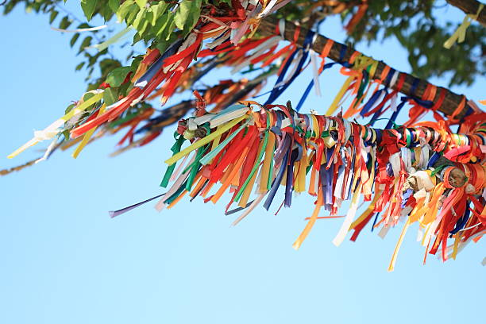
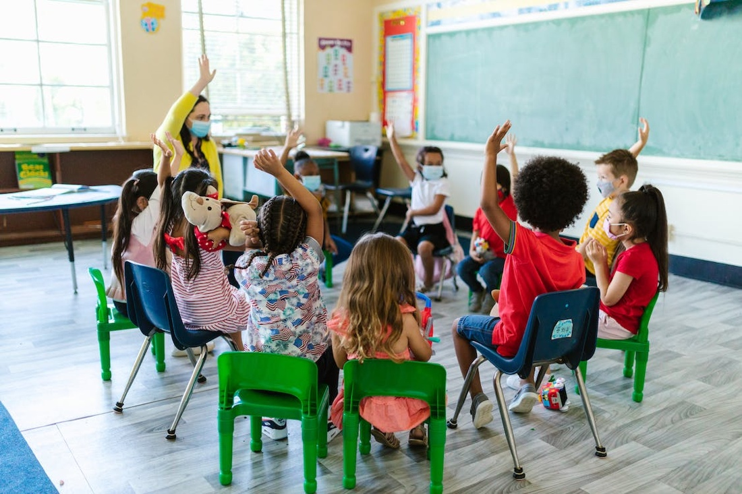
Closing:
I WISH …
Sharing Circles
Wish Tree
Notes:
Refer to Lesson Plan, pages 6-7
I Wish Sharing Circles
Make a sharing circles. You can go outside under a tree or inside. Remind students that the power of the circle is to be able to share in a safe space. Set some ground rules that will make sharing feel safe (no name rule, what is said stays in the circle, no judgements). Start with a mindful minute. Begin by asking students to sit comfortably and notice what they are thinking and feeling in their bodies. Ask how they felt before the lesson and notice how they feel now. Ask students to share their thoughts, feelings, and ideas.
To help the conversation start you can ask the students to fill in the sentence: I wish ___________. Emphasize the idea of feeling safe with what they wish to share.
Instead of a verbal activity, you can have students write their wish on a colorful scrap of paper. They can share their wish verbally and then tie it to a I Wish Tree. Another idea is to cut up pretty strips of yarn or cloth, have students tie knots or weave them together to represent their wish. Silently they tie their wish on the tree.

Slide 22
School Wide
Extensions
Notes:
Create Community with Los Dichos and ABC Programs
Have ABC and Los Dichos volunteers meet to select and plan out a project to do and a timeline for completing the projects:
Start a school garden.
Plant and grow sunflower seeds.
Create an area to be used for I Wish Sharing Circles.
Service project that promotes thinking of others.
Make cards for people in nursing home, soldiers, immigrants in detentions centers.
Make an origami heart for caring adults to say thank you.
Plan a Project Cornerstone Week that focusses on kindness.
Tap into the volunteers expertise. Ask for help in planning an event that celebrates music, dance, or art.

Slide 23
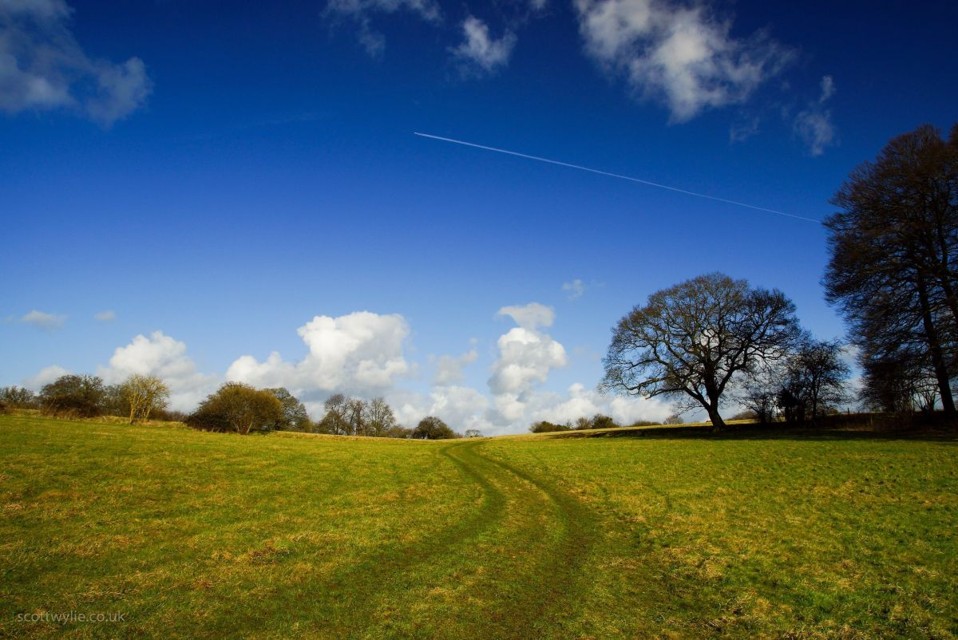
School Wide Extension
Land Acknowledgement
We gratefully acknowledge the Native Peoples on whose ancestral homelands we gather, as well as the diverse and vibrant Native communities who make their home here today.
-NMAI (National Museum of the American Indian) Land Acknowledgement
The Importance of Land
Land is something sacred to all of us, whether we consciously appreciate it or not — it is the space upon which we play, live, eat, find love, and experience life. The land is ever-changing and ever-shifting, giving us — and other creatures and beings on the earth — an infinite number of gifts and lessons.
Notes:
Refer to Lesson Plan, School Wide Extensions, page 7
Who Lived in Your Community
Materials: tablets, paper, pencils
Have students visit the website native-land.ca and search which Indigenous lands your school, neighborhood, or homes are on. Identify the names of the nations and tribes from the land you occupy. Note the history of the land and any related treaties. Research the names of living Indigenous people from this community. Learn the correct pronunciation of the names, tribes, or places that you are including.
As a group, write a land dedication poem to use at all school events that honors these Indigenous cultures. Find out information and key facts to be included and honored in your school community. Set up a special place to honor these cultures. Invite a guest speaker to visit your school.
The Muwekma Ohlone are ancestral to San Francisco, San Mateo, most of Santa Clara, Alameda, Contra Costa and portions of Napa, Santa Cruz, Solano and San Joaquin counties.

Slide 24
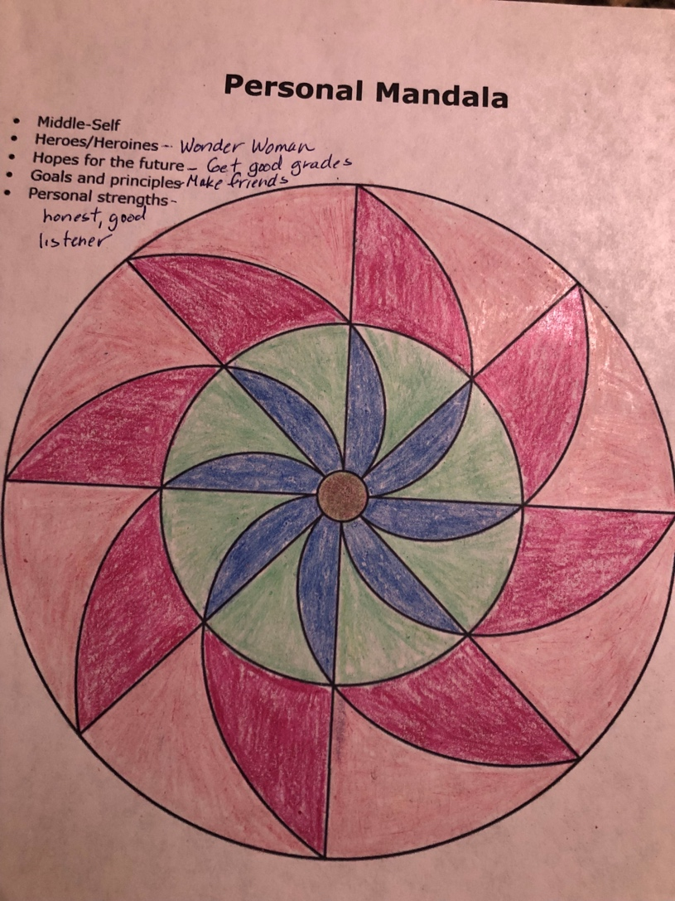
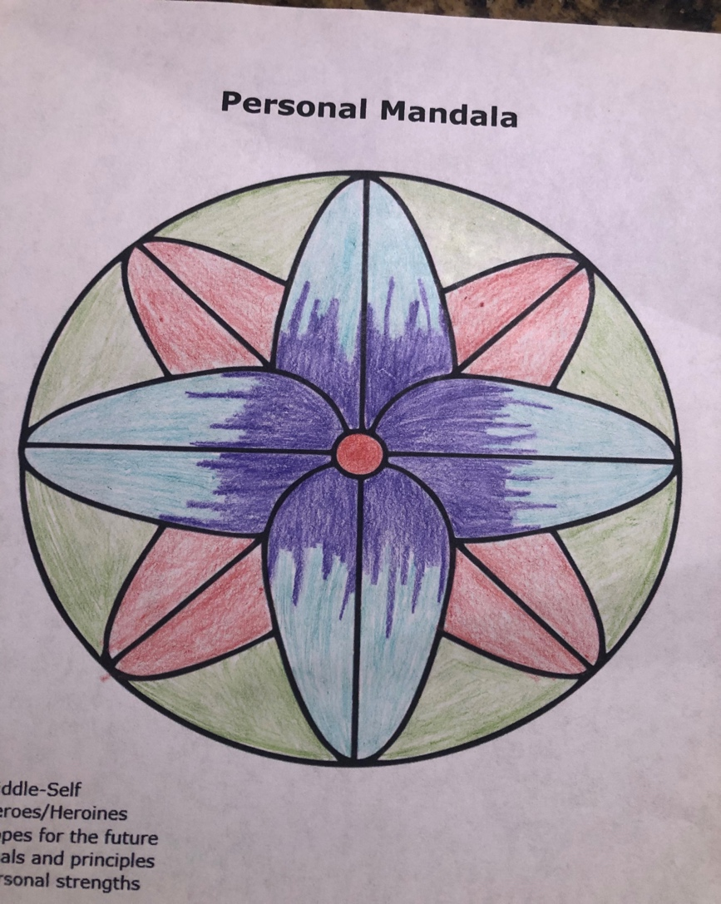
School Wide Extension:
Mandala Project
Notes:
Refer to Lesson Plan, School Wide Extensions, page 7
Mandala Bulletin Boards
A Mandala symbolizes the universe. Its repeated patterns, colors , and shapes are meant to show the universality of the human race and the connectedness of societies and nature. It contains symbols of a person’s inner self, guiding principles, and overall ideas about the world.
This Mandala of Me is a get-to-know-me exercise. Coloring mandalas is a relaxing activity that helps us feel centered and peaceful. It also promotes self-expression and a way to share about personal beliefs. Students can choose one of the 4 designs to fill in information. Start in the middle.
Information about themselves
Heroes/Heroines
Hopes for the future
Goals and principles
Personal Strengths
Post the finished mandalas on bulletin boards so that the school community can view. This could also be used as a closing activity.

Slide 25
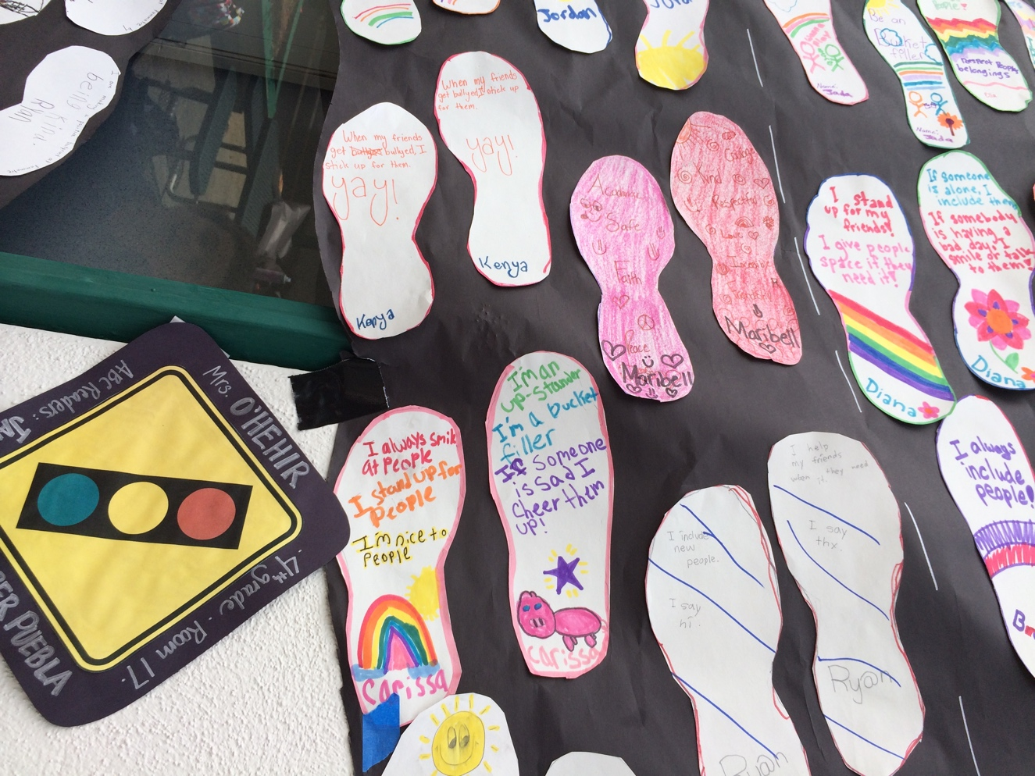
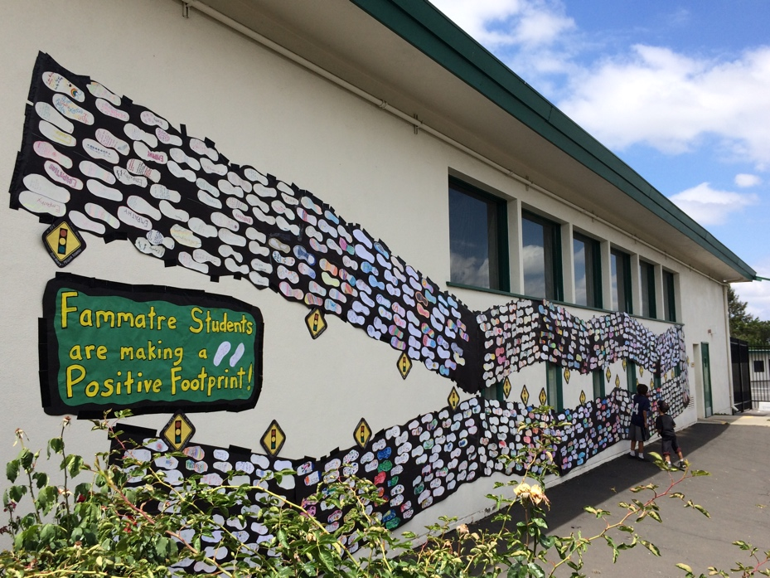
School Wide Extension:
Stand Together in Empathy
Notes:
Refer to Lesson Plan, School Wide Extensions, page 7
Stand Together in Empathy
Materials: pencil, crayons, large butcher paper for each class to stand on
Students can trace their shoes directly on a large piece of butcher paper and write their name in this and it becomes a floor mural. Ask them to write one of the following responses:
What they can say or do to stand in this shoe and show empathy?
Write about a time when they showed empathy to someone.
Write about times when they received empathy from someone else.
This can also be done with tracing their shoe on a piece of paper and cutting it out to paste on the mural or along a wall in the school.

Slide 26
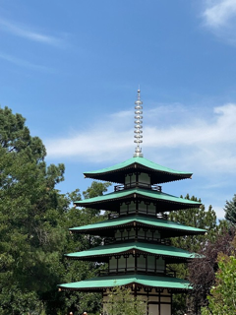
School Wide Extension:
Tower of Compassion
In 1972, the Kanemoto brothers commissioned the Tower of Compassion, located in Kanemoto Park. The five-story tower was built in the traditional style of a Japanese temple, and each level represents the meaning of compassion – Love, Empathy, Understanding, Gratitude, and Selfless Giving.
Notes:
Create a School Tower of Compassion
It all started in 1908, when a young Japanese immigrant left his home in Hiroshima, Japan and headed to Mexico. That young man, Goroku Kanemoto, began working for the railroad, and on a trip heading north to Canada, he hopped off the train in the Denver area to try his hand at farming Colorado’s fertile soil. Goroku married a young woman, Setsuno Nakasaki, also from Hiroshima. The two had three children, Jimmie, George, and Faith, and in 1919, settled in the Longmont, Colorado area. They rented a farm where they grew sugar beets and vegetables, saving up to one day own their own farm. The brothers donated land back to the City of Longmont near the Southmoor Park neighborhood in 1966. The City decided to make the land a park, and Jimmie and George asked that it be named after their father, so the seven-acre Kanemoto Park was established.
How would your school build and dedicate 5 levels of compassion? What materials would you use?
Have students plan out a school tower of compassion. With 5 levels each grade level can design their level.

Slide 27

Home and School Communication
Newsletter Blurb
Student Stickers
Parent Letter or Email Blurb
Family Movie Night
LISTEN WITH YOUR WHOLE HEART
Notes:
Email Blurb
Give the teacher the email blurb to include in her class email note or make it into the newsletter blurb.
The blurb is a great way to write a short paragraph for the school newsletter or Parent Loop etc.
Parent Letter
Available in English, Spanish, Vietnamese, Russian, Ukrainian and sometimes Mandarin.
Student Stickers
Give to students to stick on their backpack, special note pad, or article of clothing to bring home.
Family Movie Night
Every lesson has a handout to a suggested Family Movie Night.
This is another way to remind parents about the book of the month.
Bulletin Boards and Marques
Ask for volunteers to help post student art or tag lines.

Slide 28
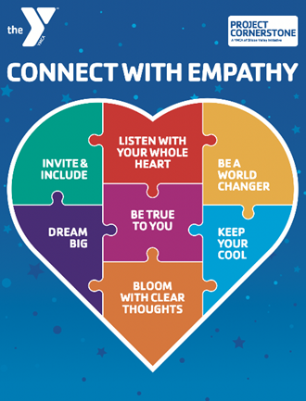
Closing Comments
  Reminders for ABC Volunteers
Support for ABC Leads
Top 3 Action Items
Notes:
Remind your ABC Readers:
Schedule reading with partner and teacher
Attend School Site trainings
Read the ABC Volunteer Guide
Oct. 12 In-person Classroom Management Training
ABC Lead Support:
Read the ABC Lead and Volunteer Guides
Attend or watch trainings
Attend coffee collaborations for in-person
Ask volunteers for help with leadership roles
Top 3 Action Items for October:
Update Volunteer List in Better Impact
Send in Asset Champion Nominations
Plan Ruby Walk to School Day-Nov. 14

