Slide 1
THE INVISIBLE BOY
ABC CHAMPION YEAR LESSON 1 PROJECT CORNERSTONE
Notes:
This presentation is intended for use by ABC Leads who have attended the monthly ABC Lead training.
ABC Lesson Plan Revised
Project Cornerstone has created a new template for this lesson.
ABC Original Lesson Available on Website
ABC GPS
Use this to help with planning for your school training. It will help you select the goals and activities for your readers.
Parent Letter or Email Newsletter Blurb
Available to use in emails or newsletter to parents at home.
Yard Duty Tips and Lanyards
Post the yard duty tips. Pass out the lanyard tags to wear.
Staff Letter
Email all school staff about the lesson.

Slide 2

ABC: Champion Year
Key Phrases:
Invite and Include
Everyone Wants to Be Invited
Notes:
Refer to Lesson Plan, pages 1-2
This book builds the developmental relationships:
Provide Support - Navigate, Empower, Advocate
Share Power – Respect me, Collaborate, Include me
Social and Emotional Learning: Relationship Skills
This book discusses the importance of making everyone feel welcome and included. It helps students develop the ability to establish and maintain healthy and rewarding relationships with a variety of people.
In our lesson today, our goals are:
Students will invite, include, and make everyone feel welcome.
Students will identify social clues (verbal, physical) to determine how others feel.
Students will build relationships by filling buckets with kindness.
Students will behave and speak in an empathetic manner by demonstrating genuine care, understanding, and consideration for others.
Students will create a caring school climate where students show respect for one another.
Narration of the book:
https://www.youtube.com/watch?v=owylgnhqEc4

Slide 3
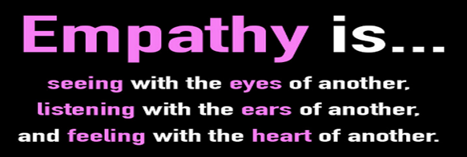
Empathy:
Connect with Empathy
Definition of Empathy:
“Empathy is an emotional skill set that allows us to understand what someone is experiencing and to reflect back that understanding.” Brené Brown
Notes:
Refer to Lead Guide, Empathy, pages 7-8
Empathy is the ability to understand and share the feelings, perspectives, and experiences of others. It’s important that we guide children in understanding and caring for people who are different from them and who may be facing challenges very different from their own challenges. Empathy builds healthy relationships, promotes social connections, and fosters community.
Empathy Skills
Read the definition out loud.
What does it look, feel, and sound like?
Brainstorm ideas on chart paper.
Focus on These Empathy Skills
Use friendship boosters like PEGS.
Smile.
Ask others to join in and play.
Learn and pronounce names correctly.
How to help students become Empathy Ambassadors:
Role model these skills.
Role play how to ask others to join in and play.

Slide 4
Information for ABC Readers
Notes:
ABC lessons build relationships in youth and adults. This month, we focus on relational bullying behaviors. People who are different are often targeted and made to feel excluded. Taking the time to get to know ​and ​value another person allows one to appreciate the ​uniqueness of an individual's personality.
Remind your volunteers that they:
Build Asset #15: Positive Peer Influence, by helping youth identify friendship skills.
Build the Positive Values Assets, by identifying the UPstander actions that help make school feel like a safe, caring place where everyone belongs.
Build Asset #3, they are creating non-parent caring adult relationships by connecting with youth in your monthly reading.
Build Asset #33 Interpersonal Competence
To learn more about how empathy develops in children, watch this video: When Do Kids Develop Empathy?-Hank Green
https://www.youtube.com/watch?v=GjJqlEusg1o

Slide 5
ABC Readers:
Key Points
Notes:
Refer to Lesson Plan, Key Points, page 2
By modeling appreciation for different types of people, caring adults can foster understanding, challenge stereotypes, promote equality, and encourage diverse and inclusive communities.
Embracing and valuing differences leads to a more compassionate and inclusive society. This connection builds empathy.
Empathy begins with the capacity to take another perspective, to walk in another’s shoes. It’s about perspective-taking and compassion.
You can also show one of these videos about empathy:
Empathy Can Change the World
https://www.youtube.com/watch?v=aU3QfyqvHk8
Building Empathy for Kids
https://www.youtube.com/watch?v=QVqZ4WgI9q8

Slide 6
Conversation
Starter

Slide 7
Conversation Starter: All Grades
From the very first moment you step into the classroom invite children to build a relationship with you.
Identify yourself as someone youth can count on.
Learn Names. Youth feel valued, respected, and known when you use their name.
Spend a little time stating your expectations for your time with the students as an ABC Reader.
Have fun with the students!
Notes:
Refer to Lesson Plan, Conversation Starter, pages 2-4
Resources: The classroom teacher is our best resource for setting boundaries and expectations for ABC Readers and students. Meet with them and discuss how ABC will work in their classroom this year.
First Lesson
Don’t rush through your introductions. Take time to introduce yourself. Get to know your students a bit.
Grades 3-6 Upper grade students are ready for volunteers to:
Start shifting to the implementation of the skills and tools.
Spend more time on the practice of the tools and less on the teaching of them.
Use suggested videos, ideas, role plays etc. found on the website and in the “Read the Book slide” of the power point.
Empower students to be leaders and role models. Involve them in the lesson.

Slide 8

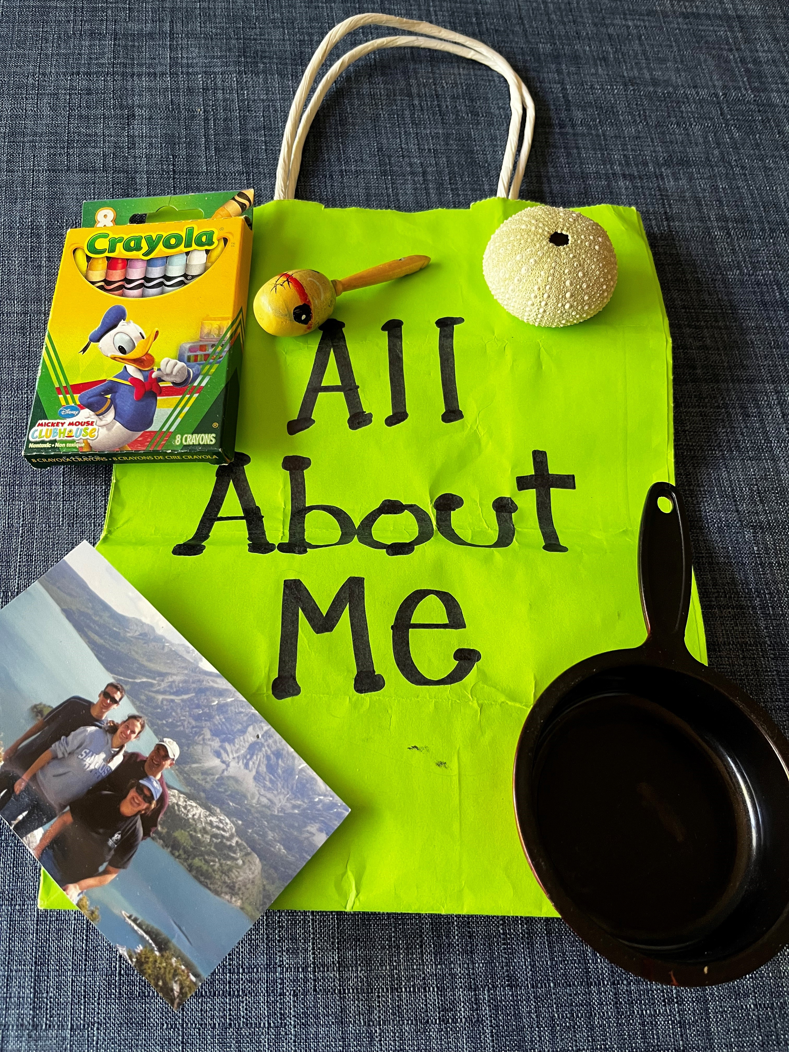
Conversation Starter: Grades K-2
Fill the buckets of your students by building relationships!
Notes:
Refer to Lesson Plan, Conversation Starter, page 2
Identify yourself as someone youth can count on.
Create and bring in an “All About Me” bag. Put 3 things in the bag that represent something about you.
Learning students’ names is key to building a relationship.
Ask them their names.
Play a name game.
Make sure they are wearing nametags every time you read.
Use a puppet to be your partner. You and the puppet can discuss the ABC Rules.
Remind the puppet of what a good listener looks like.
Go over the ABC Rules or classroom rules.
Post the ABC Rules Sign in a designated area.
Make sure to discuss the “no name” rule.
Start and/or end your lesson with a cheer, song, or fingerplay

Slide 9
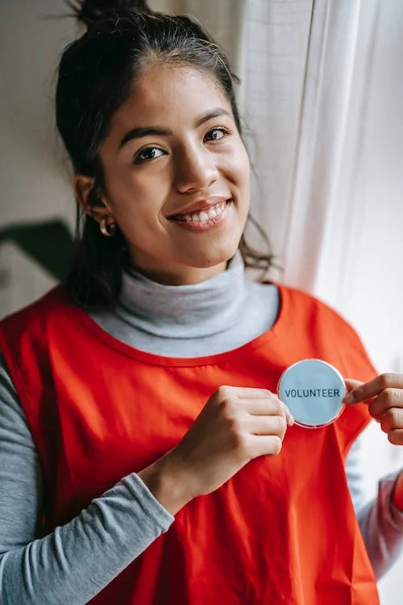
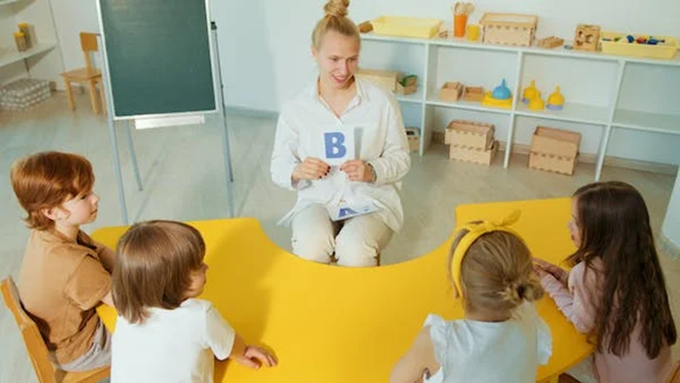
Conversation Starter: Grades 3-6
Tell your story to students!
Notes:
Refer to Lesson Plan, Conversation Starter, page 3
Share things about yourself in an engaging way by playing the game “Ask Me About”. See the handout on the website for questions and instructions.
Talk about why you volunteer for the ABC Program and how it has helped you.
Explain to students that they are role models for the younger students. The ABC books were read to them as younger students. As older students you would like to expand and train them to be role models.
Ask, “How can you be leaders and help younger graders learn these skills and tools?”
Brainstorm ideas.
Listen to the students. If you see an idea that they are excited about, try to make it happen during the year.
Explain to students your plan to revisit the books, show videos, add more activities, and include some of their ideas for this year.

Slide 10
Conversation Starter: ABC Rules
Be Respectful
Raise your hand.
Take turns.
Be an active listener.
Give your Total Support for sharing ideas & feelings.
Treat others with care.
Use a “no name” policy.
Be Responsible Be Safe
Use positive language. Keep your hands and
Be helpful. feet to yourself.
Be forgiving. Follow directions.
Be kind.
Notes:
These ABC Rules should support and reinforce existing class and school rules. For some classrooms, a review of class rules will replace the ABC Rules. Feel free to add a rule relevant to your classroom or school.
“No Name” policy:
Stories are wonderful ways to learn about tricky social interactions. Using the “No Name” rule allows us to learn, and keep others safe.
Remind grades K-2 about this every time you read.
The ABC Rules- also available on our website, as a document to download:
www.projectcornerstone.org
Click on Materials
Log-in required:
Username: Projectcornerstone
Password: Connect!
Click book name

Slide 11
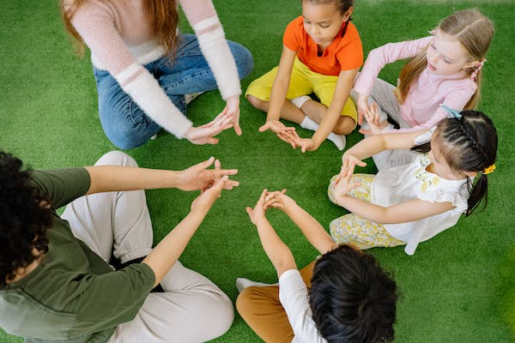
Conversation Starters: All Grades
Learn Students Names
Use Name Tags
Play a Name Game
Notes:
Refer to Lesson Plan, Conversation Starter, page 3
Names in Action for grades K-2
Have students introduce themselves to the group.
The second time, have students say their name and add a fun motion as they say it.
The group responds by repeating the name and the action that was made.
After everyone has it down, add music to this and have the students all do the move when you call out a name.
Name Storytelling for grades 3-6
Start a story with a sentence about a character with the student using their own name. “Once upon a time there was a brave night named Dana who was hopping on one foot”.
Then have each child add another sentence using their name, and so on, creating a collaborative tale.

Slide 12
Reading
The Book
Notes:
Reading to Grades 3-6
Steve Hartman from CBS News has a series called Kindness 101. It talks to children about building character. With the help of his children, they discuss how to develop these essential character traits using videos. Each ABC book is connected to one of his videos.
Show these videos:
Steve Hartman this month is friendship: https://www.cbsnews.com/video/kindness-101-students-teach-us-all-a-lesson-in-friendship/
Pre-recorded Conversation Video by SLC student Alina:
https://www.youtube.com/watch?v=zBiz9ABtyqM&list=PLBsUra9Uf_ExzBGASzOBfwwE0mjwrERzD&index=4
Follow up with discussion and choose one activity:
Empathy discussion and Learning Empathy
New Student Role Play and Class Friendship Plan
Everyone Wants to Be Invited Role Play
Hula Hoop Game
Plan out School Wide Events

Slide 13
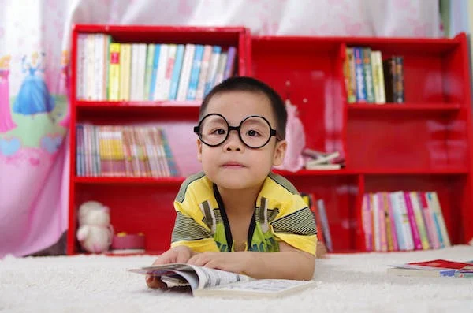
Introducing and Reading the Book
“Sharing picture books with children leads to amazing conversations. In the best picture books, there is a gap between the pictures and the words, a gap that is filled by the child’s imagination.”
Anthony Browne (Children’s Laureate 2009-2011)
Notes:
Refer to Lesson Plan, Read the book, pages 3-4
To keep younger students engaged maintain eye contact, use pauses, and ask questions as you read. If you start to see students losing concentration, stop and do a quick fingerplay, mindful breathing, or simple song to help them reengage.
Have students look at the illustrations to “read” the body language.
Have them participate with a thumbs up every time they see or hear how Brian appears invisible.
Ask students to be on the lookout for signs of Brian’s changes as the story unfolds.
For older students:
Last year had the theme of Inclusion.
This year all our books will have the theme of Connect with Empathy. What is empathy? How do show empathy to others? Is kindness a part of empathy?
Show the empathy video on slide 10.
Listen to the story to see how empathy is shown and built with the characters.
This book also focuses on developing friendship skills.
Ask students to define: What is a friend?
Discuss what it takes to make and be a friend. What have they learned from other ABC books from the last 2 years?

Slide 14
Discussing
The Book
Notes:
Let the discussion of the book be a relationship booster! Look to the discussion questions as ways to begin relationships and learn about each other.
The conversations, connections and insights gained through conversation about the book are crucial to internalizing the skills of the lesson. Don’t rush.
Take advantage of opportunities to discuss Digital Citizenship with all grade levels. Students can be invisible online too. Discuss how kindness, caring, and support in face–to-face and digital environments counters cyberbullying.
On the website under materials is a handout called Sondra’s Story. This could be used as a follow up for grades 3-6.

Slide 15
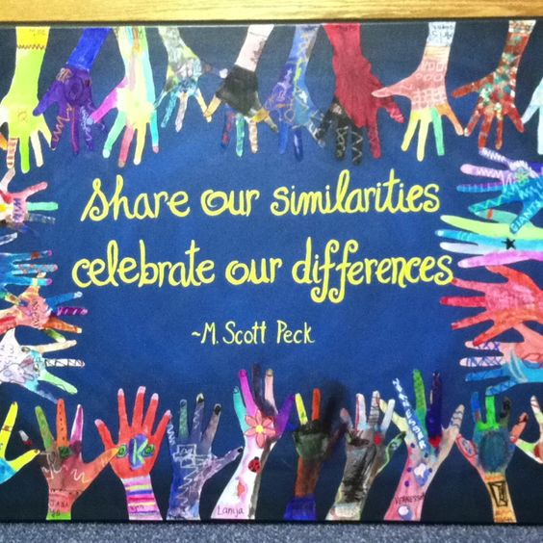
Discussion: Grades K-2
Notes:
Refer to Lesson Plan, Discussion, pages 3-4
How did Brian feel at the beginning? Have you ever felt that way?
What changed? How did Brian feel at the end? (Show the pictures.)
What can you do to get to know your classmates better?
How can you be like more like Justin and be a welcoming classmate?
What can you do when you want to join in and play with others?
If you see someone playing alone, what can you say?
Have you ever invited someone to play? What did you say?
If you need help joining in, what can you do?
How do you make a new friend? Give an example

Slide 16
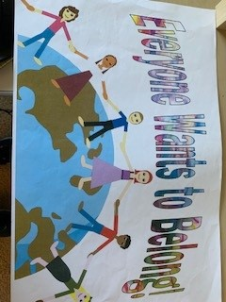
Discussion: Grades 3-6
"A little spark of kindness can put a colossal burst of sunshine into someone's day."
Notes:
Refer to Lesson Plan, Discussion, page 4
Remember in the book, Enemy Pie, Jeremy needed help to become friends with the narrator. How can you remember to get to know others for who they really are.
How can knowing yourself help you get along with others?
What is a fair way to select players in a team other than ability?
Have you ever tried to join a group, game, or activity and others wouldn’t let you play? If so, what can you do to make sure this doesn’t happen to other kids in your school?
When Madison says, “I’m so glad you guys had fun!” Was that true? Was everyone invited, even Brian?
What does being empathetic to someone who’s different than you sound like?
What expressions can you use to show empathy?
Why is it important that everyone in your class feels they have a voice and can participate?
If you’re an extrovert you may not notice other kids that are calmer than you. What can you do to stop and really see everyone around you?
How can you invite and include your classmates so all feel welcome?
What kind acts can you do to make everyone feel welcome at your school?

Slide 17
Activity Ideas
Notes:
Choose one activity to match your intent/goals for the lesson.
This part of the lesson can be done if you have 45 minutes to do the lesson.
If your discussion takes longer, it is ok to go directly to the Closing.
You can leave the activity for the teacher to do at a later time or ask to come back for a second visit.

Slide 18


Activity Ideas: Grades K-6
Everyone Wants to Be Invited
Notes:
Refer to Lesson Plan, Activity Ideas , pages 5-6
Role Play
This activity provides students a way to practice the skill of welcoming everyone and including them on the playground.
Tell your class, “Our goal is to be sure everyone is invited and has a chance to join in at school. It feels great to be invited, even if you choose not to play. Our class can start something wonderful by inviting and including others.
In a large area divide the class in half. Have students stand facing each other with about 8 feet between lines.
Ask students:
What is the first thing you can do to help someone feel invited and included?
Smile! Ask everyone to practice smiling at the people in the other line. (They don’t need to move, yet!)
What is the next step, to make other people feel invited and included?
Say,” Hi”. Ask everyone to practice smiling, saying “Hi” to the people in the other line. (They still don’t have to move!)
See Lesson Plan for the rest of the activity.

Slide 19
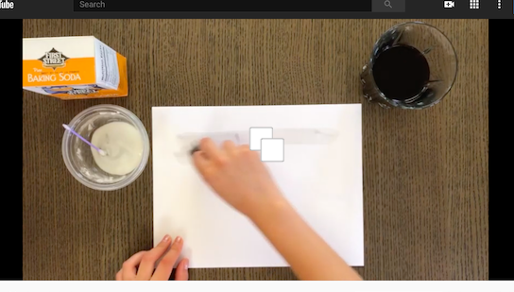
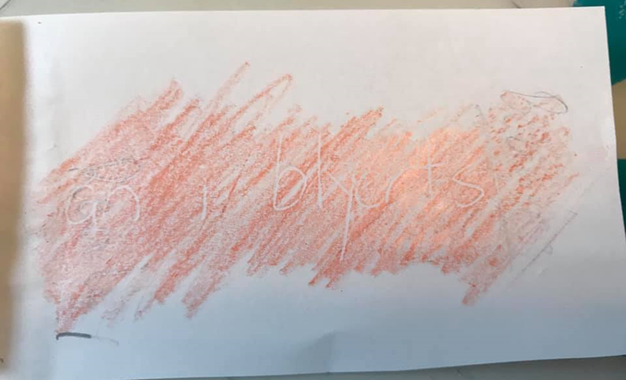
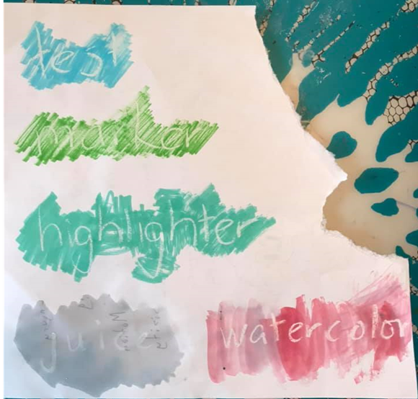
Activity Idea: Grades K-2
Invisible Ink
Write a message to make others feel welcome.
Pencil
Crayon Rubbing
Notes:
Refer to Lesson Plan, Activity, page 6,
You are Not Invisible Here!
Materials: baking soda, grape juice, cotton swab, cotton ball, water, paper
Directions: Mix 1/4 cup water with 1/4 cup baking soda. Dip a cotton swab into the mixture, then write a simple message on the paper. Let message dry. Dip cotton ball in grape juice and paint a thin layer over the paper.
Challenge: Write a message to include, invite, or make others feel welcome. For best results, keep your message short
Debrief: At first your message is invisible, just like Brian. Now, by taking the action of your message (smile, say hi, invite), kids like Brian won’t feel invisible.
Watch how to do on Pre-Recorded Video:
https://www.youtube.com/watch?v=s_vSz6undg8&feature=youtu.be
Alternative Ink Ideas are also found in the lesson plan and under materials on website.

Slide 20


Activity Ideas: Grades 3-6
New Student in School
Class Friendship Plan
Include Others: We all look for opportunities to make everyone feel that they belong.
Say Something: Start and join conversations.
Show Respect: Treat other people and their things with care.
Connect with Empathy: Build relationships with kindness.
Everyone’s Invited
Notes:
Refer to Lesson Plan, Activity Options, page 7
Divide the class into groups of 4 or 5. Each group’s task is to select one group member to play the role of a new kid in class. The new kid’s challenge is to try to gain acceptance into the group. The other kids must behave in the way that they normally would in that situation. Remind students to use appropriate language and to be on their best behavior.

Slide 21
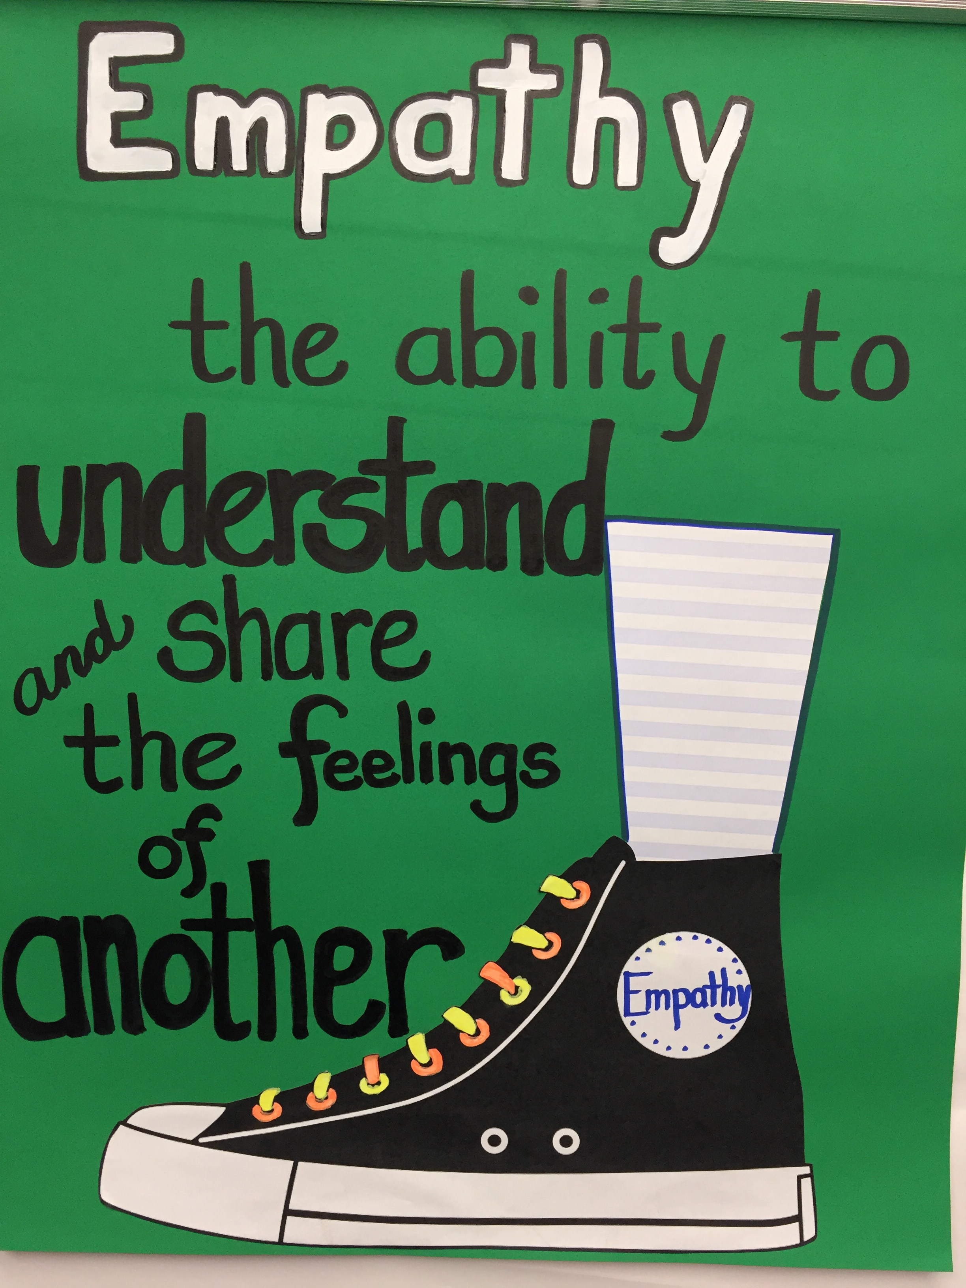
Activity Ideas: Grades 3-6
Learning Empathy
Notes:
Refer to Lesson Plan, Activity Options, page 7
Learning Empathy
Brainstorm the meaning of empathy. Explain that we can learn to be empathetic. This is the ability to think and understand how others feel.
Watch the empathy video: All About Empathy https://www.youtube.com/watch?v=Itp21tly8nM
Ask the questions from the Learning Empathy handout. Have students respond to answers by holding up fingers, A=1, B=2 etc.
Debrief: Did some situations have more than one correct answer.? Were these acts of empathy difficult? Are these actions you can incorporate into your daily routine?

Slide 22
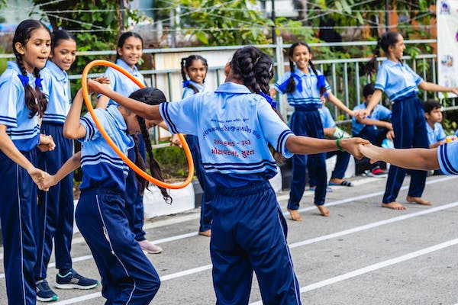
Activity Idea: Grades K-6
Hula Hoop Game
Notes:
Refer to Website, Materials, Hula Hoop Handout
Materials: 2 hula hoops
Directions: Have the students stand in 2 circles. Each circle receives the same instructions:
Slip the hoop onto one student’s arm and have the students all join hands.
The students have to find a way to move the hula hoop all the way around the circle without letting go of each other’s hands. Allow the game to continue if hands are temporarily unclasped.
3-6 Challenge: To add difficulty, the hula hoop cannot touch the ground and the chain of hands cannot be broken. If the hula hoop touches the ground or if the chain of hands anyplace in the circle is broken- the game starts over, in the same place it began.
Debrief:
How does a game help us learn about each other?
What are our strengths as classmates?
What bucket filling happened?
How did you work together as classmates to solve a problem?
What skills or lessons did you learn from this game that would help you to be a better friend?

Slide 23
Closing
Notes:
Refer to Lead Materials on website, Champion Year Cheer
Think of how you want to end the lesson. What skill did your lesson focus on? Taking the skills and concepts of the ABC book and discussion and putting them to action is a big step. Use the Closing to coach youth on ways to take these skills from the classroom to the playground.
One idea is to always end with the cheer as final closing moment:
We’re Cornerstone Kids and we’re here to say
Connect with empathy everyday!
Invite and include others
We’re Cornerstone Kids and we’re here to say
Connect with empathy everyday!

Slide 24
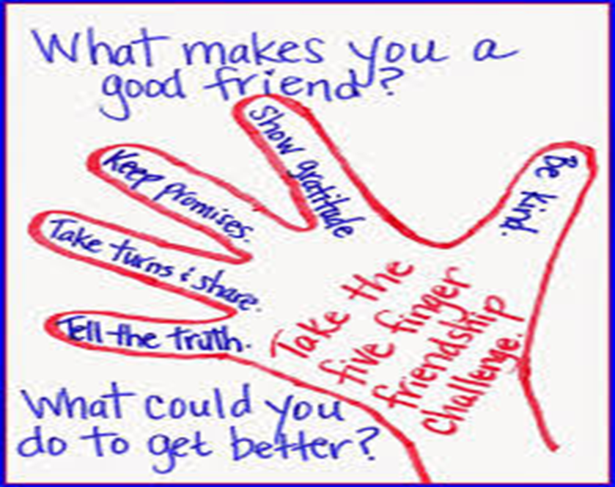
Closing:
10 Ways to Build Relationships
Everyone should feel they belong.
Smile. Say hello. Invite. Include.
Fill buckets with kindness.
  Call to Action: How will you show empathy?
Notes:
Refer to Lesson Plan, page 8
Remind students that you are a caring adult they can count on.
Ask students to think of ways that they will be a good classmate or friend and help everyone feel that they belong at our school. Show students the handout 10 Ways to Build Relationships. Ask them to commit to an action. Here are some ideas:
Reach out by smiling or saying, “Hi!” Be the first to introduce yourself.
Tell a little about yourself.
Ask others to share a little about themselves with you.
Let every voice be heard. Listen without interrupting.
Spend time with each other and be open to new ways of seeing things.
Intentionally ask others to join in and play.
Play with different people at recess.
Sit with new people at lunch.
Make your games open to everyone.
Invite, include, and make all feel welcome.
Invite students to play with you and your friends.
Accept others for the way they are, the way they speak, look, and behave.

Slide 25
School Wide
Extensions

Slide 26
Next Steps: Communication
Parent Letter/Email- Strengthen the home and school connection by sending the parent letter or email after each lesson.
Staff Letter and Yard Duty Tips- Strengthen your relationship with the staff by offering the staff letter, yard duty tips, and lanyard.
Stickers- Reminders for home and school that ABC reading was that day.
Notes:
ABC messages can be provided to entire school community.
As the ABC Lead, how will you support your readers and get good communication habits started?
How will the parent letter get home? How will the staff letters reach all staff members? How will staff have access to the lesson materials? Don’t forget yard duty staff too.
Will you, the ABC Lead take on these responsibilities, or will you delegate newsletter, website, marquee, etc.?
Will every ABC Reader be responsible for positive home and school communication (Parent Letter/Email)?
Help your ABC volunteers get in a routine that will support school-wide adoption of the ABC lessons and skills.
Download from our website: www.projectcornerstone.org
Visit the Materials Section
Log-in required:
Username: Projectcornerstone
Password: Connect!
Click Champion Year and then book name

Slide 27
Home and School Communication
Newsletter Blurb
Student Stickers
Parent Letter or Email Blurb
Family Movie Night
EVERYONE’S INVITED
Notes:
Make the Home-School Connection:
Email Blurb
Give the teacher the email blurb to include in her class email note or make it into the newsletter blurb.
The blurb is a great way to write a short paragraph for the school newsletter or Parent Loop etc.
Parent Letter
Available in English, Spanish, Vietnamese, Russian, Ukrainian and sometimes Mandarin.
Student Stickers
Give to students to stick on their backpack, special note pad, or article of clothing to bring home.
Family Movie Night
Every lesson has a handout to a suggested Family Movie Night.
This is another way to remind parents about the book of the month.
Bulletin Boards and Marques
Ask for volunteers to help post student art or tag lines.

Slide 28
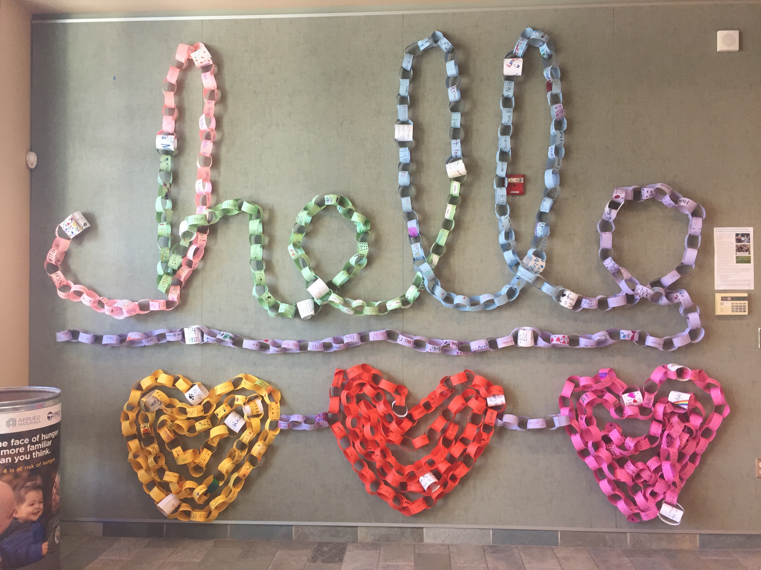
School Wide Extensions:
Welcome Back Month
Introduce yourself!
Ask them their name
Notes:
Refer to Lesson Plan, School Wide Extensions, pages 8-9
Have an all-staff and student school-wide assembly or flag pole ceremony.
Have students, volunteers and staff members participate.
Review the books from Inclusion Year.
Announce campus wide activities that will happen throughout the month that promote and role model getting to know one another, being kind, and making everyone feel welcome at school.
Announce that kindness tickets will be passed out to students who are kind. Every time kindness ambassadors see acts of kindness happening, they can pass out a kindness ticket.
Teach students the Join In and Play Rap.
Ask the students in 4th-6th grades to come up with new ideas daily. In planning this, encourage them to work collaboratively with the PTA, yard duties, and teachers. Some suggestions for the month are:
Nametag Week: Have everyone at the school wear a nametag. Each day add a little something extra to the tag:
Welcome Stops: Create welcome stops on the playground. Make a sign that says, “Welcome stop”.
Everyone Eats Together Week: Set up a week to end social isolation at lunch. Have students decide how to promote ways for classmates and classrooms to eat together

Slide 29
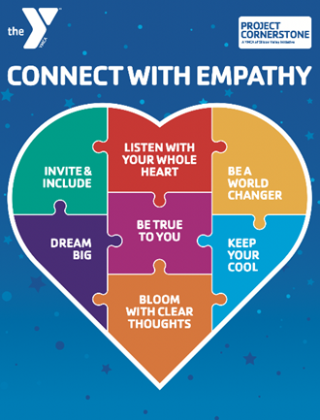
Closing Comments
  Reminders for ABC Volunteers
Support for ABC Leads
Top 3 Action Items
Notes:
Remind your ABC Readers of:
Reading Schedule (ABC Reader to schedule with teacher)
Sign-in (Decide on best way to do this)
When and how you will do trainings
Read the ABC Volunteer Guide
ABC Lead Support
Read the ABC Lead and Volunteer Guides
Attend or watch trainings
Attend coffee collaborations for in-person
Arrange for one on one coaching
Ask volunteers for help with leadership roles
Top 3 Action Items for September
Recruitment
Set School Trainings
Update Volunteer List in Better Impact

