Slide 1
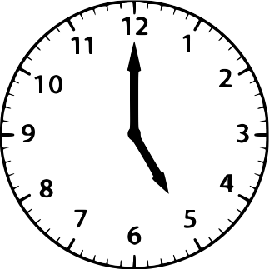
My COVID-19
Time Capsule
Take a moment to fill out these pages for your future self to look back on.
2020
By _________________________

Slide 2
Draw a picture of the people and animals you social distanced with.

Slide 3
All About Me!
My Favorites
Toy: ____________________________
Color: __________________________
Animal: _________________________
Food: ___________________________
Show: __________________________
Movie: _________________________
Book: __________________________
Game: _________________________
Place: __________________________
Song: __________________________
My Best Friends
_____________________________________________________________________________________________
When I grow up I want to be
__________________________________________________________________________________________

Slide 4
My Feelings
Something I learned from this experience
______________________________________________________________________________________________________________________________________________________________________________________________
Something I’m thankful for
_____________________________________________________________________________________________________________________________________________________________________________________________
How did your face look most days?
Draw it here.
What words describe how you felt?

Slide 5

Where I Social Distanced
Draw what your home looks like

Slide 6
Special Occasions
What occasions did you celebrate during Social Distancing?
Event | How You Celebrated

Slide 7
Letter to My Future Self
________________
Dear _______________,
_____________________________________________________________________________________________________________________________________________________________________________________________________________________________________________________________________________________________________________________________________________________________________________________________________________________________________________________________________________________________________________________________________________________________________________________________________________________________________________________________________________________________________________________
Love,
_______________________

